Slide 1
Chapter 17
Section 2 Nuclear Energy

Slide 2
Objectives
Describe nuclear fission.
Describe how a nuclear power plant works.
List three advantages and three disadvantages of nuclear energy.
Fission: Splitting Atoms

Slide 3
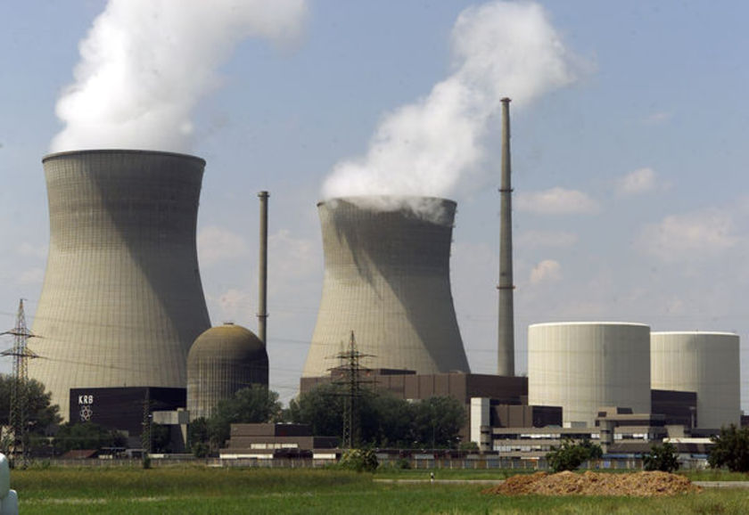
Nuclear Energy
Today, nuclear power accounts for 17% of the world’s electricity.
Notes:
In the 1950s and 1960s, nuclear power plants were seen as the power source of the future because the fuel they use is clean and plentiful.
In the 1970s and 1980s, however, many planned nuclear power plants were cancelled and others under construction were abandoned.

Slide 4
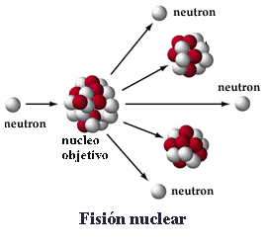
Fission: Splitting Atoms
Nuclear power plants get their power from nuclear energy.
Nuclear energy is the energy released by a fission or fusion reaction. It represents the binding energy of the atomic nucleus.
Notes:
The forces that hold together a nucleus of an atom are more than 1 million times stronger than the chemical bonds between atoms.
In nuclear power plants, atoms of the element uranium are used as the fuel.

Slide 5
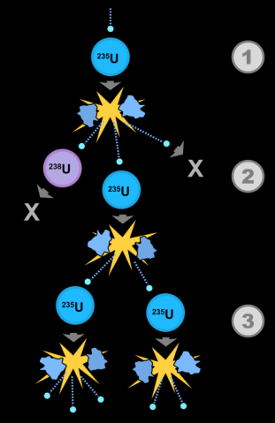
Fission: Splitting Atoms
Nuclear fission is the splitting of the nucleus of a large atom into two or more fragments.
Nuclear fission releases a tremendous amount of energy and more neutrons, which in turn collide with more uranium nuclei.
New nucei and neutrons result from the splitting of the atoms nucleus
Notes:
The nuclei of uranium atoms are bombarded with atomic particles called neutrons. These collisions cause the nuclei to split in a process called nuclear fission.

Slide 6
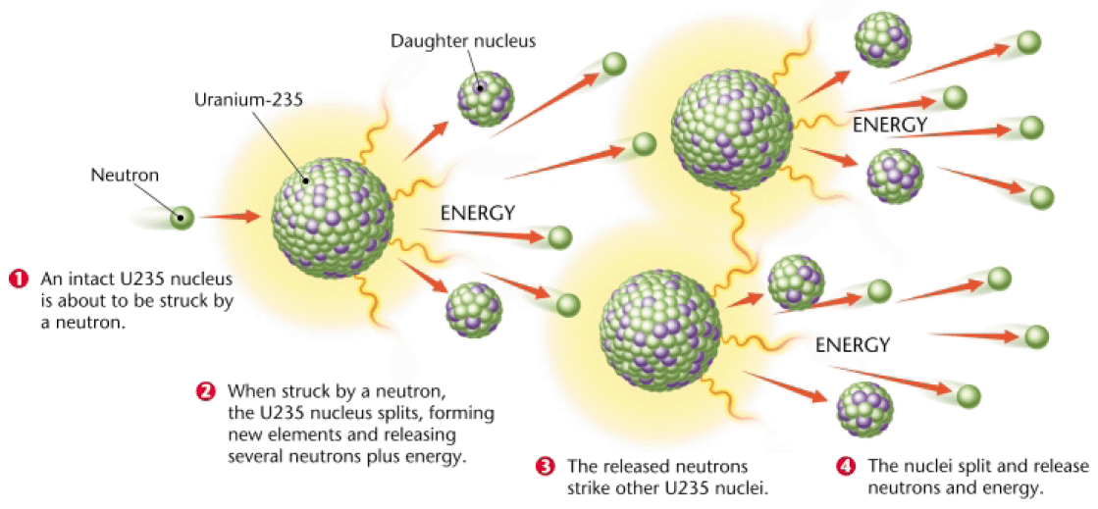
Nuclear fission works:
Nuclei of Uranium atoms are hit with neutrons
2. the collisions cause the nuclei to split
3. energy is released, more neutrons and new nuclei are released
4. the neutrons collide with more nuclei -> chain reaction releases a TON of energy

Slide 7
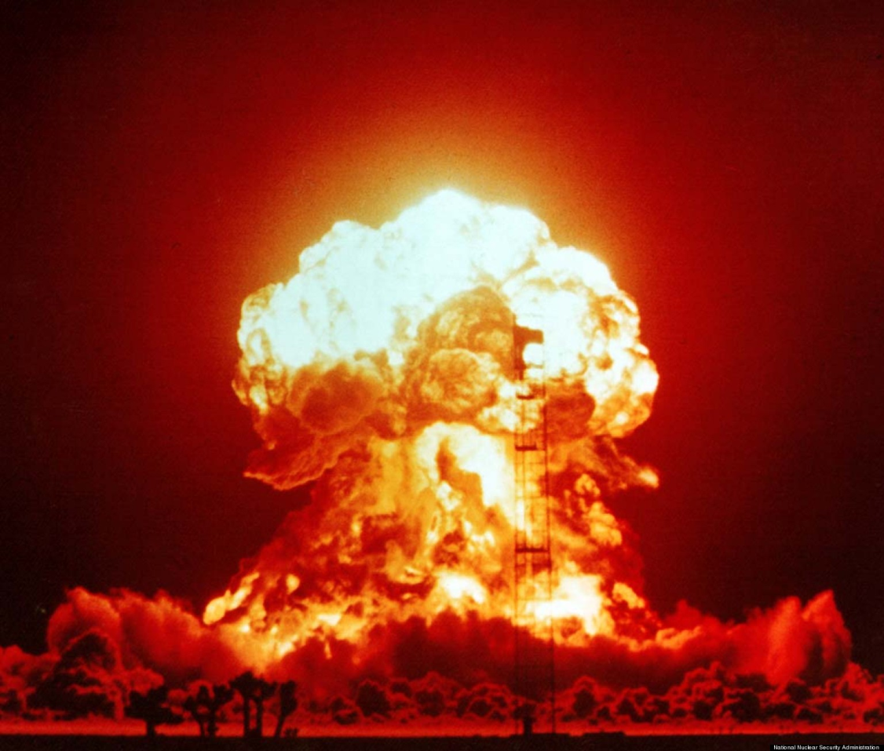
Nuclear fission works:
Controlled fission = energy we can harness in a nuclear reactor
Uncontrolled = atomic bomb
Must keep reaction in check by control rods
Notes:
Rods are inserted into the reactor – the rods are made of boron or cadmium which abosorb the neutrons and stop the reaction

Slide 8
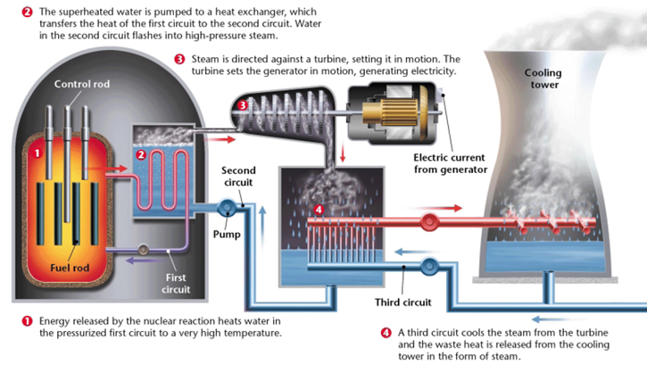
How Nuclear Energy Works
- similar to fossil fuel-generated electricity
1. Heat from the nuclear reaction is used to heat water
2. steam turns a turbine
3. turbine generates electricity
Notes:
The heat released during nuclear reactions is used to generate electricity in the same way that power plants burn fossil fuels to generate electricity.
The energy released from the fission reactions heats a closed loop of water that heats another body of water.
As the water boils, it produces steam that drives a turbine, which is used to generate electricity.

Slide 9
The Advantages of Nuclear Energy
Nuclear fuel is a very concentrated energy source.
power plants do not produce air-polluting gases.
Nuclear power plants release less radioactivity than coal-fired power plants do, when operated properly.
Countries will limited fossil-fuel resources rely heavily on nuclear plants to supply electricity.

Slide 10
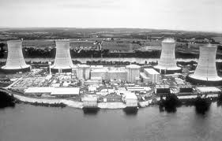
Disadvantages
Building and maintaining a safe reactor is very expensive.
Hard to store Nuclear waste
Safety concerns (Chernobyl, Three Mile Island)
Notes:
This makes nuclear plants no longer competitive with other energy sources in many countries.
The actual cost of new nuclear power plants is uncertain, so it is difficult to predict whether investors will build new plants in the United States.
The Three Mile Island Unit 2 (TMI-2) reactor, near Middletown, Pa., partially melted down on March 28, 1979. This was the most serious accident in U.S. commercial nuclear power plant operating history, although its small radioactive releases had no detectable health effects on plant workers or the public. Its aftermath brought about sweeping changes involving emergency response planning, reactor operator training, human factors engineering, radiation protection, and many other areas of nuclear power plant operations. It also caused the NRC to tighten and heighten its regulatory oversight. All of these changes significantly enhanced U.S. reactor safety.
A combination of equipment malfunctions, design-related problems and worker errors led to TMI-2's partial meltdown and very small off-site releases of radioactivity.

Slide 11
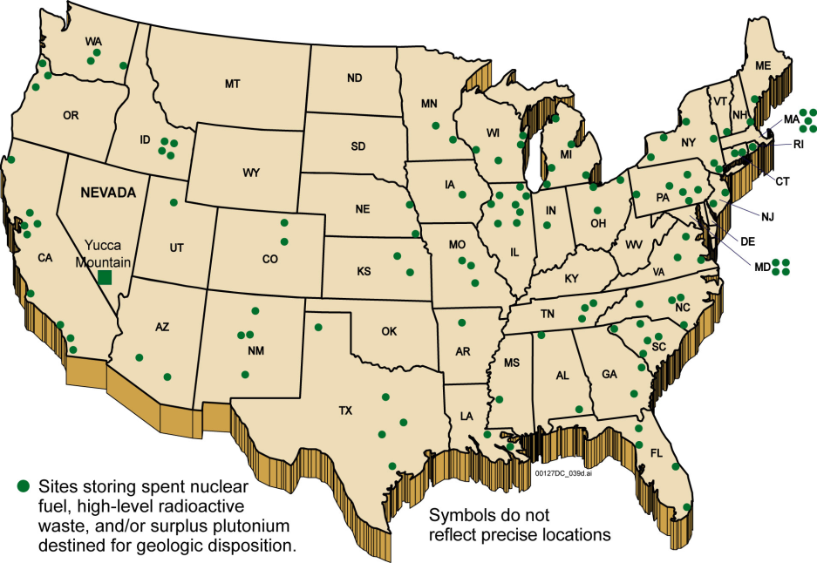
Storing Waste
The fission products produced can remain dangerously radioactive for thousands of years.
Scientists are researching a process called transmutation, that would recycle the radioactive elements in nuclear fuel.
Notes:
The greatest disadvantage of nuclear power is the difficulty in finding a safe place to store nuclear waste.
Storage sites for nuclear wastes must be located in areas that are geologically stable for tens of thousands of years.

Slide 12
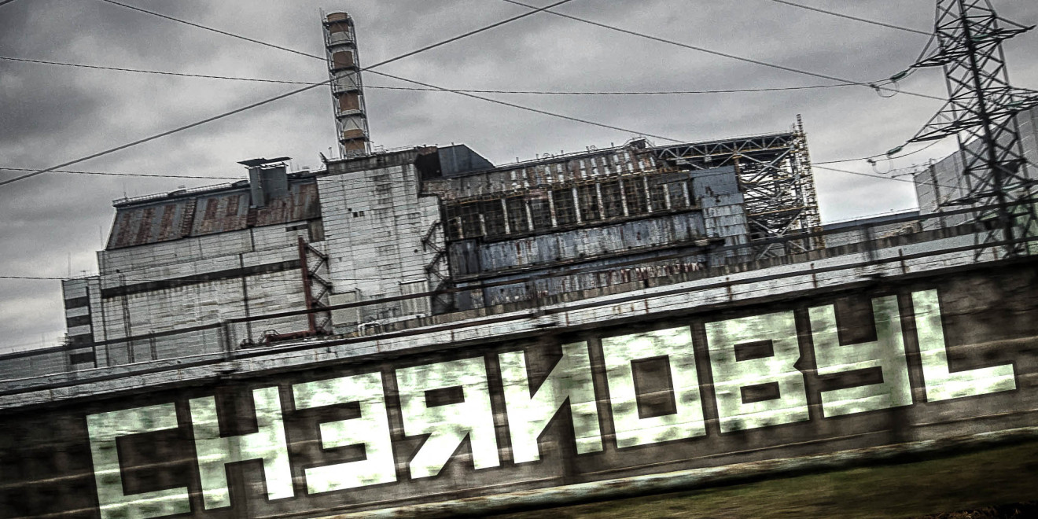
Safety Concerns
The Chernobyl reactor was destroyed in 1986 when an unauthorized test caused explosions and blasted radioactive materials into the air.
Notes:
In a poorly designed nuclear plant, the fission process can potentially get out of control.
Hundreds of people in the Ukraine died from radioactive exposure from this explosion.
Even today, parts of northern Europe and the Ukraine remain contaminated from this disaster.

Slide 13
The Future of Nuclear Power
One possible future energy source is nuclear fusion.
Nuclear fusion is the combination of the nuclei of small atoms to form a larger nucleus. Fusion releases tremendous amounts of energy.
It is potentially a safer energy source than nuclear fission is because it creates less dangerous radioactive byproducts.
Produces less waste
Difficult – high temps, high concentrations

Slide 14
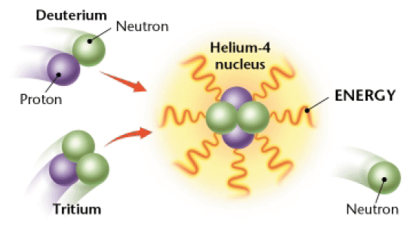
The Future of Nuclear Power
Notes:
Although the potential for nuclear fusion is great, so is the technical difficulty of achieving that potential.
For fusion to occur, three things must occur simultaneously:
Atomic nuclei must be heated to extremely high temperatures (about 100,000,000ºC or 180,000,000ºF).
The nuclei must be maintained at very high conditions.
The nuclei must be properly confined.
The technical problems are so complex that building a nuclear fusion plant may take decades or may never happen.

