Slide 1
Chapter 17
Non-Renewable Energy

Slide 2
Objectives
List five factors that influence the value of a fuel.
Explain how fuels are used to generate electricity in an electric power plant.
Identify patterns of energy consumption and production in the world and in the United States.
Explain how fossil fuels form and how they are used.
Compare the advantages and disadvantages of fossil-fuel use.
List three factors that influence predictions of fossil-fuel production.

Slide 3
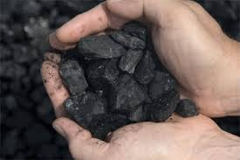
Energy Resources and Fossil Fuels
A fossil fuel is a nonrenewable energy resource formed from the remains of organisms that lived long ago; examples include oil, coal, and natural gas.
Most of the energy we use comes from this group of natural resources called fossil fuels.
We use fossil fuels to run cars, ships, planes, and factories and to produce electricity.

Slide 4
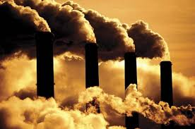
Energy Resources and Fossil Fuels
Fossil fuels are central to life in modern societies, but there are two main problems with fossil fuels.
The supply of fossil fuels is limited.
Obtaining and using them has environmental consequences.
In the 21st century, societies will continue to explore alternatives to fossil fuels but will also focus on developing more-efficient ways to use these fuels.

Slide 5
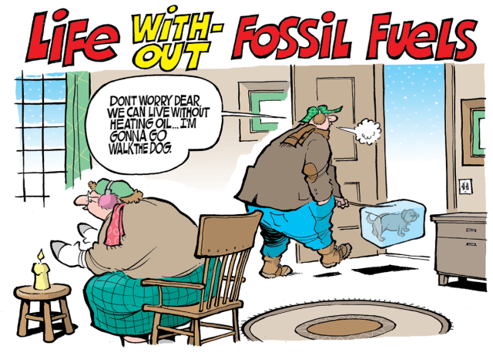
Fuels for Different Uses
Fuel is used for five main purposes:
cooking
Transportation
Manufacturing
Heating and cooling buildings
Generating electricity to run machines and appliances
Different fuels are used for different purposes.
The suitability of a fuel for each application depends on the fuel’s energy content, cost, availability, safety, and byproducts.

Slide 6
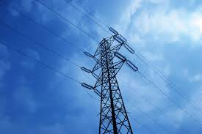
Electricity-Power on Demand
Because electricity is more convenient to use, the energy in fuel is often converted before used.
Electricity can be transported quickly across great distances.
This makes it a good source of power for computers, light switches, and more.
Two disadvantages of electricity are that it is difficult to store and other energy sources have to be used to generate it.

Slide 7
How Is Electricity Generated?
An electric generator is a device that converts mechanical energy into electrical energy.
Generators produce electrical energy by moving an electrically conductive material within a magnetic field.
Most commercial electric generators convert the movement of a turbine into electrical energy. A turbine is a wheel that changes the force of a moving gas or a liquid into energy that can do work.
The turbine spins a generator to produce electricity.

Slide 8
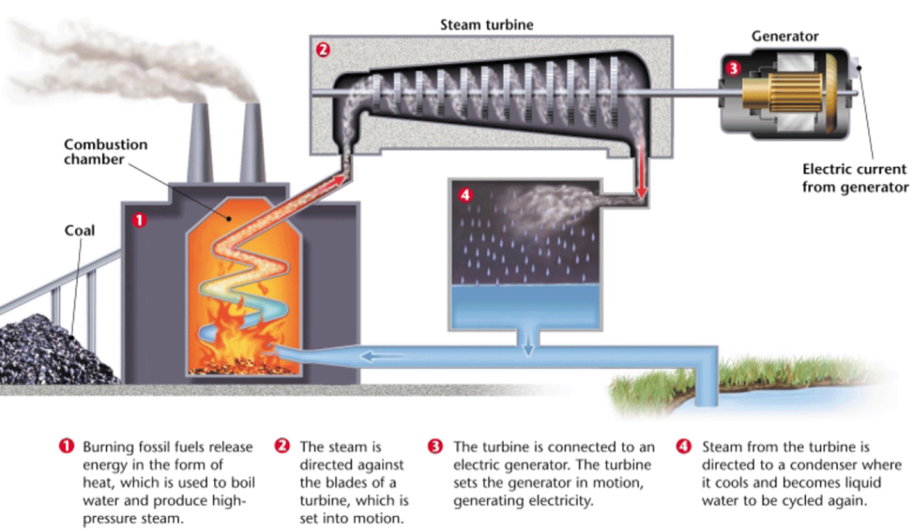
How Is Electricity Generated?
Water is heated by burning a fuel to produce steam
The steam runs the turbine and the turbine spins a generator to produce electricity

Slide 9
How Is Electricity Generated

Slide 10
World Energy Use
Everything you do, from the food you eat to the clothes you wear requires energy.
There are dramatic differences in fuel use and efficiency throughout the world.
People in developed societies use more energy than people in developing countries do.
And within developed societies, there are differences in energy consumption.
A person in US or Canada uses twice as much energy as a person in Japan or Switzerland

Slide 11
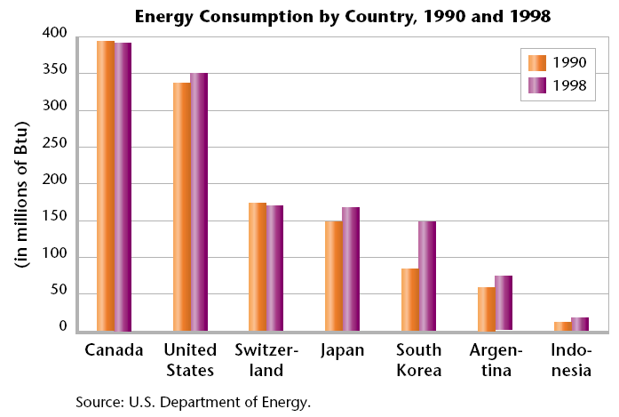
World Energy Use
The difference in energy use among developed countries depends on how energy is generated and used in those countries.

Slide 12
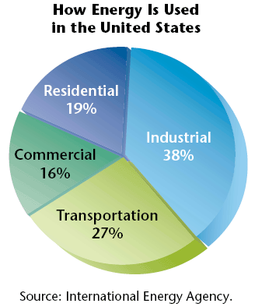
Energy Use in the United States
The United States uses more energy per person than any other country except Canada and the United Arab Emirates.
The U.S. uses more than 25% of its energy to transport goods and people.

Slide 13
Energy Use in the United States
Other countries, such as Japan and Switzerland, depend on extensive rail systems and are smaller, compact countries
Residents of the United States and Canada enjoy some of the lowest gasoline taxes in the world. There is little incentive to conserve gasoline when its cost is so low.
Countries with limited fossil-fuel resources supplement a greater percentage of their energy needs with other energy sources, such as hydroelectric or nuclear.

Slide 14
How Fossil-Fuel Deposits Form
Fossil fuel deposits are not distributed evenly.
There is an abundance of oil in Texas and Alaska, but very little in Maine.
The eastern United States produces more coal than other areas.
The reason for this difference lies in the geologic history of the areas.

Slide 15
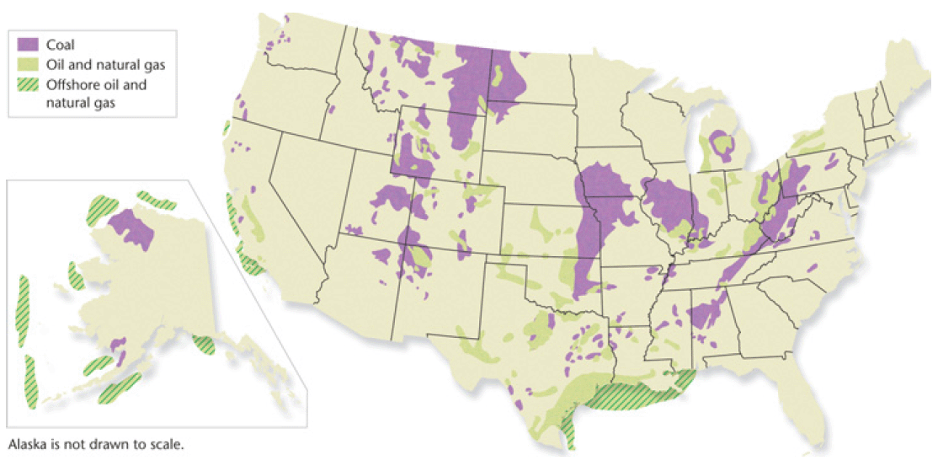
Oil and Gas Deposits in the United States

Slide 16
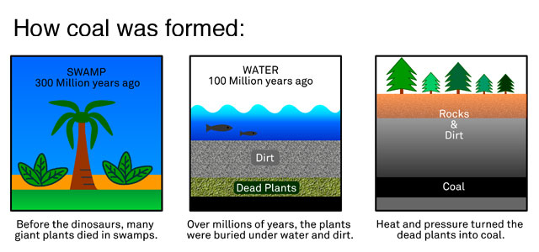
Coal Formation
Coal forms from the remains of plants that lived in swamps hundreds of millions of years ago.
As ocean levels rose and fell, swamps were repeatedly covered with sediment.
Layers of sediment compressed the plant remains, and heat and pressure within the Earth’s crust caused coal to form.

Slide 17
Coal Formation
Much of the coal in the United States formed about 300 to 250 million years ago. Deposits in western states, however, formed between 100 and 40 million years ago.

Slide 18
Oil and Natural Gas Formation
Oil and natural gas result from the decay of tiny marine organisms that accumulated on the bottom of the ocean millions of years ago.
These remains were buried by sediments and then heated until they became complex energy-rich carbon molecules.
These molecules, over time, migrated into the porous rock formations that now contain them.

Slide 19
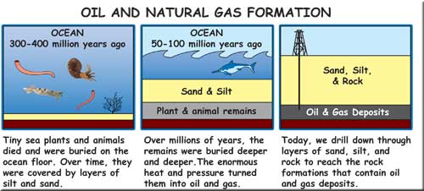
Oil and Natural Gas Formation
Oil and natural gas are located in Alaska, Texas, California and Gulf of Mexico.

Slide 20
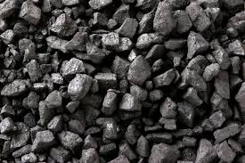
Coal
Most of the world’s fossil-fuel reserves are made up of coal.
Coal is relatively inexpensive and it needs little refining after being mined.
Asia and North America are particularly rich in coal deposits.

Slide 21
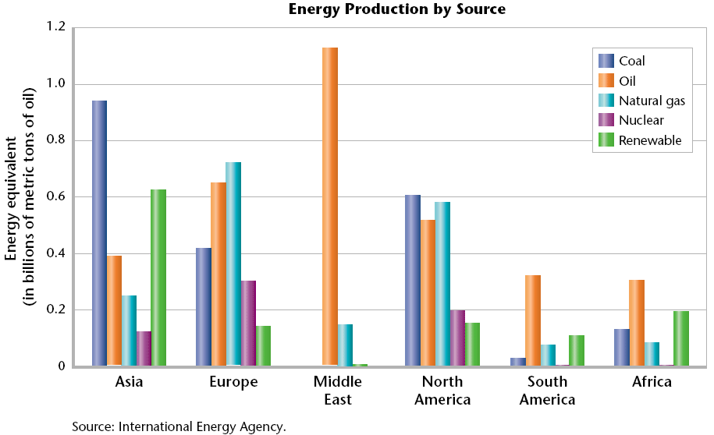
Coal

Slide 22
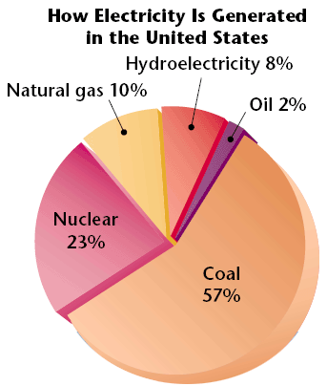
Coal
Over half the electricity generated in the United States comes from coal-fired power plants.

Slide 23
Coal Mining and the Environment
The environmental effects of coal mining vary.
Underground mining may have minimal effect on the environment at the surface, but surface coal-mining operations sometimes remove the top of an entire mountain to reach the coal deposit.
A lot of research focuses on locating the most productive, clean-burning coal deposits and finding less damaging methods of mining coal.

Slide 24
Air Pollution
The quality of coal varies. Higher-grade coals, such as bituminous coal, produce more heat and less pollution than lower-grade coal, such as lignite.
Sulfur, found in all grades of coal, can be a major source of pollution when coal is burned.
The air pollution and acid precipitation that result from burning high-sulfur coal without adequate pollution controls are serious problems in countries such as China.
However, clean-burning coal technology has dramatically reduced air pollution in countries such as the United States.

Slide 25
Petroleum
Petroleum is a liquid mixture of complex hydrocarbon compounds that is used widely as a fuel source.
Petroleum, also known as crude oil.
Anything that is made from crude oil, such as fuels, chemicals, and plastics, is called a petroleum product.
Notes:
Petroleum accounts for 45% of the world’s commercial energy use.

Slide 26
Locating Oil Deposits
Oil is found in and around major geologic features, such as folds, faults, and salt domes, that tend to trap oil as it moves in the Earth’s crust.
Most of the world’s oil reserves are in the Middle East. Large deposits also exist in the United States, Venezuela, the North Sea, Siberia, and Nigeria.
Geologists use many different methods to locate the rock formations that could contain oil.

Slide 27
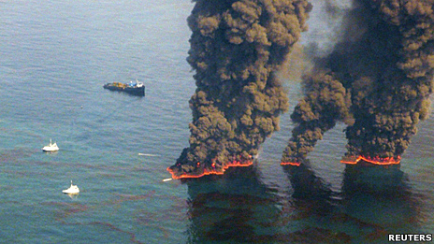
The Environmental Effects of Using Oil
Petroleum fuel releases pollutants when burned.
These pollutants contribute to smog and cause health problems.
Many scientists think that the carbon dioxide released from burning petroleum fuels contributes to global warming.

Slide 28
The Environmental Effects of Using Oil
Oil spills from tanker ships are another potential environmental problem of oil use .
While oil spills are dramatic, much more oil pollution comes from everyday sources, like leaking cars.

Slide 29
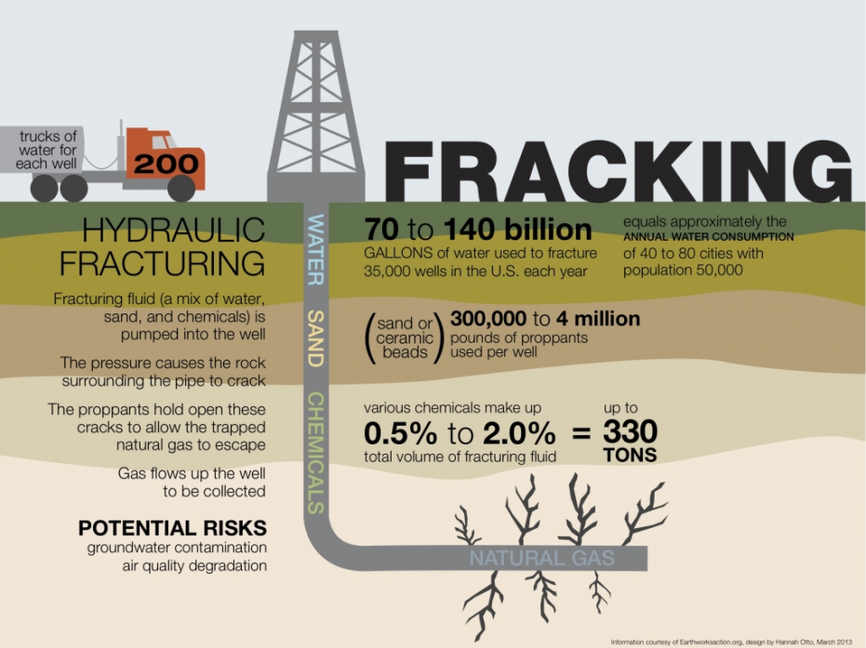
Natural Gas
About 20% of the world’s nonrenewable energy comes from natural gas.
Natural gas, or methane (CH4), produces fewer pollutants than other fossil fuels when burned.
Vehicles that run on natural gas require fewer pollution controls.
Electric power plants can also use this clean-burning fuel.

Slide 30
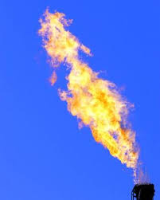
Natural Gas
Burning natural gas produces fewer pollutants than any other fossil fuel.

Slide 31
Fossil Fuels and the Future
Fossil fuels supply about 90% of the energy used in developed countries.
Most of energy in the US is used for industrial purposes
This will make other energy sources more attractive.
Planning for the energy we will use in the future is important because it takes many years for a new source of energy to make a significant contribution to our energy supply.

Slide 32
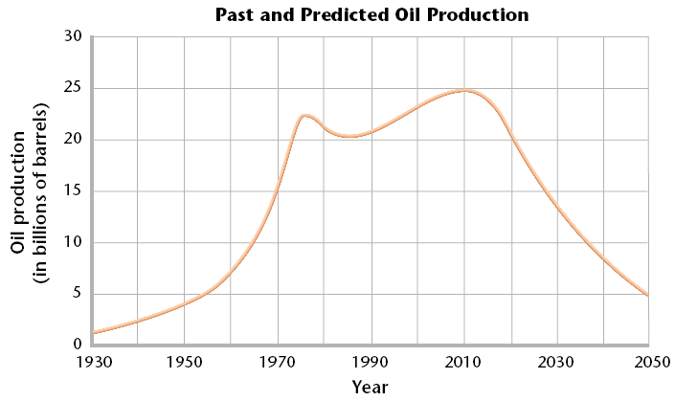
Predicting Oil Prediction
Oil production is still increasing, but it is increasing much more slowly than it has in the past. 1990 needs for US rose slightly

Slide 33
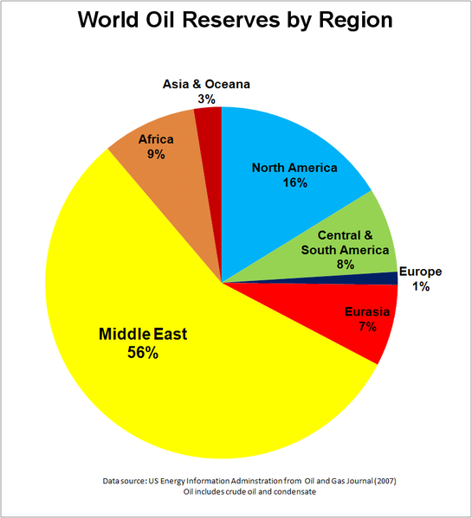
Predicting Oil Production
Following factors help predict future oil production:
- Changes in technology
- cost of obtaining fuel
-Number of oil deposits discovered

Slide 34
Where did the energy originate?
.The energy in fossil fuels originated from the sun

