Slide 1
Cellular Respiration
Cellular Respiration: Harvesting Chemical Energy

Slide 2
Life Requires Energy
Living cells require energy from outside sources
Some animals, such as the giant panda, obtain energy by eating plants; others feed on organisms that eat plants

Slide 3
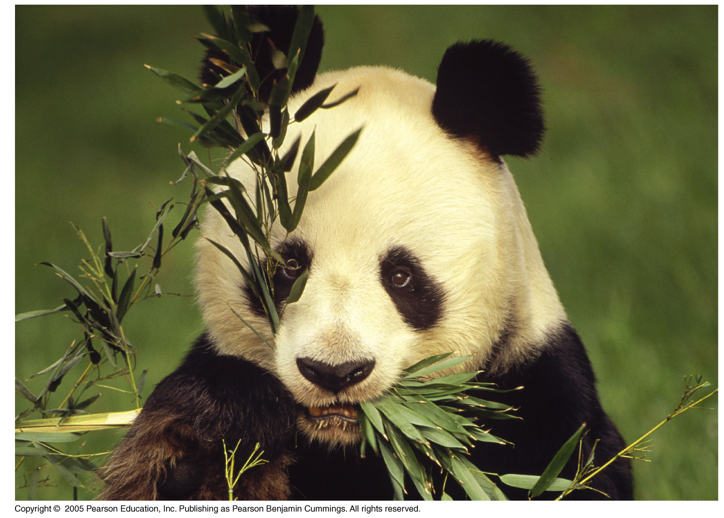

Slide 4
Energy flows into an ecosystem as sunlight and leaves as heat
Photosynthesis uses sunlight to generate oxygen and glucose sugar.
Cell respiration uses chemical energy in the form of carbohydrates, lipids, or proteins, to produce ATP.

Slide 5
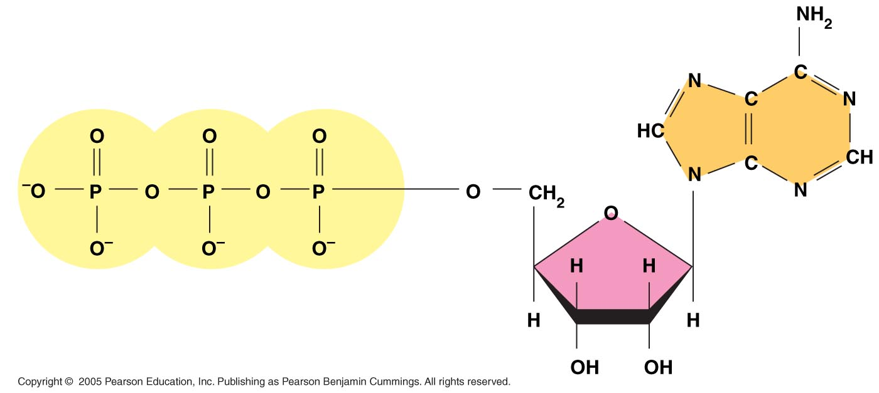
ATP
ATP stands for Adenosine Tri-Phosphate
ATP is a molecule that serves as the most basic unit of energy
ATP is used by cells to perform their daily tasks

Slide 6
ATP
ATP can be broken down into a molecule of ADP by removing one of the phosphate groups.
This releases energy.
ADP can be remade into ATP later when the cell has food that can be broken down (i.e. glucose)

Slide 7
NADH
NADH is a molecule that can “carry” H+ ions and electrons from one part of the cell to another.
NADH is the “energized” version of this molecule that is carrying the H+ ion and two high-energy electrons.
NAD+ is the “non-energized” version of this molecule that does not have the ion or the extra two electrons.

Slide 8
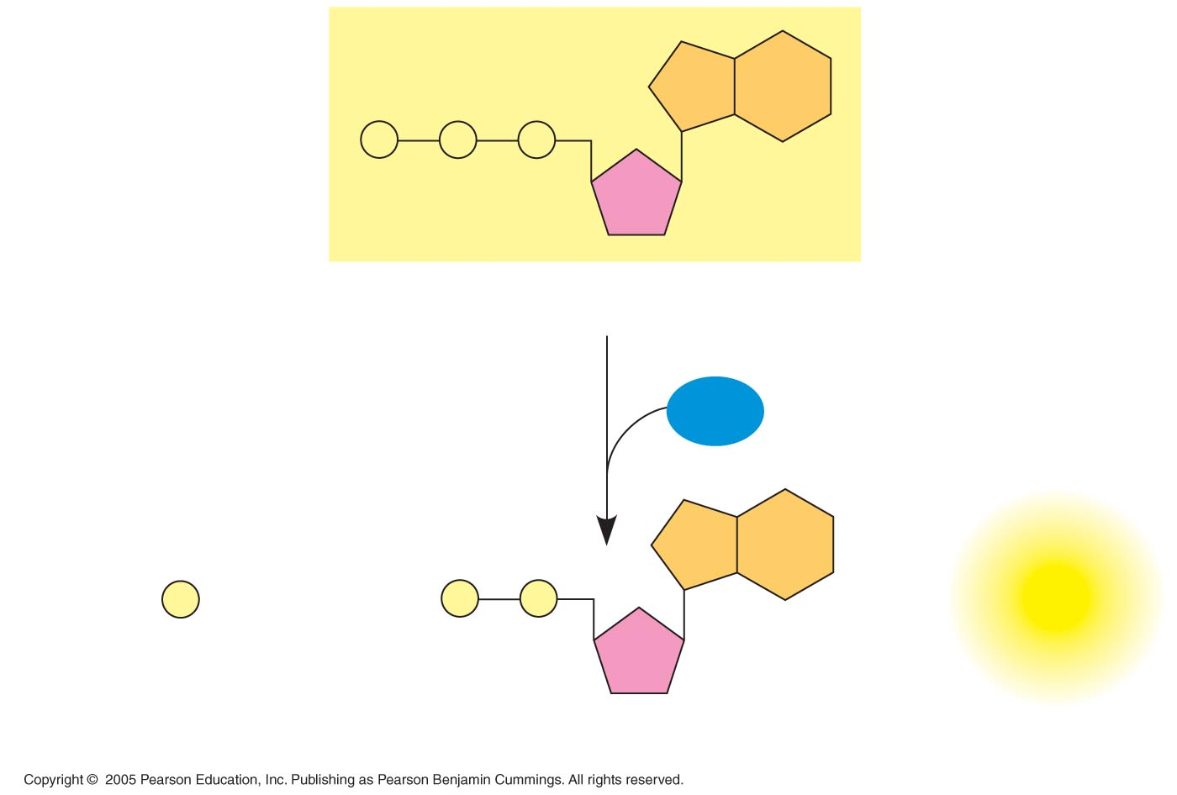
LE 8-9
P
P
P
Adenosine triphosphate (ATP)
H₂O
P
+
P
P
+
Energy
i
Inorganic phosphate
Adenosine diphosphate (ADP)

Slide 9
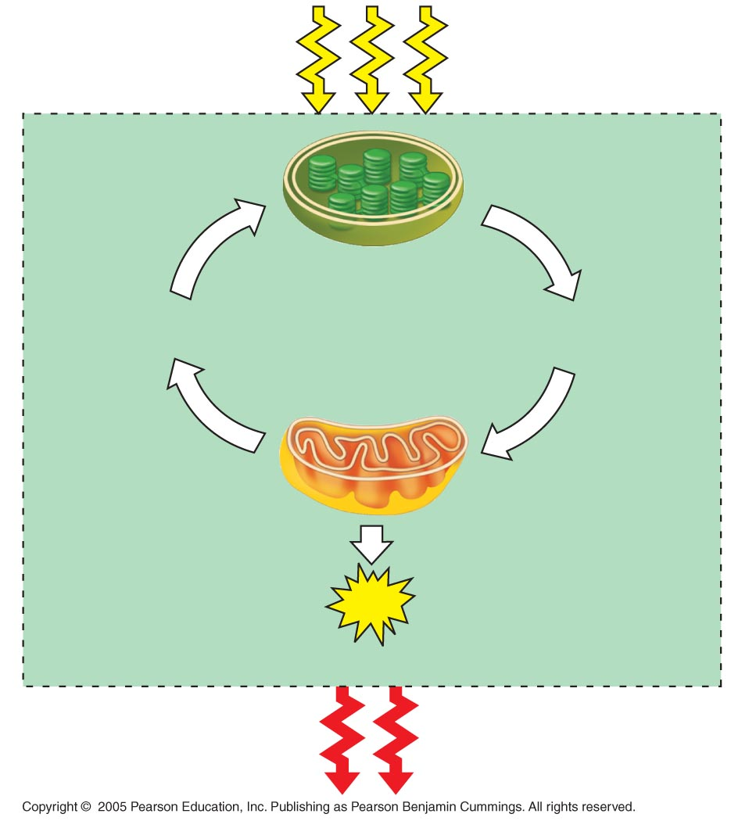
LE 9-2
Light
energy
ECOSYSTEM
Photosynthesis
in chloroplasts
CO₂ + H₂O
Simple sugars
(Glucose)
+ O₂
Cellular respiration
in mitochondria
ATP
powers most cellular work
Heat
energy

Slide 10
Cell Respiration and Production of ATP
The breakdown of organic molecules (carbohydrates, lipids, proteins) releases energy.
Cellular respiration consumes oxygen and organic molecules and yields ATP
Although carbohydrates, fats, and proteins are all consumed as fuel, it is helpful to trace cellular respiration with the sugar glucose:
C₆H₁₂O₆ + 6O₂ → 6CO₂ + 6H₂O + Energy

Slide 11
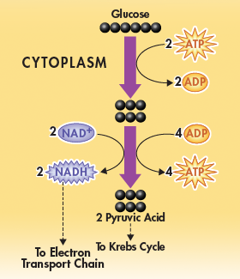
Glycolysis
Glycolysis is the first stage of cellular respiration.
Occurs in cytoplasm.
During glycolysis, glucose is broken down into 2 molecules of the 3-carbon molecule pyruvic acid.
ATP and NADH are produced as part of the process.

Slide 12
Glycolysis
Glycolysis uses up:
1 molecule of glucose (6-carbon sugar)
2 molecules of ATP
2 molecules of NAD+
Glycolysis produces
2 molecules of pyruvic acid (3-carbon acids)
4 molecules of ATP
2 molecules of NADH

Slide 13
Advantages of Glycolysis
Glycolysis produces ATP very fast, which is an advantage when the energy demands of the cell suddenly increase.
Glycolysis does not require oxygen, so it can quickly supply energy to cells when oxygen is unavailable.

Slide 14
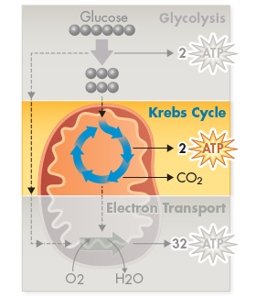
Krebs Cycle
During the citric acid cycle, pyruvic acid produced in glycolysis is broken down into carbon dioxide and more energy is extracted.

Slide 15
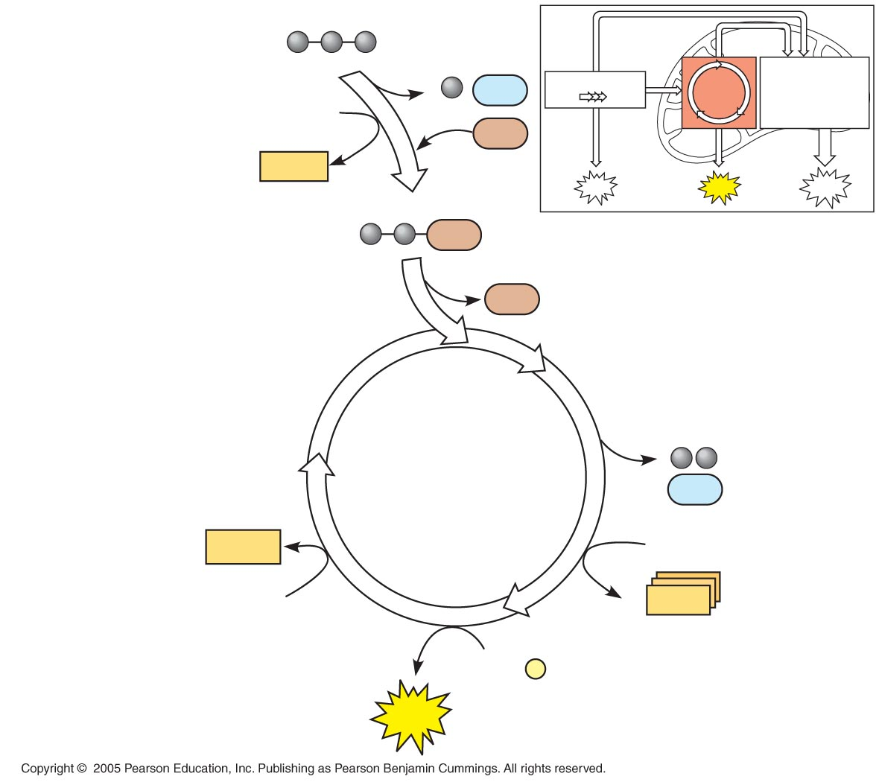
LE 9-11
Pyruvic acid
(from glycolysis,
2 molecules per glucose)
CO₂
Glycolysis
Citric
acid
cycle
Oxidation
phosphorylation
NAD⁺
CoA
NADH
+ H⁺
ATP
ATP
ATP
Acetyl CoA
CoA
CoA
Citric
acid
cycle
2
CO₂
FADH₂
3 NAD⁺
FAD
3
NADH
+ 3 H⁺
ADP + P
i
ATP

Slide 16
Electron Transport Chain
The electron transport chain occurs in the inner membrane of the mitochondria.
Electrons are passed along the chain, from one protein to another.
Each time the electron is passed, a little bit of energy is extracted from it.
Electrons drop in energy as they go down the chain and until they end with O₂, forming water

Slide 17
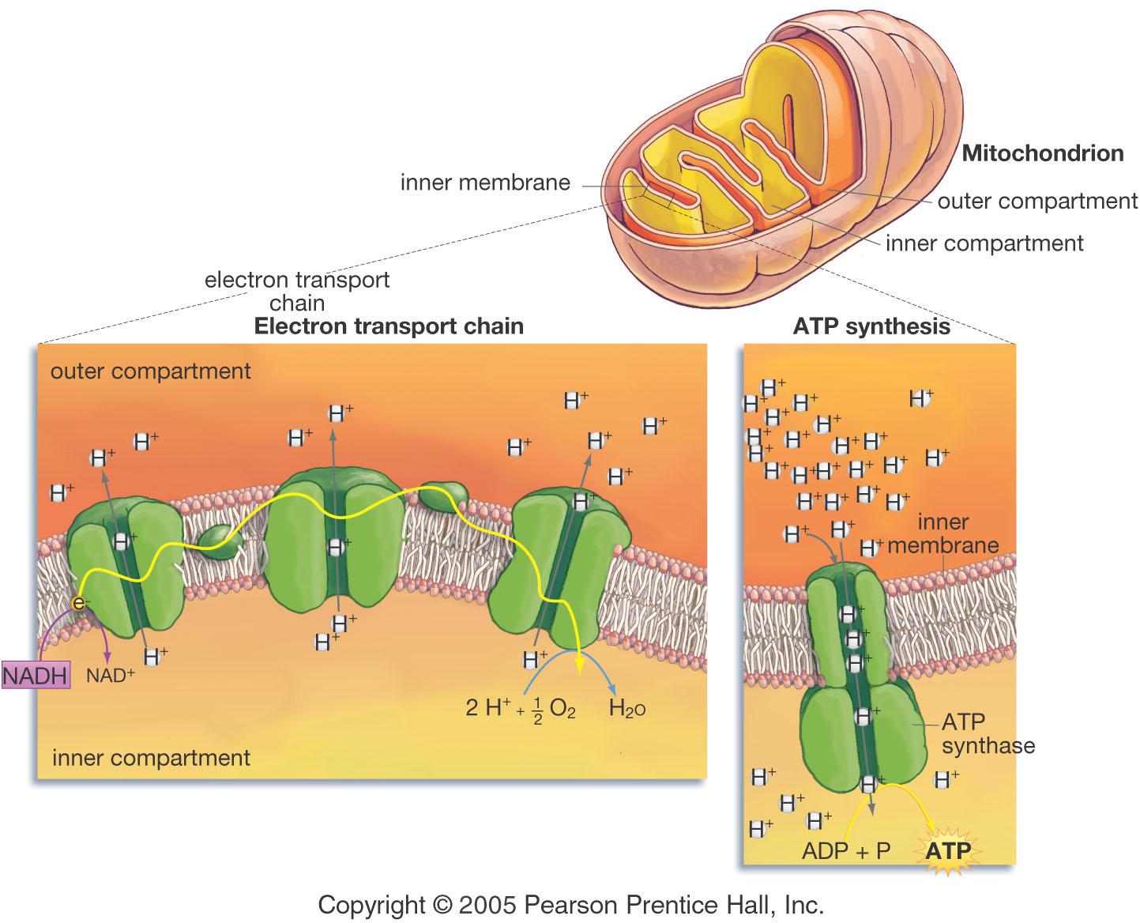

Slide 18
Chemiosmosis
The electron transport chain has created a high concentration of H+ ions in the outer fluid of the mitochondria.
H⁺ then moves back across the membrane, into the inner fluid.
H+ ions pass through a channel protein called ATP Synthase
ATP synthase uses this flow of H⁺ to convert ADP molecules (low energy) into ATP (high energy)

Slide 19
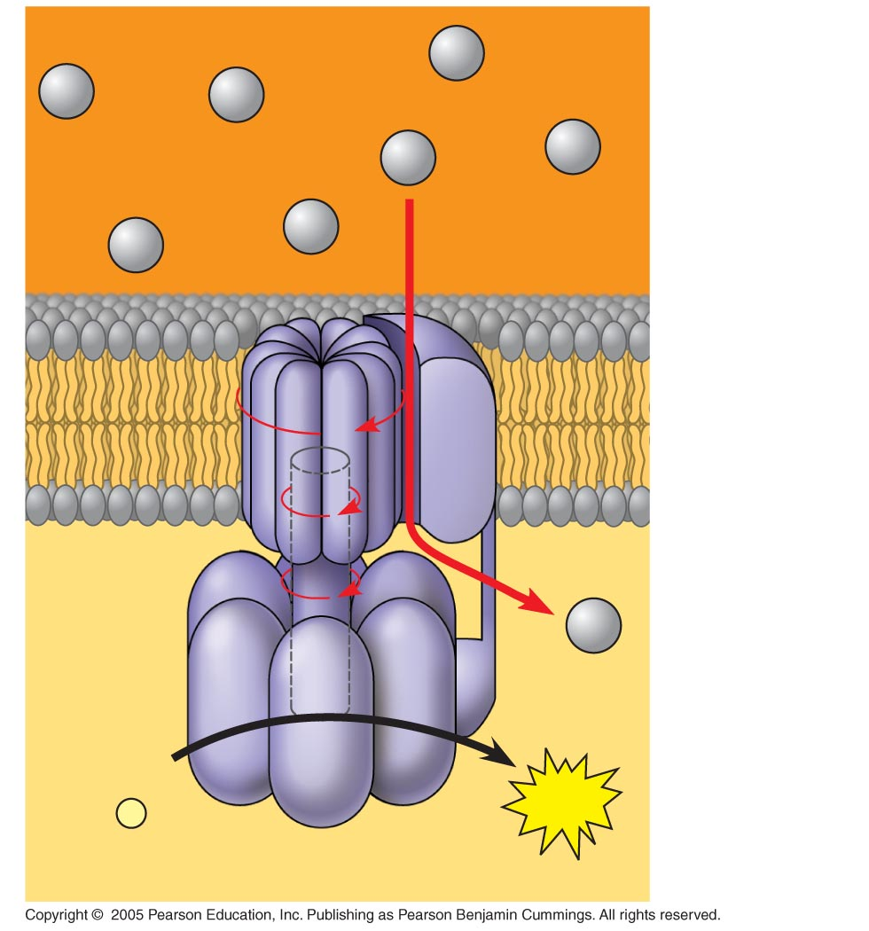
LE 9-14
INTERMEMBRANE SPACE
H⁺
A rotor within the membrane spins as shown when H⁺ flows past
it down the H⁺ gradient.
H⁺
H⁺
H⁺
H⁺
H⁺
H⁺
A stator anchored in the membrane holds the knob stationary.
A rod (or “stalk”) extending into the knob also spins, activating catalytic sites in the knob.
H⁺
Three catalytic sites in the stationary knob join inorganic phosphate to ADP to make ATP.
ADP
+
P
ATP
i
MITOCHONDRAL MATRIX

Slide 20
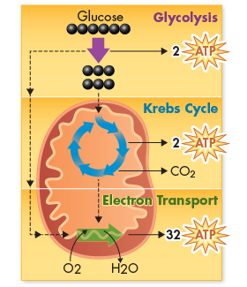
Total ATP Production
During cellular respiration, most energy flows in this sequence:
glucose → NADH
→ electron transport chain →chemiosmosis →ATP
About 40% of the energy in a glucose molecule is transferred to ATP during cellular respiration, making about 38 total ATP
Remainder is lost as waste heat

Slide 21
Fermentation
Cellular respiration requires O₂ to produce ATP
Glycolysis can produce ATP with or without O₂ (in aerobic or anaerobic conditions)
In the absence of O₂, glycolysis can couples with a process called fermentation to produce ATP.

Slide 22
Types of Fermentation
Fermentation consists of glycolysis + reactions that regenerate NAD⁺, which can be reused by glycolysis
Two common types are alcohol fermentation and lactic acid fermentation

Slide 23
Alcohol Fermentation
Yeast and a few other microorganisms use alcoholic fermentation that produces ethyl alcohol and carbon dioxide.
This process is used to produce alcoholic beverages and causes bread dough to rise.
Pyruvic acid + NADH → Alcohol + CO2 + NAD+

Slide 24
Lactic Acid Fermentation
Most organisms, including humans, carry out fermentation using a chemical reaction that converts pyruvic acid to lactic acid.
Pyruvic acid + NADH → Lactic acid + NAD⁺

Slide 25
In lactic acid fermentation, pyruvate is reduced to NADH, the only end product is lactic acid. No carbon dioxide is released.
Lactic acid fermentation by some fungi and bacteria is used to make cheese and yogurt
Human muscle cells use lactic acid fermentation to generate ATP when O₂ is scarce (out of breath)
Result: Soreness!

Slide 26
Yeast and many bacteria are facultative anaerobes, meaning that they can survive using either fermentation or cellular respiration
Most other organisms cannot survive in the long-run using glycolysis and fermentation, they require oxygen.
These are obligate aerobic organisms.

