Slide 1
Chapter 11 Introduction to Genetics
Pg. 262

Slide 2
What makes you unique?
Sure, we’re all humans, but what makes you different from others in the room.
Your talents, interests or dreams?
Your personality, looks or clothes?
Actually, one of the reasons you’re unique is because of the genes you inherited from your parents.
Your genes make you unique, they have a hidden potential that can make you excel at things others can not.
Seek out your potential and you will find it, otherwise it will be wasted.

Slide 3
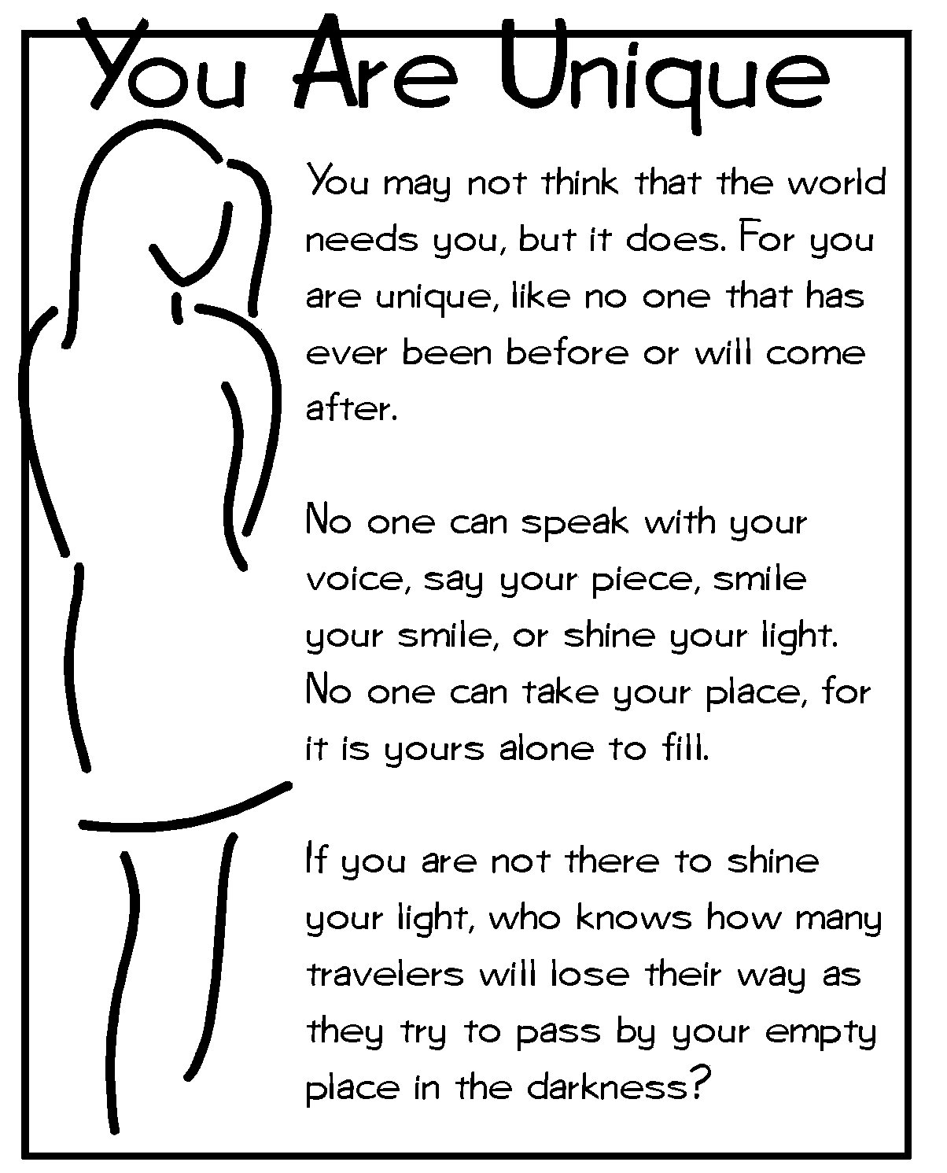
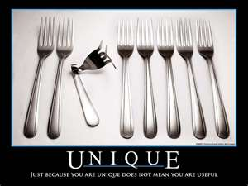
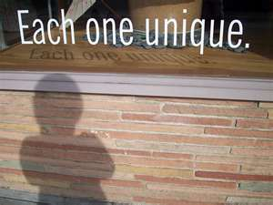

Slide 4
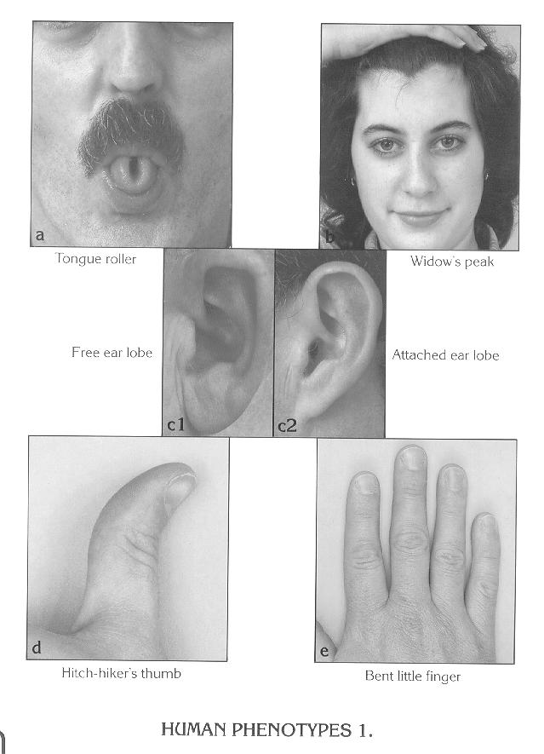
Genetics
Genetics is the study of how traits are passed from one generation to the next.
Traits are specific characteristics that vary from one individual to another.
Examples: hair color, height, intelligence

Slide 5
Let’s check out our traits!
Take out a piece of paper to keep track of your traits.
The first trait we’ll do together.
Are you colorblind?
There are three main kinds of color vision defects. Red-green color vision defects are the most common. This type occurs in men more than in women. The other major types are blue-yellow color vision defects and a complete absence of color vision. Most of the time, color blindness is genetic.
I will show you a series of slides. On your paper write down the number you see or the word spots if you don’t see a number.
DO NOT SAY ANYTHIG OUT LOUD!

Slide 6
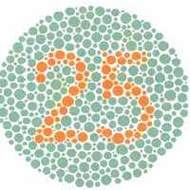
QUIETLY, write down what you see.

Slide 7
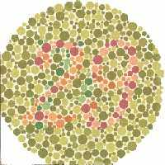
QUIETLY, write down what you see.

Slide 8
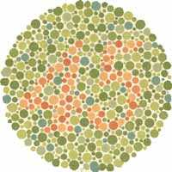
QUIETLY, write down what you see.

Slide 9
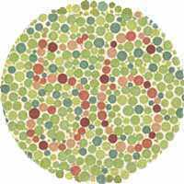
QUIETLY, write down what you see.

Slide 10
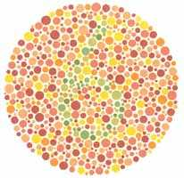
QUIETLY, write down what you see.

Slide 11
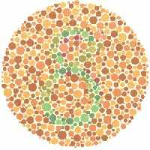
QUIETLY, write down what you see.

Slide 12
How did you do?
Slide 1 showed an orange # 25
Slide 2 showed a red # 29
Slide 3 showed an orange # 45
Slide 4 showed a red # 56
Slide 5 showed a green # 6
Slide 6 showed a green # 8
You may be red-green colorblind if you only saw the numbers 25 and 56. All of the other slides would have appeared to have only had spots.
On your paper identify if you are color blind or if you have “normal” color vision.

Slide 13
Now for the rest…
Individually complete the worksheet given to you. As a class we will then collect and analyze our trait data
http://www.usc.edu/org/cosee-west/AprilLectureMaterials/Activities/AnInventoryofMyTraits.pdf
Take a moment and clasp your hands together so that they are on the desk.
Look at your hands…
Which finger is on top? Note this on your sheet.
The following slides will have pictures to help you determine if you and your partner have the various traits we’ll be looking at.

Slide 14
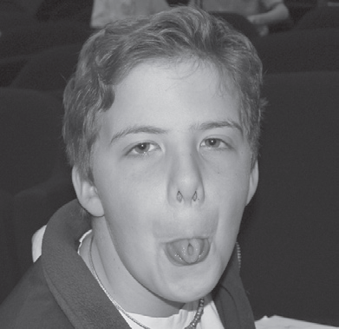
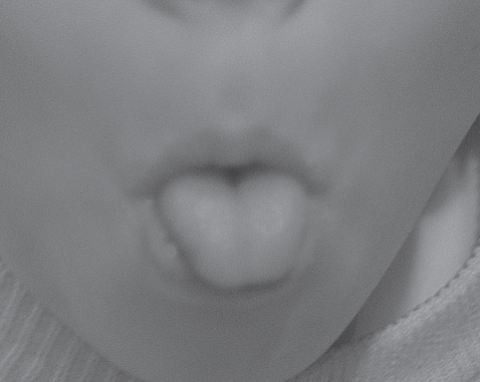
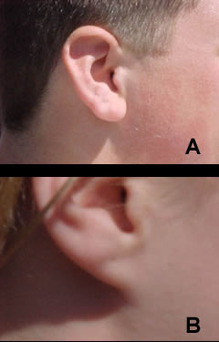
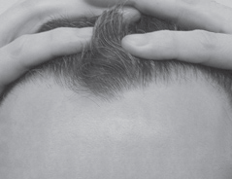
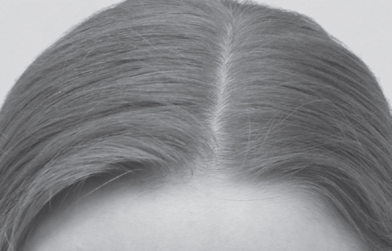
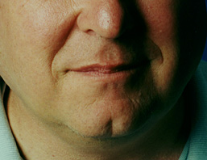
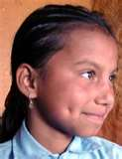
Detached Earlobes
Attached Earlobes
Tongue roller Non roller
Widow’s Peak Straight Hair Line
Dimples
Cleft Chin

Slide 15
Let’s see the class results..
Let’s calculate the frequency of each trait for our class:
Number of students with the trait x 100 = ________%
Number of students in the class
Example: Hitchhiker’s thumb (Class size =21)
5 x 100 = 24%
21
Let’s compare the frequency of traits in the classroom population with the frequency in the general population.

Slide 16
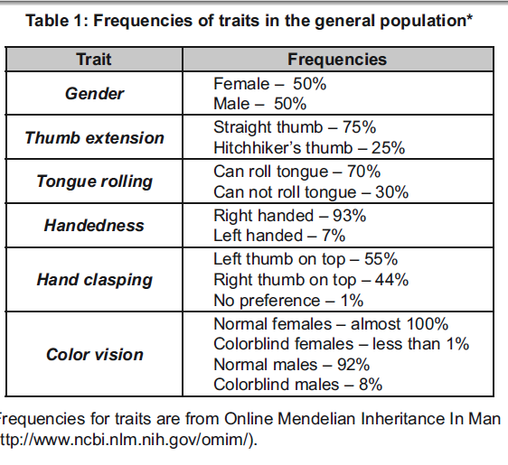

Slide 17
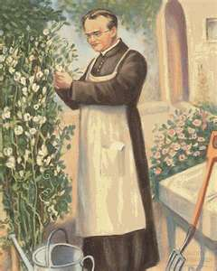
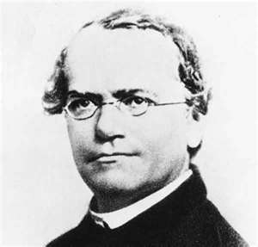
The Father of Genetics
Gregor Mendel 1822-1884
After becoming a priest, Mendel spent several years studying science and math.
He spent 14 years working in the monastery and teaching at the high school.
Mendel was also in charge of the monastery garden. It was in this garden that Mendel did work that would change biology forever!

Slide 18
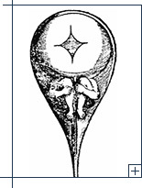
What did Mendel do?
Gregor Mendel discovered how traits get passed on from one generation to the next. He discovered how heredity works!
How did Mendel achieve such a feat?
PEAS!
http://youtu.be/GTiOETaZg4w

Slide 19
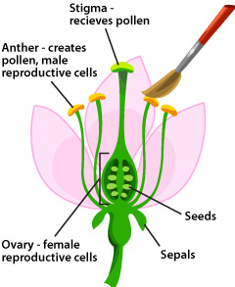
More about pea’s please…
Mendel knew that pea plants can “self-pollinate”, meaning they had both pollen (sperm) and seeds (eggs) in the same flower.
This means that seeds produced by peas inherit all of the characteristics from the parent plant.

Slide 20
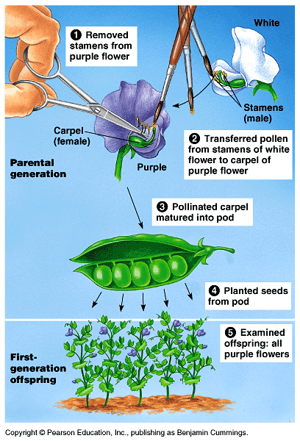
True-breeding plants like peas produce offspring identical to themselves.
Mendel wanted to cross pollinate the plants with different traits. This meant that he had to prevent self-pollination by removing the male parts and physically dusting the female parts with the desired pollen.
This allowed Mendel to cross breed plants with different traits and study the results.

Slide 21
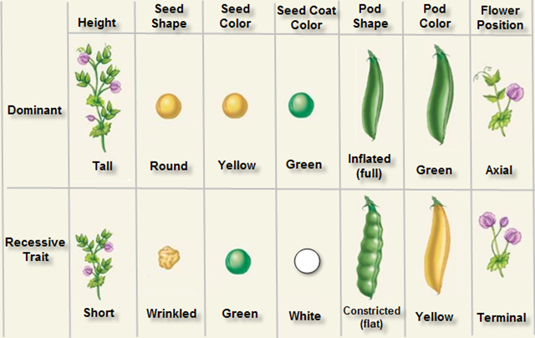
Genes and Dominance
Mendel studies the following pea traits.
The offspring of parents with different traits are called hybrids.

Slide 22
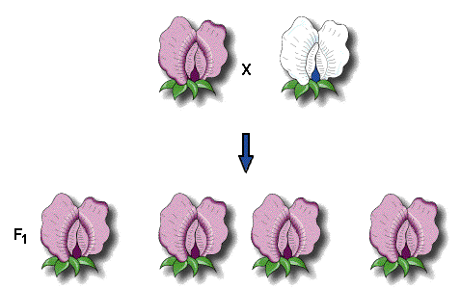
Parents and Offspring
We call the original pair of breeding plants the P (parental) generation.
The offspring of the P are called the F1, or “first filial” generation (filius means “son” and filia means “daughter” in Latin)
What did the F1 hybrid plants look like? To Mendel’s surprise, all of the offspring had the characteristics of only one of the parents. The other one seemed to have disappeared.
P

Slide 23
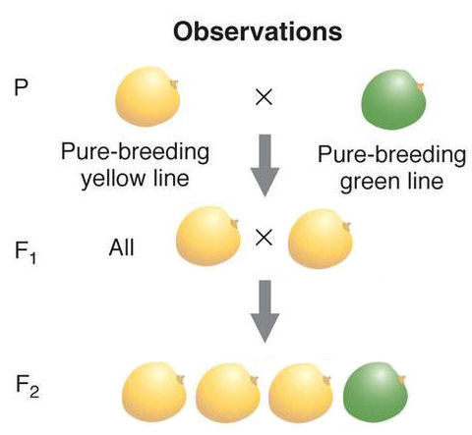
The F2 Generation
Mendel then allowed the F1 generation to self-pollinate to create the F2 generation.
Mendel discovered that the trait that “disappeared” in the F1 showed up
again in the F2.

Slide 24
Two Conclusions
Mendel’s first conclusion from this set of experiments was that biological inheritance is determined by factors that are passed from one generation to the next.
Today we call these chemical factors that determine traits genes.
Each of these traits is controlled by one gene that has two different forms.
The different forms of a gene are called alleles.
Example: there is one gene for plant height with two alleles, tall and short.
http://www.powermediaplus.com/player.asp?mediaID=35531&segmentID=201142

Slide 25
The Principle of Dominance
The principle of dominance states that some alleles are dominant and others are recessive.

Slide 26
Dominant Alleles
An organism with a dominant allele for a trait will always show that trait.
Dominant alleles are represented with the capital letter of the dominant trait.
Example: T is for tall, R is for round, Y is for yellow, etc.
If you see a capital
letter for an allele, it
WILL show that trait.
TT or Tt are tall
RR or Rr are round
YY or Yy are green

Slide 27
Recessive Alleles
An organism with a recessive allele for a trait will only show that form if the dominant allele for the trait is absent. For a recessive trait to show, there must be two recessive alleles, NO DOMINAT.
Recessive alleles are represented with the lower case letter of the dominant trait.
Example: t is for short, r is for wrinkled, y is for green, etc.
http://www.powermediaplus.com/player.asp?mediaID=35531&segmentID=201143

Slide 28
You try it…
Take out the trait activity we recently did. Write the allele combination you may have for each of the following traits. Let’s do the first couple together.
Unattached earlobes are dominant and attached
earlobes are recessive.
Straight thumb is dominant and hitchhiker’s thumb is recessive.
The ability to roll the tongue a dominant trait and the lack of tongue rolling ability a recessive trait.
Dimples dominant and a lack of dimples recessive.
Right handedness dominant and left handedness
recessive.
Freckles is dominant, the absence of freckles is recessive.
Cleft chin dominant and a smooth chin recessive.
Widow’s peak dominant and a straight hairline recessive.

Slide 29
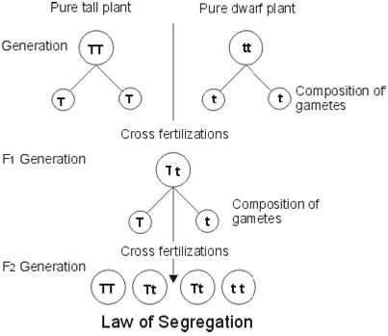
Explaining the F1 cross
Remember that when Mendel allowed the F1 generation to self-pollinate that the recessive trait showed up in 25% of the population.
This reappearance indicated that at some point the allele for yellow separated from the allele for green.

Slide 30
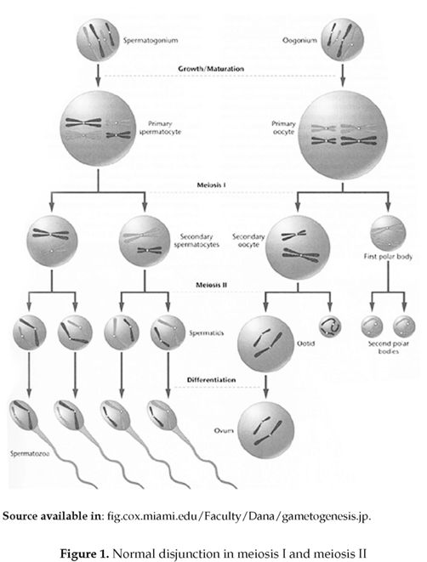
The Law of Segregation
Mendel realized that alleles separate when gametes or sex cells (sperm and eggs) form.
During gamete formation, alleles separate from each other so that each gamete carries only one allele.

Slide 31
Vocabulary
Homozygous: organisms that have two identical allelles for a trait. Example: TT or tt (true breeding)
HOMO means same
Heterozygous: Organisms that have two different alleles for a trait. Example: Tt (hybrids)
HETERO means different
Phenotype: The physical characteristics (what we see). Example: tall, short, round
Genotype: The genetic make-up (combination of alleles). Example: TT, aa, Rr

Slide 32
Vocabulary Review
For each genotype, indicate whether it is heterozygous (HE) or homozygous (HO)
AA ____ Bb ____ Cc ____ Dd ____ | Ee ____ ff ____ GG ____ HH ____ | Ii ____ Jj ____ kk ____ Ll ____ | Mm ____ nn ____ OO ____ Pp ____
For each of the genotypes below, determine the phenotype.
Purple flowers are dominant to white flowers PP __________________ Pp _________________ pp __________________ | Brown eyes are dominant to blue eyes BB ___________________________ Bb ___________________________ bb ___________________________
Round seeds are dominant to wrinkled RR ___________________________ Rr ___________________________ rr ___________________________ | Bobtails are recessive (long tails dominant) TT ___________________ Tt ___________________ tt __________________

Slide 33
For each phenotype, list the genotypes.
(Remember to use the letter of the dominant trait)
Straight hair is dominant to curly. ____________ straight ____________ straight ____________ curly | Pointed heads are dominant to round heads. ____________ pointed ____________ pointed ____________ round

Slide 34
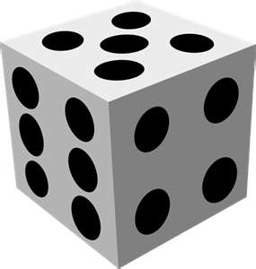
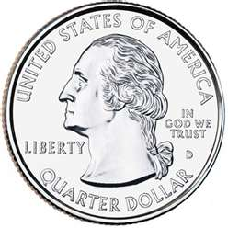
Section 11-2 Probability and Punnett Squares
The likelihood of something happening is called probability.
When you flip the coin what is the probability of flipping a head?
When you roll the dice, what is the probability of getting a two?
When talking probabilities, past outcomes DO NOT affect future ones.
The principle of probability can be used to predict the outcome of genetic crosses.

Slide 35
Genetics with a Smile
http://sciencespot.net/Media/gen_smilewkst1.pdf
Now for an activity to see how probability plays a role in genetic crosses.

Slide 36
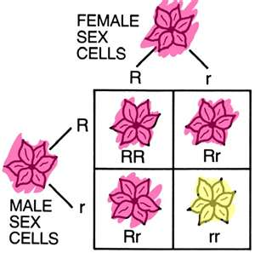
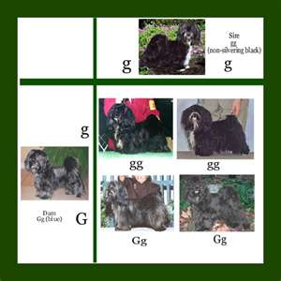
Punnett Squares
Gene combinations that could result from a genetic cross (breeding) can be determined by drawing a Punnett Square.
A Punnett Square demonstrates how alleles segregate in the gametes and the possible combinations of them coming together again in the offspring.
The Punnett Square is a guide to possible results, not a guarantee of results.

Slide 37
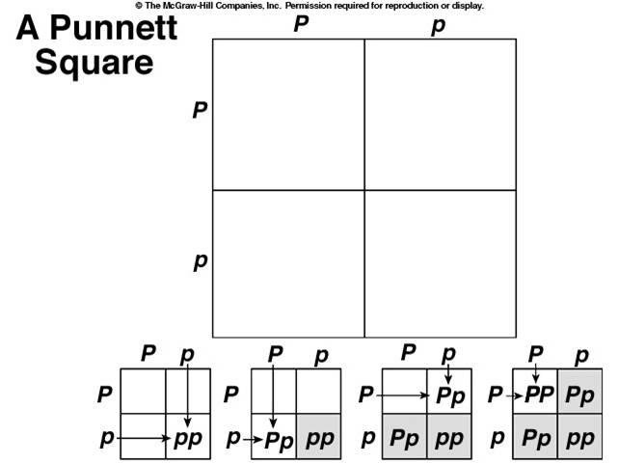
Punnett Squares

Slide 38
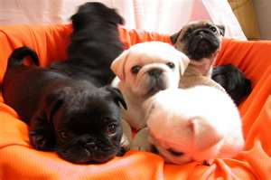
Probabilities predict averages!
Remember that probabilities predict the average outcome of a large number of events.
Probability does not predict the precise outcome of an individual event.
The same is true of genetics. The larger the number of offspring, the closer the resulting numbers will get to expected values.

Slide 39
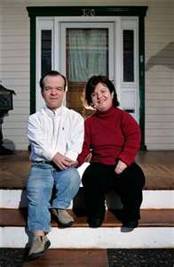
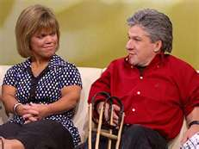
Monohybrid Cross
Studying the inheritance of a single trait is called a monohybrid cross.
In humans, acondroplasia “dwarfism” (D) is dominant over normal (d). A homozygous dominant (DD) person dies before the age of one. A heterozygous (Dd) person is dwarfed. A homozygous recessive individual is normal.
A heterozygous dwarf man marries a dwarf
heterozygous woman……..

Slide 40
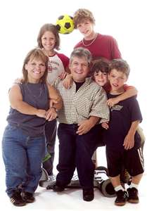
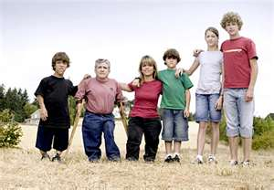
What is the probability of having a normal child?
What is the probability of having a child that is a dwarf?
What is the probability of having a child that dies at one from this disorder?

Slide 41
Let’s sum it up.
http://youtu.be/prkHKjfUmMs

Slide 42
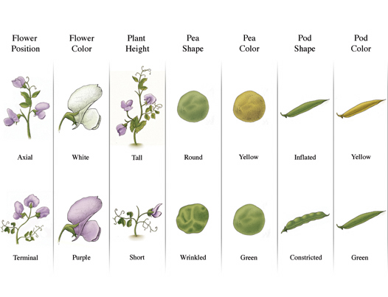
Section 11-3 Exploring Mendelian Genetics
After showing that alleles segregated during the formation of gametes, Mendel wondered if certain alleles traveled together or if they separated independently from each other..
Example: Does the gene that determines a seeds shape (round or wrinkled) have anything to do with the seeds color (yellow or green)? Must a round seed also be yellow?

Slide 43
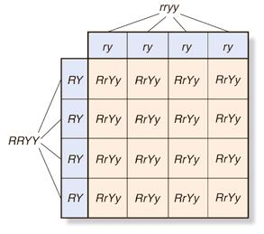
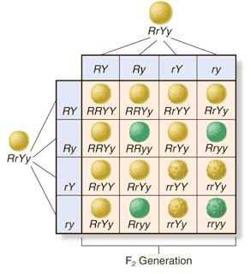
The di-hybrid cross
R = round r = wrinkled
Y = yellow y = green

Slide 44
www.goo.gl/mxV11

Slide 45
Dihybrid Practice
A tall green pea plant (TTGG) is crossed with a short white pea plant (ttgg).
TT or Tt = tall tt = short GG or Gg = green gg = white
___________ X ___________

Slide 46
Now you try…
A tall green pea plant (TTGg) is crossed with a tall green pea plant (TtGg)
TT or Tt = tall tt = short GG or Gg = green gg = white
___________ X ___________

Slide 47
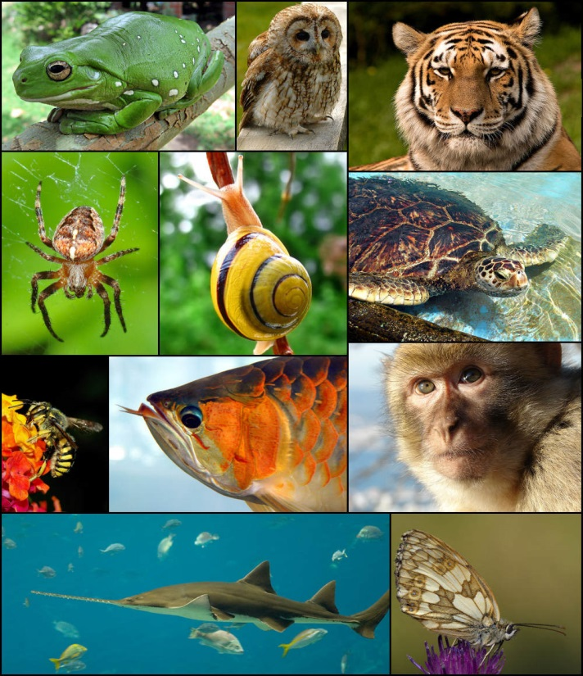
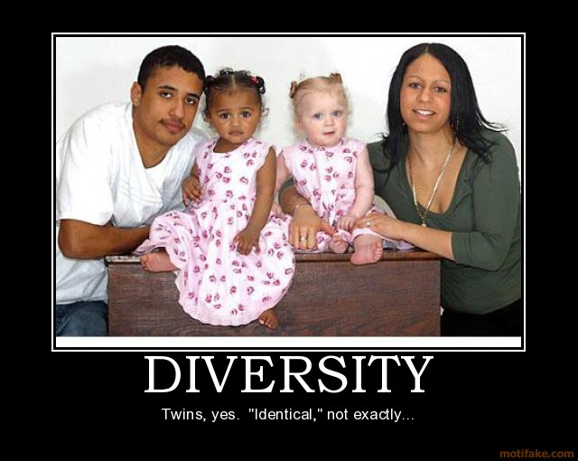
Independent Assortment
The principle of independent assortment states that genes for different traits do not travel together.
We now know that if genes are located on the same chromosome, they can travel together.
It’s this independent assortment that gives us the many genetic variations we observe in plants, animals and other organisms.

Slide 48
A Summary of Mendel’s Principles
The traits we inherit come from our genes. Genes are passed from parents to offspring.
Some alleles are dominant and others are recessive.
Each organism receives an allele from each parent to make their genes. These genes are segregated when gametes are formed.
Alleles for different genes segregate independently of one another.

Slide 49
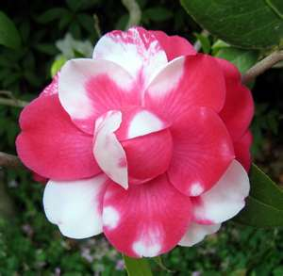
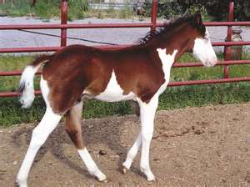
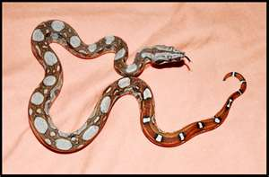
Beyond Dominant and Recessive
We now know that there are many exceptions to Mendel’s principles.
The majority of genes have more than two alleles.
Many traits are controlled by more than one gene.
Some alleles are neither dominant nor recessive, and many traits are controlled by multiple alleles or genes.

Slide 50
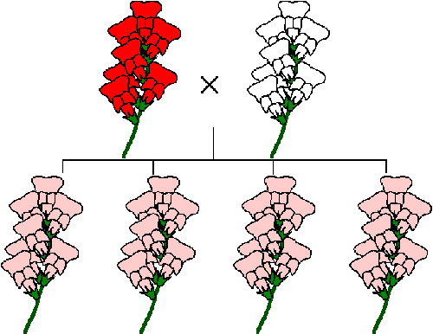
Incomplete Dominance
A cross between some individuals causes a trait to blend together. When one allele is not completely dominant over another it is called incomplete dominance.
Red (RR) + White (WW)= pink (RW)
Example: A cross between
A red flower (RR) and
a white flower (WW) creates
Pink flowers (RW)

Slide 51
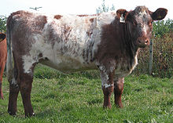
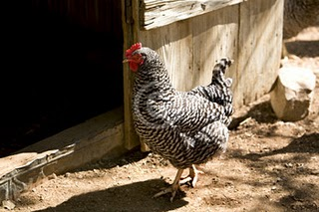
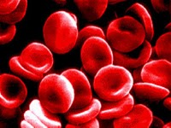
Codominance
When both alleles are dominant and both show up in the offspring, it’s called codominance.
Examples: Roan Cows Erminette Chickens
Blood Type AB

Slide 52
Multiple alleles
Many genes have more than two alleles that exist in a population.
An individual will still only have two alleles for the trait.
One example is coat color in rabbits. A rabbit’s coat color is determined by a single gene that has at least four different alleles.

Slide 53
What color eyes…
What color eyes would your children have?
http://museum.thetech.org/ugenetics/eyeCalc/eyecalculator.html

Slide 54
Eye color can change…
Baby eyes: Eye color changes in children are usually due to a delay in the production of melanin. The greater amount of melanin present in the eye usually denotes a more brown tint.
Pupil size: Eye color can also change as the pupils dilate and shrink. As the pupil dilates, the melanin pigments in the iris are pushed together causing a darker looking eye. As the pupil shrinks, the melanin pigments spread out making the eyes appear lighter in color.

Slide 55
Eye color change…
Disease: some diseases can cause dramatic changes in eye color. For example, some diseases may change one eye color from brown to blue resulting in heterochromia (two different colored eyes).
Horner syndrome, some forms of glaucoma, and Fuch's disease can cause a change in eye color.
Age: Between 10 and 15 percent of the Caucasian population will experience a change in eye color as they age. This is usually due to a degradation of the color of the pigments in the eye, or a loss of melanin granules in the eyes over time.

Slide 56
Polygenic Traits
Many traits are produced by the interaction of many genes.
Traits controlled by two or more genes are polygenic traits.
For example, the wide range of skin color in humans comes about partly because more than four different genes control the trait.

Slide 57
Applying Mendel’s Principles
In the 1900’s a scientist, Thomas Morgan, wanted to find an organism that could help advance the study of genetics.
He decided on the fruit fly Drosophila because
It could produce lots of offspring very quickly (up to 100 offspring per pair)
It’s easy to keep in the lab
It’s small
He discovered that Mendel’s
principles apply to all organisms,
not just plants.

Slide 58
Genetics and the Environment
The characteristics of any organism are not determined only be the genes it inherits. They are determined by interactions between genes and the environment.
Example: Genes may affect a sunflowers height and the color of its flowers, but these characteristics are also influenced by climate, soil and water.
Genes provide a plan for development, but how that plan unfolds also depends on the environment.

Slide 59
Section 11-4 Meiosis
Mendel did not know where the genes he had discovered were located in the cell.
We now know that genes are located on chromosomes in the cell nucleus.
http://youtu.be/qCLmR9-YY7o

Slide 60
Chromosome Number
Remember that offspring inherit a single copy of each gene from each parent, or half the number of chromosomes.
This means that when gametes (sex cells) form, the two sets of genes must be separated so each gamete ends up with only one set.

Slide 61
Vocabulary
Homologous chromosomes: The matching chromosomes that come from each parent.
Diploid: A body cell with both sets of chromosomes (2N)
Haploid: sex cells
with only one set of chromosomes (N)

Slide 62
Meiosis
Meiosis turns a diploid cell into a haploid cell.
2N Into N
Recall that mitosis clones a cell.
2N makes another 2N

Slide 63
Meiosis 1 - prophase, metaphase, anaphase, telophase
Prior to meiosis 1, each chromosome is replicated.
In meiosis 1 each chromosome pairs with its homologous partner to form a tetrad (4 chromatids). This pairing is KEY to understanding meiosis.
As tetrads are formed, they exchange portions of their chromatids in a process called crossing over (prophase I)

Slide 64
Next…
The homologous chromosomes separate and two new cells are formed.
The chromosomes have been sorted and shuffled like a deck of cards. VERY IMPORTANT to diversity.
These new cells
now have
chromosomes and
alleles that are
different from each
other and from the
parent cells!

Slide 65
Meiosis 2
Now one more division to half the genetic material in each cell.
We now have 4 genetically
different cells!
(mitosis creates
2 genetically
identical cells)

Slide 67
11-5 Linkage and Gene Maps
Mendel concluded that alleles assort independently from each other, but he didn’t know genes were on chromosomes.
Do genes on the same chromosome travel together?
Well, when Morgan was studying his fruit flies in 1910 he discovered that the answer was yes.

Slide 68
Every chromosome is actually a group of linked genes.
This means that Mendel’s conclusion still holds true only its chromosomes that assort independently and not every allele.

Slide 69
Genetic Diversity
Sometimes crossing over separates the genes that are on a chromosome and can produce a new combination of alleles.
This helps create genetic diversity!

Slide 70
Let’s try it out…
Everyone come up and get a cell division set.
If you do not have one partner with someone who does.
Meiosis 1 is similar to mitosis, let’s review.
Now…

Slide 71
The End!

