Slide 1
Chapter 13 Changing the Living World
Pg. 319

Slide 2
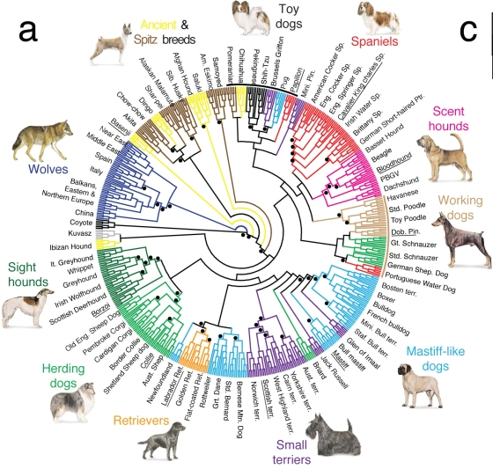
Selective Breeding
Selective breeding: when humans allow only the organisms with desired characteristics to breed.

Slide 3
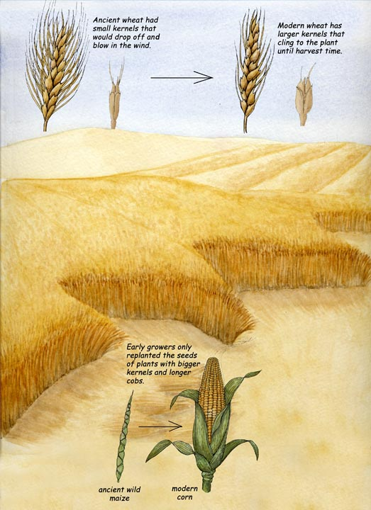
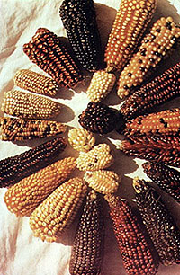
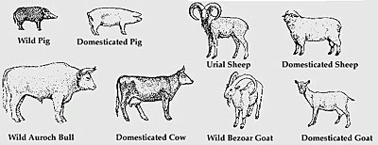
Domestication
Nearly ALL domestic animals and plants have been produced by selective breeding.
Maize, or what Americans tend to call "corn," was first domesticated in Meso-America several thousand years ago. It became the main food crop of many cultures from eastern North America to Chile in South America.
Maize has excellent nutritional value and, eaten together with squash and beans, the other staples of early American agriculture, provides all the amino acids necessary for human life.

Slide 4
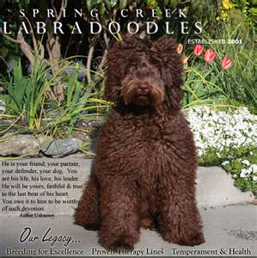
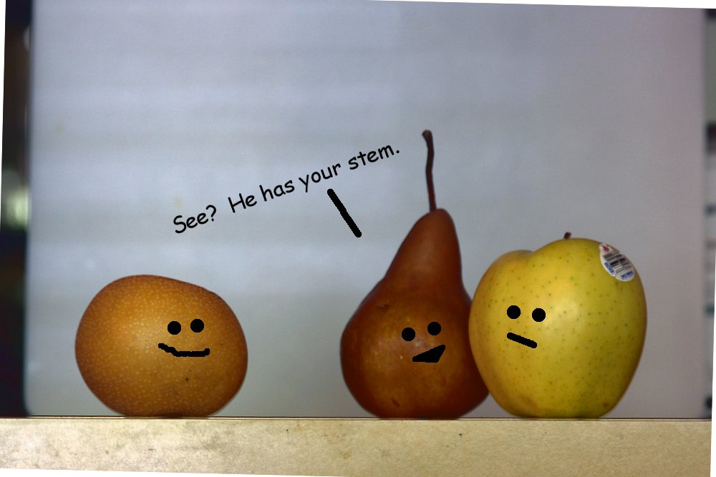
Hybrids
In order to increase the amount of genetic variability in a species, humans would cross dissimilar individuals together to try to get the desirable traits of each.

Slide 5
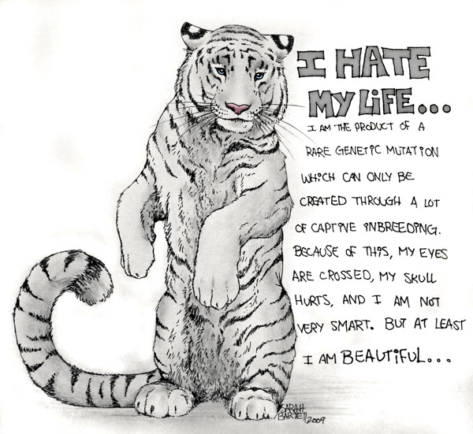
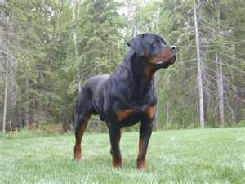
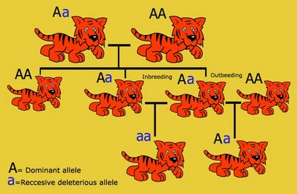
Inbreeding
In order to maintain the desired characteristic of an organisms, breeders often inbreed them.
Inbreeding is the continual breeding of individuals with similar traits.
Example “purebreds” like begals, poodles, etc.
Inbreeding is useful to retain certain characteristics but because of their genetic similarity they risk brining together two recessive alleles for a genetic defect.
Example: many breeds of dogs suffer
from blindness, joint deformities,
hip dysplasia, etc.

Slide 6
Let’s try it!
Breeding Border Collies
Grab your laptop and go to http://pbskids.org/dragonflytv/games/game_dogbreeding.html
Take a worksheet and it will explain what you need to do.

Slide 7
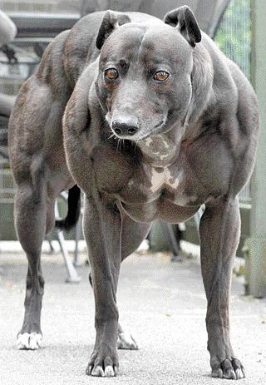
How can we possibly “change the living world” by Selective Breeding?
Domestication of plants and animals.
Cows

Slide 8
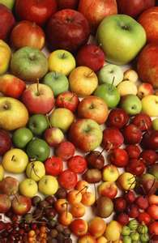
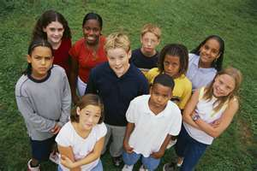
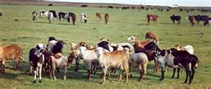
Desired Characteristics???
What do they mean by desired characteristics?
How do organisms get these desired traits?
These desired traits are a
product of natural genetic
variation.

Slide 9
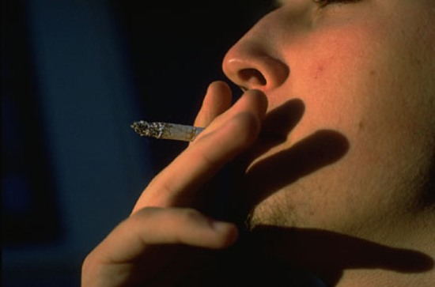
Increasing Variation
Some breeders increase genetic variation by mutating the organisms DNA.
They can induce these mutations by using radiation and chemicals.
Every so often a desirable trait, not found in the original population, will show up.

Slide 10
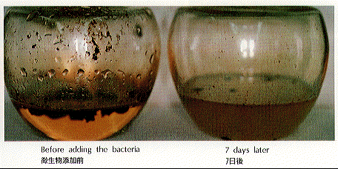
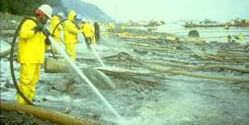
New Kinds of Bacteria
By inducing mutations in bacteria we have been able to produce a bacteria that can digest oil.
They can induce these mutations by using radiation and chemicals.
Produces a useful mutant

Slide 11
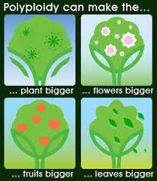
New Kinds of Plants
Polyploidy- many sets of chromosomes
Use drugs to prevent chromosomal separation during meiosis
Fatal in animals
Beneficial in plants
Plants are larger and stronger
Plants become a new species when chromosome numbers are doubled and tripled

Slide 12
13-2 Manipulating DNA
Until recently breeders have only been able to use hybridization, inbreeding or inducing mutations to manipulate organisms.
Now we can rewrite an organisms DNA!
We can transfer genes
at will from one organism to
another!
Knowing the sequence of an organisms DNA allows researchers to study specific genes

Slide 13
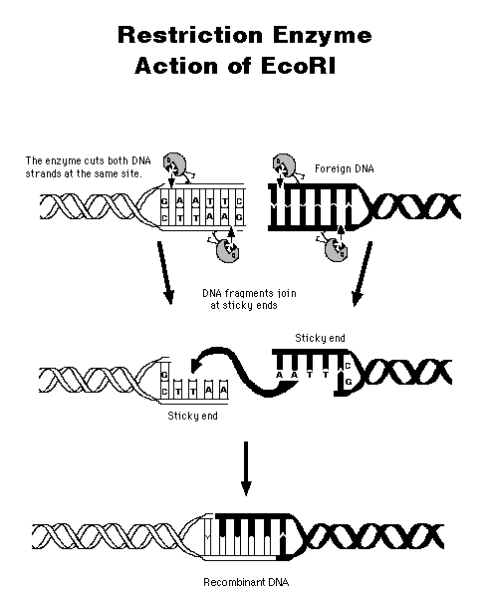
How are changes made to DNA?
Scientists use their knowledge of the structure of DNA to study and change it.
Use of restriction enzymes are used to edit DNA

Slide 14
Genetic Engineering
Genetic engineering makes changes in the DNA code of a living organism.
Analogy: Your favorite video game is run by a coded computer program. How would you go about rewriting parts of the program?
To make such changes, software engineers need to get the program out of the computer, read it, make changes in it and then put the modified code back into the game.

Slide 15
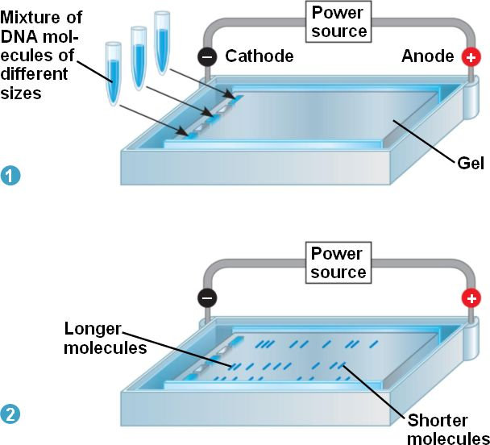
Step one: Get the DNA out of the cell. Extraction
Step two: Cut the DNA into small manageable fragments.
Remember that there is a lot of DNA inside of every nucleus! This is where we use restriciton enzymes
Step three: Separate the DNA fragments
Gel Electrophoresis is a tool that’s used to separate large and small DNA fragments (pieces).
http://www.bing.com/videos/watch/video/dna-fingerprinting/69e0e2c75d314a206d8f69e0e2c75d314a206d8f-420948083606?q=gel+electrophoresis&FROM=LKVR5&GT1=LKVR5&FORM=LKVR33
Virtual lab http://learn.genetics.utah.edu/content/labs/gel/

Slide 16
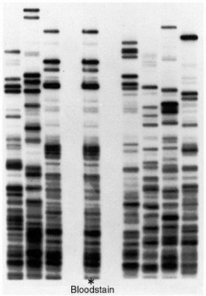
Using the DNA Sequence
Study Specific Genes
Compare Genes with other organisms
Discover gene combinations
Change DNA
The results from a gel electrophoresis can not only be used to change a DNA sequence, it can be used to identify individuals.
When would we want to use a DNA Fingerprint for identification purposes?
http://www.dnai.org/d/index.html?m=1 examples
Green River Killer Trailer
Using DNA to catch a killer video

Slide 17
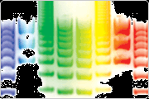
Reading the Sequence
Use a single strand of DNA in a test tube
Add DNA polymerase to make a new strand
New strand has chemical dye attached
New strands are different lengths according to which base was used

Slide 18
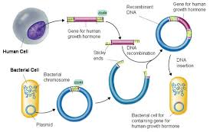
Cutting and Pasting
Recombinant DNA - a DNA Model produced by combining DNA from different sources

Slide 19
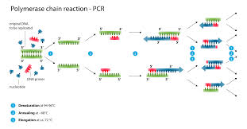
Making Copies
Polymerase Chain Reaction – make many copies of a particular gene

Slide 20
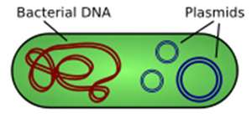
13-3 Cell Transformation
Remember Griffith’s experiment with the mice?
He discovered that bacteria can take in DNA from outside the cell and make it a part of their DNA, in a process he called transformation.
During transformation a cell takes DNA from outside the cell. The external DNA becomes a component of the cells DNA
In the lab, we must join the foreign DNA to a small circular DNA molecule known as a plasmid.
Plasmids are found naturally in some bacteria and is very useful for DNA transfer due to its ability to replicate foreign DNA.

Slide 21
13-3 Cell Transformation
A Recombinant Plasmid gets inside a bacteria cell by TRANSFORMATION
One way to use bacteria is to produce human growth hormone is to insert a human gene into bacterial DNA. The new combination of genes is then returned to a bacterial cell. The bacterial cell containing gene replicates over and over.

Slide 22
Transforming Bacteria
Plasmid - Foreign DNA is joined into a small circular DNA
Has DNA sequence that helps promote plasmid replication
Has a genetic marker – gene that makes it possible to distinguish bacteria that carry the plasmid
Genes for resistance to antibiotics, compounds that can kill bacteria are commonly used as markers

Slide 23
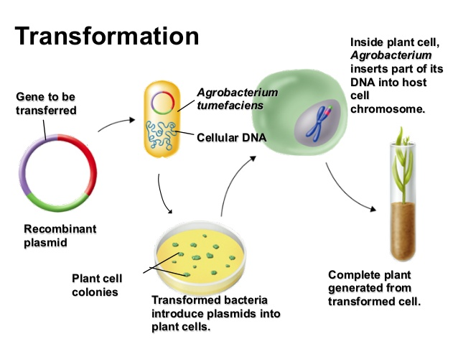
Transforming a Plant Cell
Many plant cells can be transformed using a process that takes advantage of a bacterium
Agrobacterium tumefaciens is used to introduce foreign DNA to Plants
If successful the DNA will become part of the cells chromosomes

Slide 24
Transforming a Plant Cell
Remove cell Wall
- cells may take up DNA on own
Or
DNA can be injected directly into cells
Then you can culture to produce DNA

Slide 25
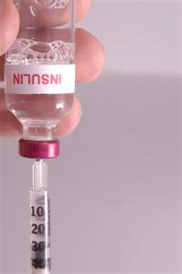
Making human insulin through genetic engineering
Insulin is a hormone that regulates glucose (sugar) in our blood.
Type 1 diabetes, the pancreas stops producing insulin (need injections);
Type 2 diabetes, the body becomes
resistant to the insulin the pancreas produces.
Let’s see how we can transform bacteria so they can make HUMAN insulin! making human insulin.
http://youtu.be/iMosKBs-v0E

Slide 26
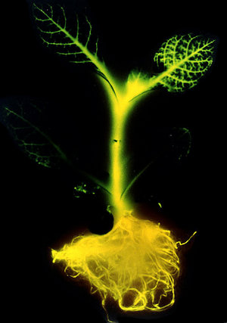
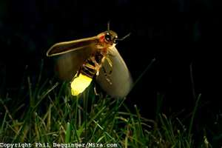
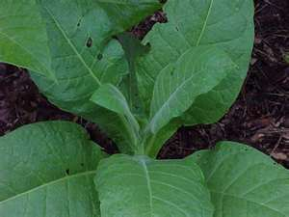
13-4 Applications of Genetic Engineering
Genetic engineering makes it possible to transfer DNA sequences, including whole genes, from one organism to another.
In 1986 researchers isolated the
gene for luciferase (allows fireflies
to glow) and inserted it into tobacco cells.
These plants glow in the dark!

Slide 27
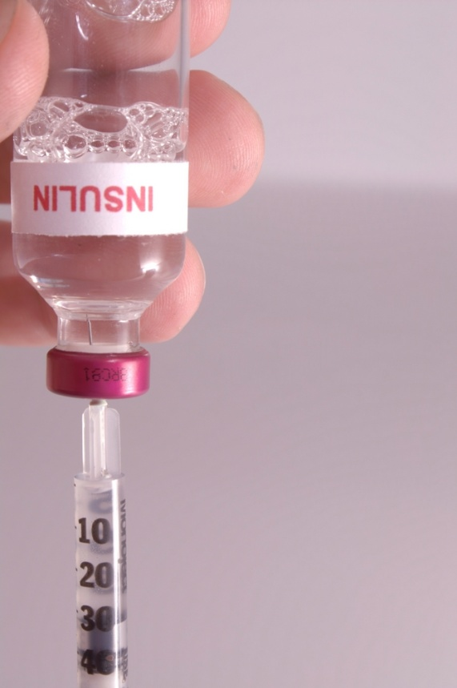
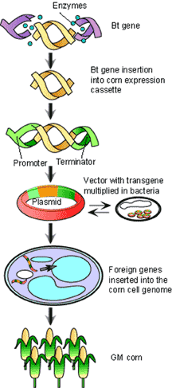
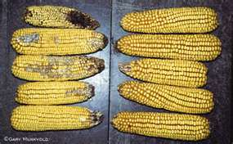
Transgenic Organisms
Transgenic organisms contain DNA from other species.
Because they reproduce rapidly and are easy to grow, transgenic bacteria now produce a host of important substances useful for health and industry.
http://www.powermediaplus.com/player.asp?mediaID=35534&segmentID=201099

Slide 28
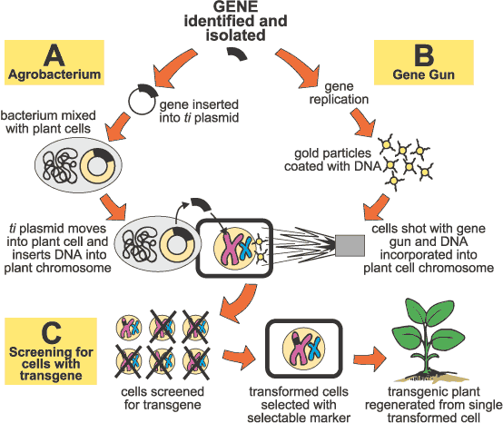
How to make transgenic plants

Slide 29
Transgenic Plants
More than half of our soy beans and more than 80% of the corn grown in the United States are genetically modified (GM).
Many of these plants contain genes that produce a natural insecticide so that crops do not need to be sprayed with chemicals.
Other crop plants have genes that enable them to withstand weed killing chemicals. (You may have seen this in the paper lately with sugar beets.)
Lets take a look at bT corn.
http://www.teachersdomain.org/resource/tdc02.sci.life.gen.btcorn/

Slide 30
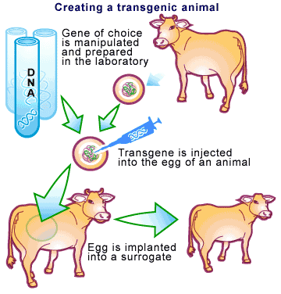
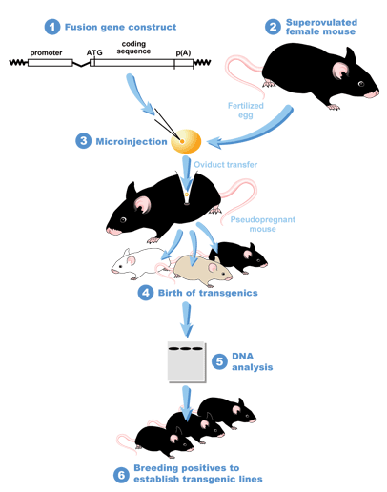
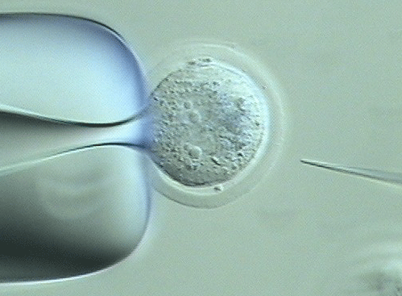
Transforming Animal Cells
Many egg cells are large enough that DNA can be directly injected into the nucleus.
Once inside the nucleus, enzymes usually responsible for DNA repair may help to insert the foreign DNA into the chromosomes of the injected cell.

Slide 31
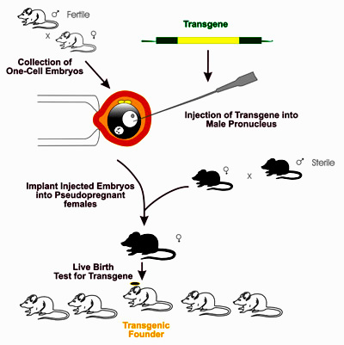
Transgenic Animals
Transgenic animals have been used to study genes and improve the food supply.
Mice have been produced with human genes that make their immune systems act similarly to those of humans so scientists can study how disease effects the immune system.
Some livestock have been given extra copies of growth hormone genes so they will grow faster and produce leaner meat.

Slide 32
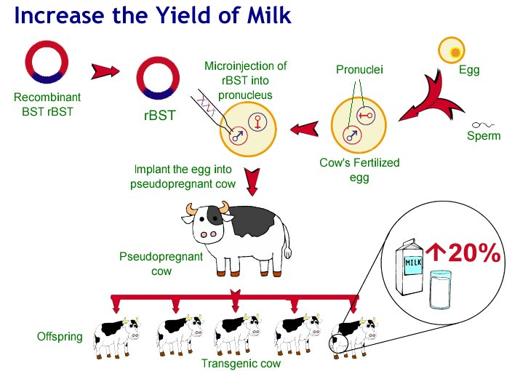
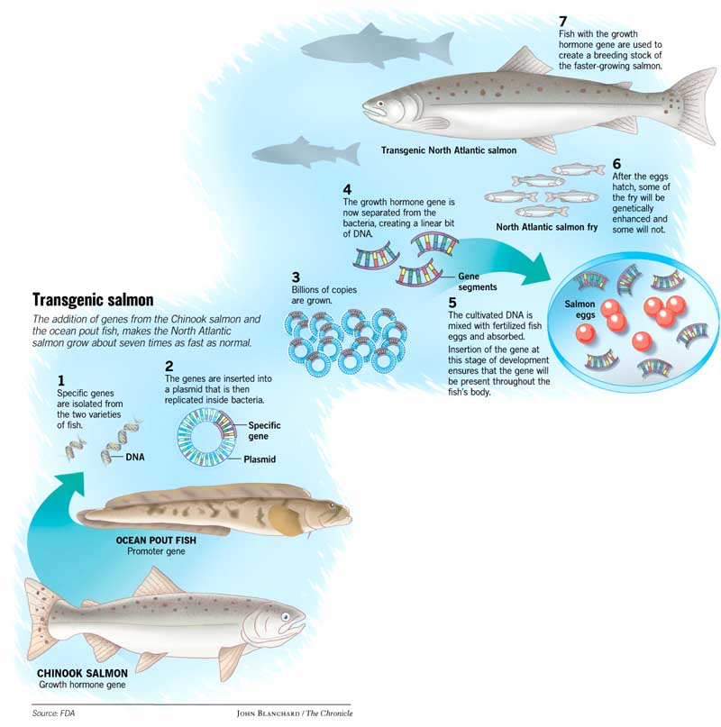

Slide 33
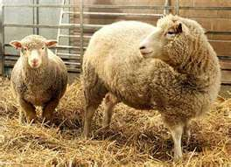
Cloning
Clone: a cell, or organism that is genetically identical to a single common ancestor.
Cloned colonies of bacteria and other microorganisms are easy to grow, but this is not always true of multicellular organisms.
In 1997 the “impossible” task of cloning a mammal was successfully accomplished by Scottish researcher Ian Wilmut.

Slide 34
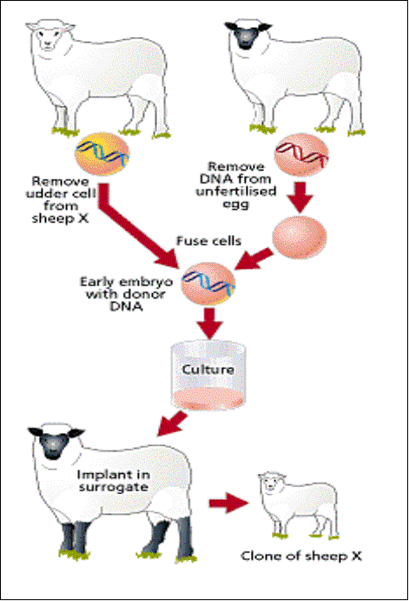
http://learn.genetics.utah.edu/content/tech/cloning/whatiscloning/
Animations
http://learn.genetics.utah.edu/content/tech/cloning/
Clone a mouse game
Dolly was the first mammal cloned from an adult cell (body cell – sheep's udder)

Slide 35
Genetic Engineering Video
Grab a Discussion questions sheet.
We are going to watch a video about genetic engineering.

Slide 36
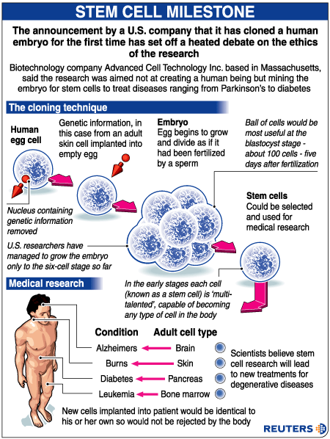
NOVA Movie Clip on growing
Organs
http://video.pbs.org/video/1754457671

