Slide 2
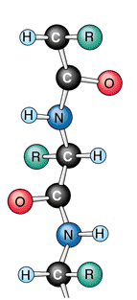
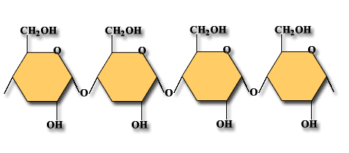
The Chemistry of Life Chapter 2-3
KEY CONCEPTS:
What macromolecules are important to living things?
What are the functions of each group of macromolecules?
http://www.uri.edu/pharmacy/faculty/cho/research.html
http://sps.k12.ar.us/massengale/biochemistry_notes_bi_ch3.htm
Phospholipid by RIEDELL

Slide 3
MACROMOLECULES important to living things!
_____________
_____________
_____________ (Fats, oils, waxes, steroids)
_____________
Carbohydrates
Proteins
Lipids
Nucleic acids

Slide 4
CARBOHYDRATES contain Carbon, Hydrogen, & Oxygen (with a ratio of 1 C: 2 H: 1 O) Molecules made up of only one ___________ molecule are called ________________
sugar
monosaccharides
Example:
GLUCOSE C₆H₁₂O₆
Image from: http://www.estrellamountain.edu/faculty/farabee/biobk/BioBookCHEM2.html

Slide 5
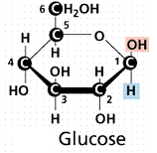
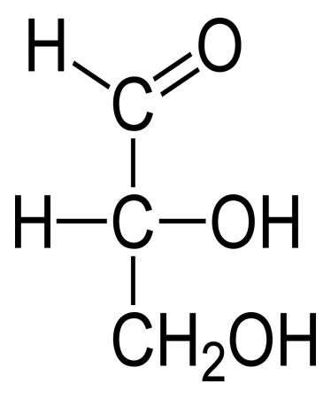
Important MONOSACCHARIDES
glyceraldehyde
C₆H₁₂O₆
C₅H₁₀O₅
C₃H₆O₃
2
1
ALL HAVE __C: __ H: __ O
1
http://www.estrellamountain.edu/faculty/farabee/biobk/BioBookCHEM2.html
http://www.estrellamountain.edu/faculty/farabee/biobk/BioBookCHEM2.html
http://en.wikipedia.org/wiki/File:D-glyceraldehyde-2D-Fischer.png

Slide 6
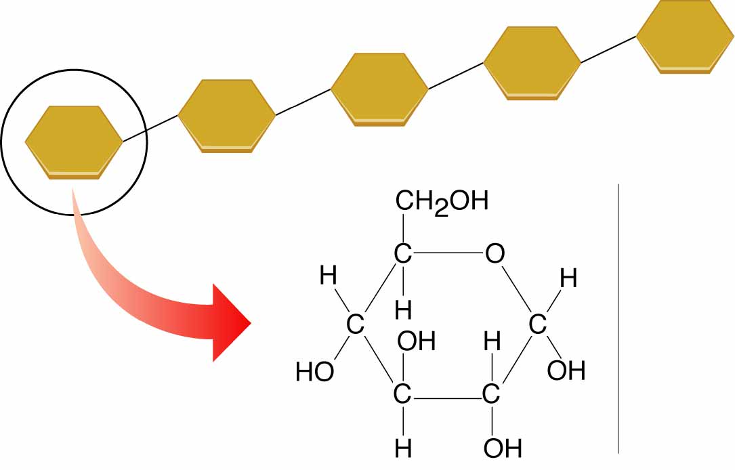
Monosaccharides can be joined together using
____________________ to make
________________ made of
___________ molecules.
dehydration synthesis
POLYSACCHARIDES
MANY SUGAR
Image from: Modern Biology; Pearson Prentice Hall © 2005

Slide 7
Examples of IMPORTANT POLYSACCHARIDES
___________
___________
___________
STARCH
CELLULOSE
GLYCOGEN
Image from: http://bioweb.wku.edu/courses/BIOL115/Wyatt/Biochem/Carbos/Carb_poly.gif

Slide 8
WHAT DO CARBOHYDRATES
DO?
Image from: http://www.sdada.org/Pyramid-Vegetarian-01.jpg

Slide 9
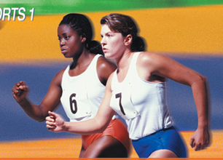
CARBOHYDRATES SUPPLY ENERGY
burn glucose
Cells _______________
for their ________ needs
energy
More about this in Chapters 7 and 9
Images from: http://www.miranda.com/library.en/Images/Pictures/girls-runners.jpg
http://www.estrellamountain.edu/faculty/farabee/biobk/BioBookCHEM2.html

Slide 10
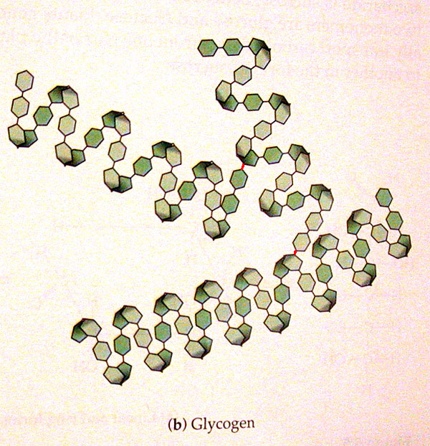
CARBOHYDRATES SUPPLY ENERGY
_______ cells _____________
as __________.
ANIMAL
store glucose
glycogen
Image from: http://www.msu.edu/course/lbs/145/smith/s02/graphics/campbell_5.6.gif

Slide 11
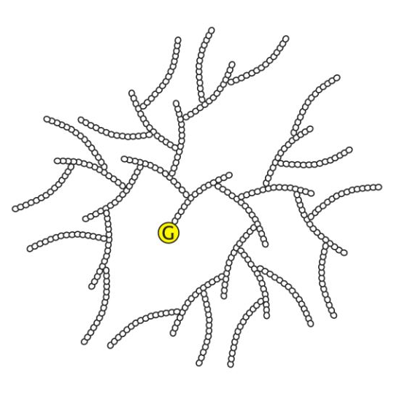
CARBOHYDRATES SUPPLY ENERGY
PLANT
________ cells
____________
as _________
store glucose
STARCH
Images from: http://bioweb.wku.edu/courses/BIOL115/Wyatt/Biochem/Carbos/Carb_poly.gif
http://oregonstate.edu/instruction/bb450/stryer/ch21/Slide24.jpg

Slide 12
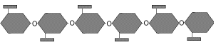
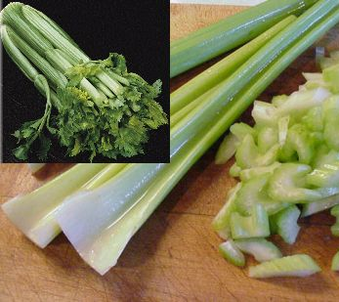
CARBOHYDRATES are STRUCTURAL
_____ also use glucose to make ___________
Cellulose makes plants _______
PLANTS
CELLULOSE
STURDY
Images from: http://bioweb.wku.edu/courses/BIOL115/Wyatt/Biochem/Carbos/Carb_poly.gif
http://www.kalyx.com/store/images/ApiumGraveolens9.jpg

Slide 13
CARBOHYDRATES HELP
with CELL IDENTIFICATION
GLYCOPROTEINS
_____________ (proteins with _____ attached) on the surface of cells help cells
_____________
sugars
recognize “self”
More about this in Chapters 7 and 11
Image from: http://faculty.clintoncc.suny.edu/faculty/Michael.Gregory/files/Bio%20101/Bio%20101%20Lectures/Membranes/membrane.htm

Slide 14
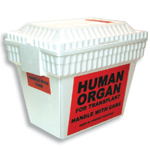
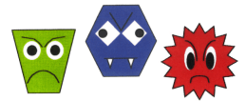
GLYCOPROTEINS are important for:
BLOOD TYPES
ORGAN REJECTION
RECOGNIZING GERMS
Images from:http://library.thinkquest.org/03oct/00737/bloodgp.jpg http://static.howstuffworks.com/gif/organ-transplant-ch.jpg http://www.imac.auckland.ac.nz/vaccines/vacc_graph.htm

Slide 15
MACROMOLECULES important to living things!
_____________
_____________
_____________ (Fats, oils, waxes, steroids)
_____________
Carbohydrates
Proteins

Slide 16
PROTEINS contain: ________, _________, _______, and _________ and are built from __________ subunits
Carbon
Hydrogen
Oxygen
Nitrogen
AMINO ACID
Image by: Riedell

Slide 17
Figure 2-16 Amino Acids
Section 2-3
Amino group
Carboxyl group
General structure
Alanine
Serine

Slide 18
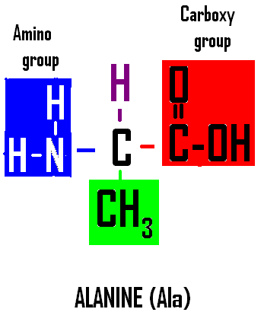
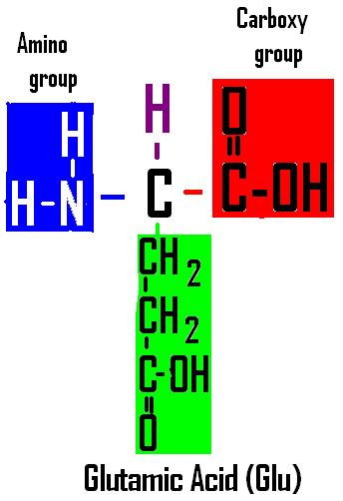
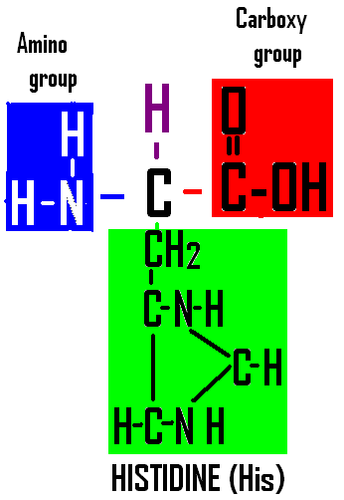
_______ is _________ for each AMINO ACID
R-group
different
20 different
There are _____________
____________ used by cells
to ________________
AMINO ACIDS
make proteins

Slide 19
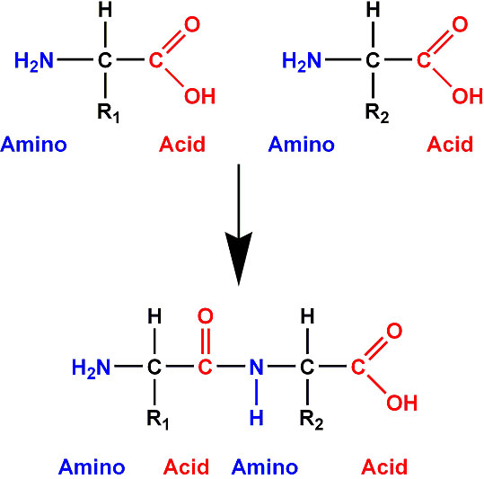
What kind of chemical reaction do you think is used to join amino acid subunits to make proteins?
____________
____________
dehydration
synthesis
http://www.chemicalconnection.org.uk/chemistry/topics/images/pp3.jpg

Slide 20
The __________ of amino acids in the protein chain is determined by the ______________
sequence
DNA code
Images from: http://www.emc.maricopa.edu/faculty/farabee/BIOBK/BioBookCHEM2.html

Slide 21
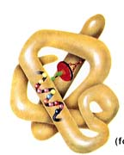
Proteins have a 3D shape
“Like wants to be
near like”
hydrophobic
The _____________ and ______________
____________ make it fold up.
hydrophilic
R groups
Van der Waals
Then ____________ forces & __________ bonds hold it
together.
hydrogen
Image from: http://www.tvdsb.on.ca/saunders/courses/online/SBI3C/Cells/Protein-Structure03.jpg

Slide 22
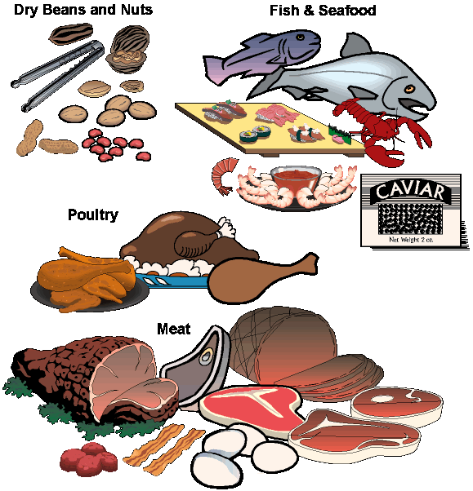
WHAT DO PROTEINS
DO?
Image from: http://www.drpbody.com/images/meatpoultryfish.gif

Slide 23
__________________ (SUGARS attached to ________)
GLYCOPROTEINS
proteins
on the surface of cells
help cells ____________
recognize “self”
More about this in Chapters 7 and 11
Image from: http://faculty.clintoncc.suny.edu/faculty/Michael.Gregory/files/Bio%20101/Bio%20101%20Lectures/Membranes/membrane.htm

Slide 24
GLYCOPROTEINS are important for:
BLOOD TYPES
ORGAN REJECTION
RECOGNIZING GERMS
Images from:http://library.thinkquest.org/03oct/00737/bloodgp.jpg http://static.howstuffworks.com/gif/organ-transplant-ch.jpg http://www.imac.auckland.ac.nz/vaccines/vacc_graph.htm

Slide 25
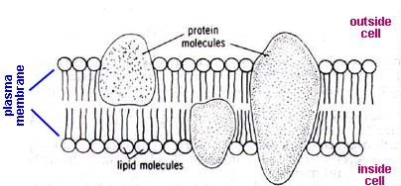
STRUCTURAL
PROTEINS ARE ___________
_______ and ___________
are _______________ in
_____________
Proteins
Phospholipids
main components
cell membranes
More about this in Chapters 7
Image from: http://www.borg.com/~lubehawk/cell.htm#plcell_dia_ques

Slide 26
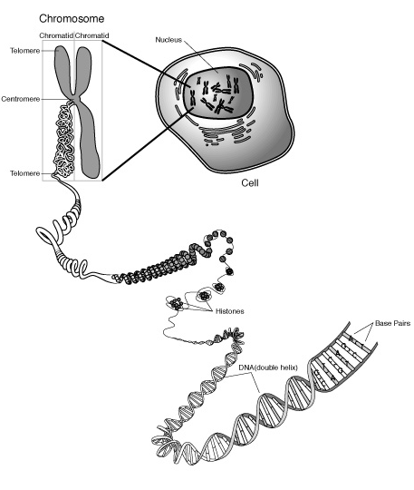
PROTEINS ARE STRUCTURAL
Proteins
_______ with ______ to wrap up into ___________
Combine
DNA
chromosomes
More about this in Chapters 7 and 10
Image from: http://employees.csbsju.edu/hjakubowski/classes/ch331/dna/chromosome.gif

Slide 27
Image from: http://www.hillstrath.on.ca/moffatt/bio3a/digestive/enzanim.htm
PROTEINS ACT AS ENZYMES
__________
______ chemical _____________ faster
ENZYMES
help
reactions happen
More about this in Chapters 7,8,9 and 12

Slide 28
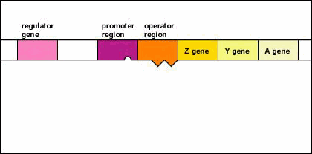
PROTEINS _______________
CONTROL GENES
by _______ them ____ and ____
turning
ON
OFF
More about this in Chapters 12
http://www.cat.cc.md.us/courses/bio141/lecguide/unit4/genetics/protsyn/regulation/ionoind.html

Slide 29
PROTEINS ____________
Images from: http://www.imac.auckland.ac.nz/vaccines/vacc_graph.htm
FIGHT GERMS
_____________ are proteins
ANTIBODIES
ANTIBODIES ATTACK & KILL THEM

Slide 30
PROTEINS help in _________
TRANSPORT
Proteins in ________________ help ___________ _________ of cells
cell membranes
move molecules
in and out
More about this in Chapters 7 and 11
Image from: http://bio.winona.msus.edu/berg/ANIMTNS/FacDiff.htm

Slide 31
PROTEINS help in Transport
HEMOGLOBIN
_____________
in ____________ ___________ to all ____ cells
red blood cells
carries oxygen
body
More about this in Chapter 11
Image from: http://www.cellsalive.com/pics/cover4.gif

Slide 32
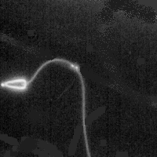
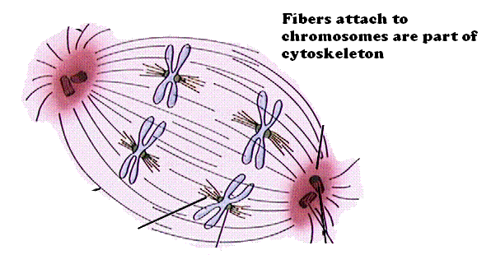
PROTEINS help with __________________
MOVEMENT
Images from: http://en.wikipedia.org/wiki/Image:Arm_flex_supinate.jpg
http://www.emc.maricopa.edu/faculty/farabee/BIOBK/BioBookmito.html
MUSCLES
Body _________, ____________, and __________________ are made of PROTEINS
FLAGELLA
MITOTIC SPINDLE
More about this in Chapters 7 and 10

Slide 33
PROTEINS act as ___________
HORMONES
Eating food puts GLUCOSE in your bloodstream
INSULIN
________________ is a protein hormone that ________________________
controls blood sugar
Image from: http://www.cibike.org/CartoonEating.gif

Slide 34
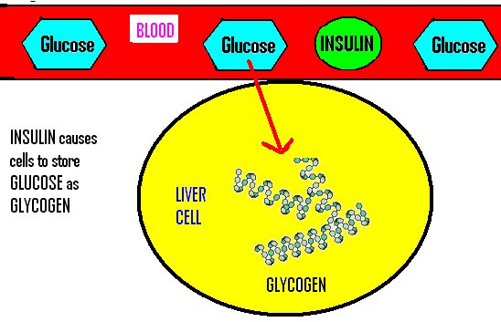
INSULIN
__________
causes cells
to
________
________
store glucose
Insulin function image by Riedell using Glycogen image modified from: http://www.msu.edu/course/lbs/145/smith/s02/graphics/campbell_5.6.gif

Slide 35
DIABETES
People with ____________ can’t make _______________ and their
___________ stays _________ because cells ___________ glucose.
Insulin ______ can
replace
the missing insulin
insulin
blood sugar
TOO high
can’t store
shots
Image modified from: http://sonya.lanecurrent.net/Health/Images/meds.gif

Slide 36
MACROMOLECULES important to living things!
_____________
_____________
_____________
(Fats, oils, waxes, steroids)
4. _____________
Carbohydrates
Proteins
Lipids

Slide 37
Lipids are made mainly from __________ and ___________ (very ___________ atoms)
Carbon
Hydrogen
few oxygen
Images: http://www.emc.maricopa.edu/faculty/farabee/BIOBK/BioBookCHEM2.html
http://media.pearsoncmg.com/bc/bc_campbell_essentials_2/cipl/03/HTML/source/03-16-steroids-nl.htm

Slide 38
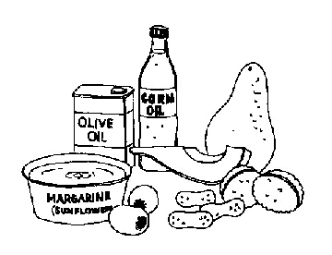
WHAT DO LIPIDS
DO?
Image from: http://www.umassmed.edu/diabeteshandbook/chap06.htm

Slide 39
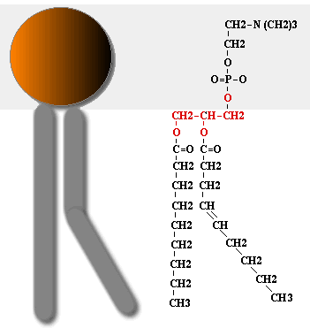
___________________ (lipid tails + glycerol/phosphate head)
PHOSPHOLIPIDS
Polar head
________
_________
Non-polar
tails
http://asm.wku.edu/pix/cells/P-lipid2.gif
Arrow: http://www.gifanimations.com/action/ImageDisplay/1/2/11/next

Slide 40
PHOSPHOLIPIDS & STEROIDS
join with PROTEINS to _______________________
make cell membranes
More about this in Chapters 7
Image from: http://www.borg.com/~lubehawk/cell.htm#plcell_dia_ques

Slide 41
LIPIDS can be used to _________ ________
store energy
long term
Image from: http://blackmovie.us/movie/Fat.Albert/fat.albert.movie.jpg

Slide 42
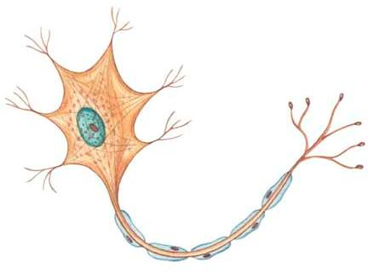
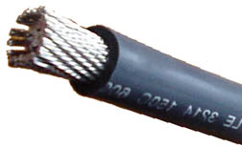
LIPIDS __________
INSULATE
LIPIDS form
__________
(insulation
on ______ cells)
myelin
nerve
http://www.roweindustries.com/braidless-wire.html
http://www.alongnaturestrail.com/the_nervous_system.html

Slide 43
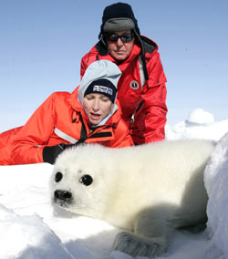
LIPIDS insulate
Help
__________
___________
(helps with
___________)
maintain
body heat
homeostasis
http://www.heraldsun.news.com.au/common/imagedata/0,1658,5116542,00.jpg

Slide 44
LIPIDS can be _____________
HORMONES
STEROIDS
___________ like
_____________, ___________, and _____________are steroid hormones involved in _____________
TESTOSTERONE
ESTROGEN
PROGESTERONE
reproduction
http://media.pearsoncmg.com/bc/bc_campbell_essentials_2/cipl/03/HTML/source/03-16-steroids-nl.htm

Slide 45
MACROMOLECULES important to living things!
_____________
_____________
_____________ (Fats, oils, waxes, steroids)
_____________
Carbohydrates
Proteins
Lipids
Nucleic acids

Slide 46
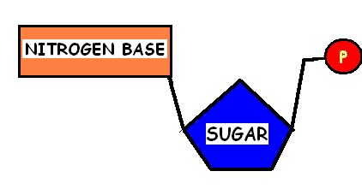
NUCLEIC ACIDS contain: _______, _________, _______, ___________ and ________
are built from ___________ subunits
CARBON
NUCLEOTIDE
HYDROGEN
OXYGEN
PHOSPHORUS
NITROGEN
Image by: Riedell

Slide 47
NUCLEOTIDES
Image by: Riedell
sugar
Changing the _______ &
and ____________ produces ___________nucleotide subunits
nitrogen base
different
Arrow: http://www.gifanimations.com/action/ImageDisplay/1/2/11/next

Slide 48
Image by: Riedell
NUCLEOTIDES
2 SUGARS can be used:
____________
(_____)
DEOXYRIBOSE
________
(____)
RIBOSE
DNA
RNA
Sugars: http://fig.cox.miami.edu/~cmallery/150/chemistry/fig5x27b.jpg
Arrow: http://www.gifanimations.com/action/ImageDisplay/1/2/11/next

Slide 49
5 NITROGEN BASES
ADENINE
_____________ = A
_____________ = G
_____________ = C
_____________ = T (only in DNA)
_____________ = U (only in RNA)
GUANINE
CYTOSINE
THYMINE
URACIL

Slide 50
DNA
MAKING _____ USES:
These
Nitrogen bases:
_____________
NO __________
Image by: Riedell
A, T, C, or G
uracil
SUGAR
= _______________
DEOXYRIBOSE
Sugars: http://fig.cox.miami.edu/~cmallery/150/chemistry/fig5x27b.jpg

Slide 51
Making _____ uses”
RNA
These
Nitrogen bases
_____________
NO __________
Image by: Riedell
A, U, C, or G
thymine
SUGAR
= __________
RIBOSE
Sugars: http://fig.cox.miami.edu/~cmallery/150/chemistry/fig5x27b.jpg

Slide 52
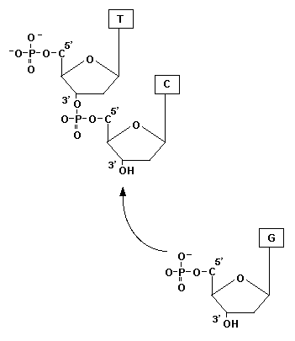
What kind of chemical reaction do you think is used to join nucleotide subunits to make nucleic acids?
____________
____________
dehydration
synthesis
http://avery.rutgers.edu/WSSP/StudentScholars/project/archives/onions/orien.html

Slide 53
2 KINDS of NUCLEIC ACIDS
Deoxyribonucleic acid
DNA= __________________
DOUBLE
______________ STRANDED
SUBUNITS: A, T, G, C (No U)
Image from: http://www.tokyo-med.ac.jp/genet/picts/dna.jpg

Slide 54
DNA molecule forms a HELIX or “twisted ladder”
ADENINE
THYMINE
__________ bonds _________
with
_________ bonds __________
with
CYTOSINE
GUANINE
Image from: http://evolution.berkeley.edu/evosite/evo101/images/dna_bases.gif

Slide 55
2 KINDS of NUCLEIC ACIDS
Ribonucleic acid
RNA= ________________
_________STRANDED
Subunits:
A, U, G, C (NO T)
SINGLE
Image from: http://www.makingthemodernworld.org.uk/learning_modules/biology/01.TU.03/illustrations/01.IL.09.gif

Slide 56
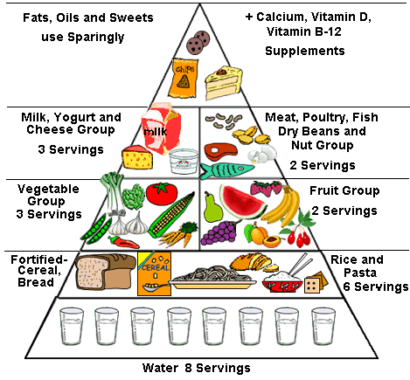
WHAT DO NUCLEIC ACIDS
DO?
Image from: http://www.ohsu.edu/healthyaging/caregiving/images/food_pyramid.gif

Slide 57
ONE SPECIAL KIND of NUCLEOTIDE is used by cells to _______________________
Store and transport ENERGY
Image by: Riedell
ATP
RIBOSE
Sugar =_____________
Nitrogen base =__________
+___ PHOSPHATE groups
RIBOSE
ADENINE
3
More about this in Chapters 7, 8, 9,10, and 12

Slide 58
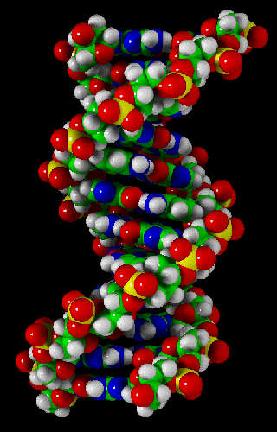
Image from: http://sbchem.sunysb.edu/msl/dna.gif
DNA
_______
_________
__________
in cells
Stores
genetic
information
More about this in Chapters 7, 10, 11, 12, and 14

Slide 59
Image from: Pearson Education Inc, publishing as Pearson Prentice Hall. All rights reserved
RNA
_______________________ __________ out ________
Helps with _________________
CARRIES INFORMATION
from DNA
to cell
PROTEIN SYNTHESIS
More about this in Chapters 7 and 12

Slide 60
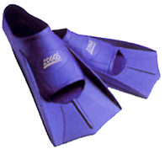
MAKE CONNECTIONS
How are the SHAPES of the molecules you learned about related to their FUNCTIONS?
http://www.gb-sports.co.uk/zoggsfinz.jpg
http://www.webweaver.nu/clipart/img/misc/construction/hammer-animation.gif

Slide 61
Concept Map
Section 2-3
Carbon
Compounds
include
that consist of
that consist of
that consist of
that consist of
which contain
which contain
which contain
which contain

Slide 62
Concept Map
Section 2-3
Carbon
Compounds
include
Carbohydrates
Lipids
Nucleic acids
Proteins
that consist of
that consist of
that consist of
that consist of
Sugars and
starches
Fats and oils
Nucleotides
Amino Acids
which contain
which contain
which contain
which contain
Carbon,
hydrogen,
oxygen
Carbon,
hydrogen,
oxygen
Carbon,hydrogen,
oxygen, nitrogen,
phosphorus
Carbon,
hydrogen,oxygen,
nitrogen,

Slide 63
SOUTH DAKOTA CORE SCIENCE STANDARDS
LIFE SCIENCE: Indicator 1: Understand the fundamental structures,
functions, classifications, and mechanisms found
in living things
9-12.L.1.1. Students are able to relate cellular functions and processes to specialized structures within cells.

Slide 64
SOUTH DAKOTA ADVANCED STANDARDS
LIFE SCIENCE
Indicator 1: Understand the fundamental structures, functions, classifications, and mechanisms found in living things.
9-12.L.1.2A. (Synthesis) Describe how living systems use biofeedback mechanisms to maintain homeostasis.
9-12.L.1.3A. (Synthesis) Explain how gene expression regulates cell growth and differentiation.
Examples:
Tissue formation Development of new cells from original stem cells
9-12.L.1.4A. (Application) Identify factors that change the rates of enzyme catalyzed reactions.

Slide 65
Core High School Life Science Performance Descriptors
High school students performing at the ADVANCED level: | INTRODUCTION TO BE ABLE TO DO THE FOLLOWING LATER: explain the steps of photophosphorylation and the Calvin Cycle; analyze chemical reaction and chemical processes involved in the Calvin Cycle and Krebs Cycle; predict the function of a given structure; predict the outcome of changes in the cell cycle; explain how protein production is regulated; predict how homeostasis is maintained within living systems; predict how traits are transmitted from parents to offspring;
High school students performing at the PROFICIENT level: | INTRODUCTION TO BE ABLE TO DO THE FOLLOWING LATER: describe and give examples of chemical reactions required to sustain life (hydrolysis, dehydration synthesis, photosynthesis, cellular respiration, ADP/ATP, role of enzymes); describe the relationship between structure and function (cells, tissues, organs, organ systems, and organisms); compare and contrast the cell cycles in somatic and germ cells; tell how DNA determines protein formation; explain how homeostasis is maintained within living systems; explain how traits are transmitted from parents to offspring; predict how life systems respond to changes in the environment;
High school students performing at the BASIC level | INTRODUCTION TO BE ABLE TO DO THE FOLLOWING LATER: name chemical reactions required to sustain life (hydrolysis, dehydration synthesis, photosynthesis, cellular respiration, ADP/ATP, role of enzymes); recognize that different structures perform different functions; describe the life cycle of somatic cells; identify DNA as the structure that carries the genetic code; define homeostasis;

