Slide 1
Ch 5 – How ecosystems Work
Section 2 – The Cycling of Materials

Slide 2
The Carbon Cycle
http://youtu.be/U3SZKJVKRxQ

Slide 3
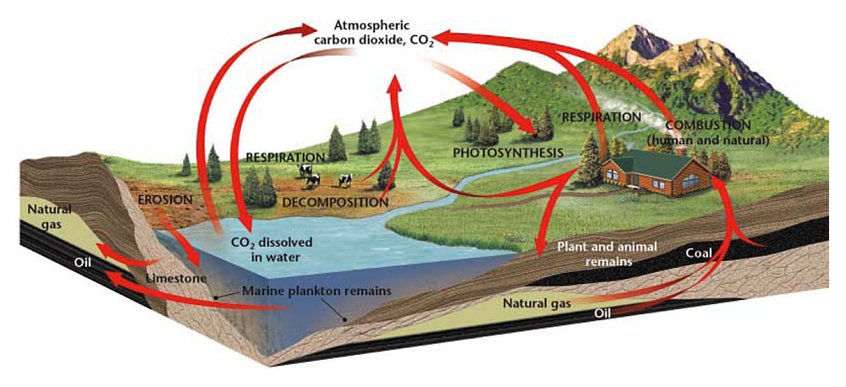
The Carbon Cycle
- Is the movement of carbon from the nonliving environment into living things and back
- Carbon is the essential component of proteins, fats, and carbohydrates, which make up all organisms

Slide 4
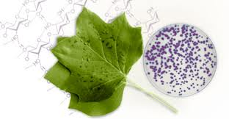
The Carbon Cycle – Short term
- Carbon exists in air, water, and living organisms.
- Producers convert carbon dioxide in the atmosphere into carbohydrates during photosynthesis
- Consumers obtain carbon by eating the producers that made the carbohydrates

Slide 5
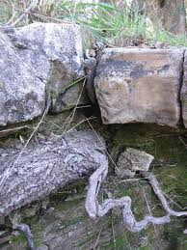
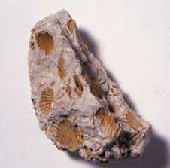
The Carbon Cycle short term
- During cellular respiration, some of the carbon is released back into the atmosphere as carbon dioxide
)

Slide 6
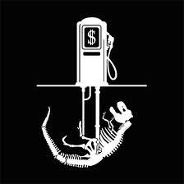
The Carbon Cycle – long term
- Some carbon is stored in limestone, forming one of the largest “carbon sinks” on Earth (carbon reservoir
-Carbon stored in the bodies of organisms gets released into the soil or air when the organisms dies
- They can form deposits of coal, oil, or natural gas (known as fossil fuels)
- Fossil fuels store carbon left over from
bodies of organisms that dies millions of
years ago

Slide 7
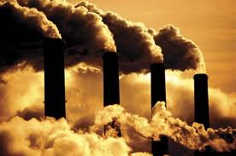
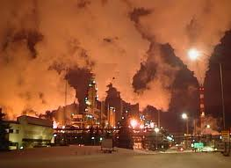
How Humans Affect the Carbon Cycle
- Humans burn fossil fuels, releasing carbon into the atmosphere
- The carbon returns to the atmosphere as carbon dioxide

Slide 8
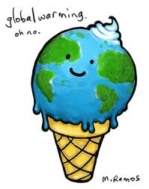
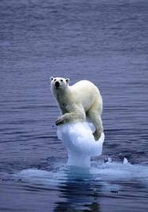
How Humans Affect the Carbon Cycle
- Increased levels of carbon dioxide may contribute to global warming
- Global warming is an increase in the temperature of the Earth.

Slide 9
The Nitrogen Cycle
http://youtu.be/ZaFVfHftzpI

Slide 10
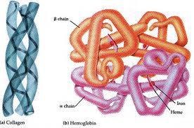
The Nitrogen Cycle
- Is the process when nitrogen circulates among the air, soil, water, plants, and animals in an ecosystem
- Nitrogen makes up 78 percent of the gases in the atmosphere
- All organisms need nitrogen to build proteins

Slide 11
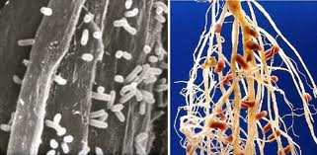
The Nitrogen Cycle
- Nitrogen must be altered, or fixed, before organisms can use it
- Only a few species of bacteria can fix atmospheric nitrogen into chemical compounds that can be used by other organisms
- These bacteria are known as “nitrogen-fixing” bacteria

Slide 12
The Nitrogen Cycle
- Nitrogen-fixing bacteria are bacteria that convert atmospheric nitrogen into ammonia
- These bacteria live within the roots of plants called legumes (beans, peas, and clover)
- The bacteria use sugar provided by the legumes to produce nitrates
- Excess nitrogen fixed by the bacteria is released into the soil

Slide 13
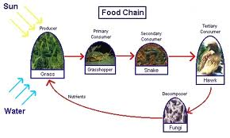
Decomposers and the Nitrogen Cycle
- Nitrogen stored in the bodies of living things is returned to the cycle once those organisms die
- Decomposers break down decaying plants and animals and their wastes
- Then other bacteria transform some of it into nitrogen gas, and return it to the atmosphere

Slide 14
3 Stages of the Nitrogen Cycle
- Nitrogen stored in the bodies of living things is returned to the cycle once those organisms die
- Decomposers break down decaying plants and animals and their wastes
- Then other bacteria transform some of it into nitrogen gas, and return it to the atmosphere

Slide 15
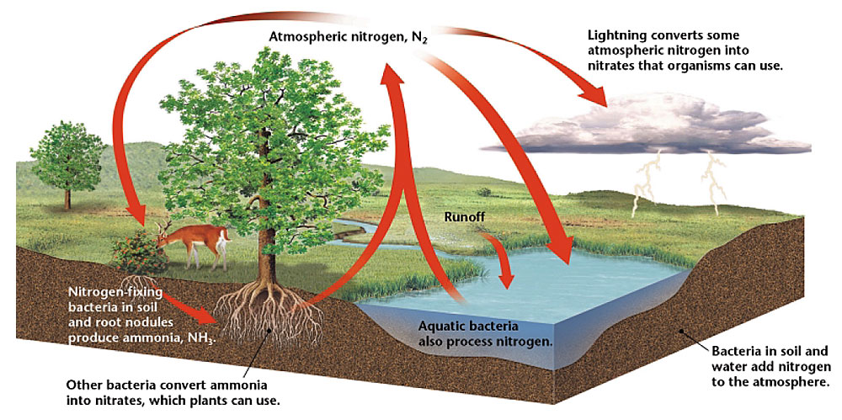
The Nitrogen Cycle

Slide 16
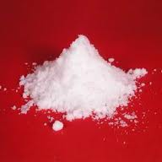
The Phosphorus Cycle
http://youtu.be/3iwL24oVpH4

Slide 17
The Phosphorus Cycle
- Phosphorus is an element that is part of many molecules that make up the cells of living organisms
- Plants get phosphorus from soil and water
- Animals get their phosphorus by eating plants or other animals that have eaten plants

Slide 18
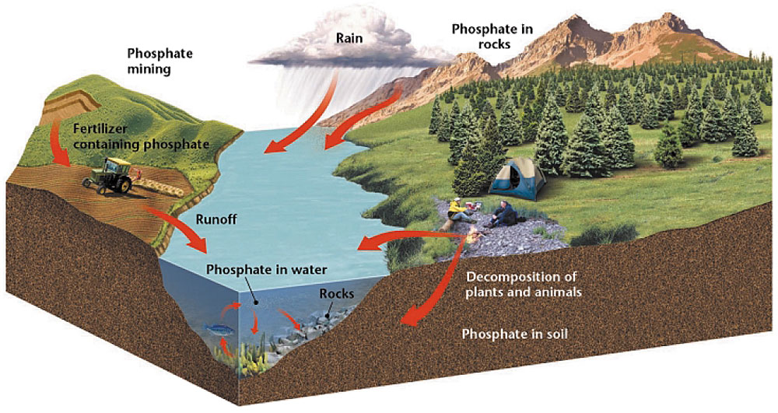
The Phosphorus Cycle
- The movement of phosphorus in different chemical forms from the environment, to organisms and then back to the environment

Slide 19
The Phosphorus Cycle
- Phosphorus enters soil and water when rocks erode
- Small amounts of phosphorus dissolve as phosphates and move into the soil
- Plants absorb phosphates in the soil through their roots
- Some phosphorus washes off the land and ends up in the ocean
- Many phosphate salts are not soluble in water SO they sink to the bottom and accumulate as sediment

Slide 20
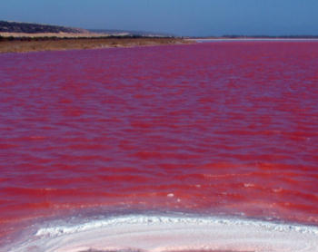
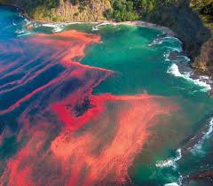
Fertilizers and the Nitrogen and Phosphorus Cycles
- Fertilizers contain both nitrogen and phosphorus.
- Excessive amounts of fertilizer can enter land and aquatic ecosystems through runoff
- Excess nitrogen and phosphorus causes rapid growth of algae (a protist)
- Excess algae can deplete an aquatic ecosystem of important nutrients such as oxygen, on which fish and other aquatic organisms depend

Slide 21
Algae Bloom
http://youtu.be/9MXl6OhIVu8

Slide 22
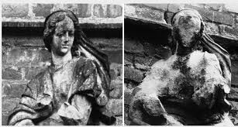
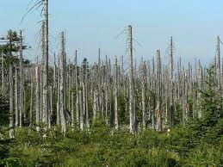
Acid Precipitation
- When fuel is burned, large amounts of nitric oxide is release into the atmosphere
- In the air, nitric oxide can combine with oxygen and water vapor to form nitric acid
- Dissolved in rain or snow, the nitric acid falls as acid precipitation
- Acid precipitation can eat away at buildings, and kill plant life

Slide 23
Recap:
The carbon cycle is:
The nitrogen cycle is:
The phosphorous cycle is:
Fertilizer does:
Acid precipitation does:

