Slide 1
Ch 5 – how ecosystems work
Section 3 – How Ecosystems Change

Slide 2
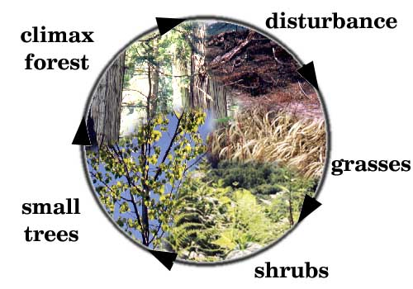
Ecological Succession
- Ecosystems are constantly _____________
- Ecological succession is a __________ process of change and replacement of the types of species in a community
- Each new community that arises often makes it __________ for the previous community to survive

Slide 3
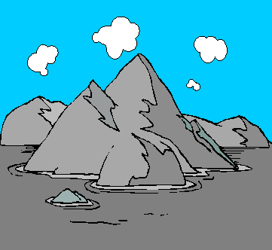
_________Succession
- A type of succession that occurs on a surface where ___ ecosystem existed before
- It begins in an area that previously did not support ____
- Primary succession can occur on rocks, ______, or sand dunes

Slide 4
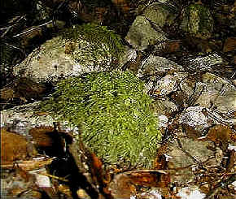
Ecological Succession
__________species colonize an uninhabited area and ________an ecological cycle where many other species can establish themselves
- Over time, a pioneer species will make the new area __________for other species

Slide 5
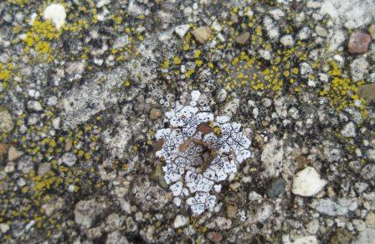
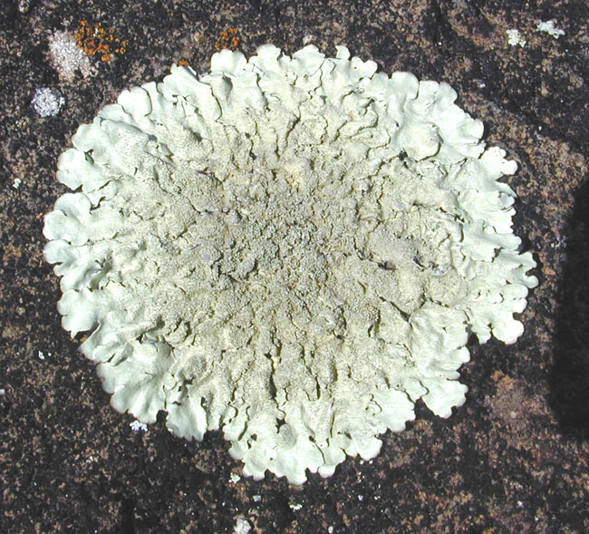
Ecological Succession
- The first pioneer species to colonize bare rock will probably be bacteria and _________ , which can live without __________
- The growth of lichens breaks down the _____, which with the action of water, begins to form soil.

Slide 6
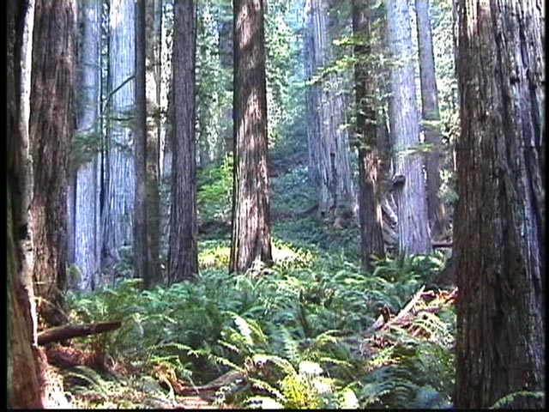
Ecological Succession
- A ____________________is the final, stable community in ____________with the environment
- Even though a climax community may change in small ways, this type of community may remain the same through time if it is not ____________

Slide 7
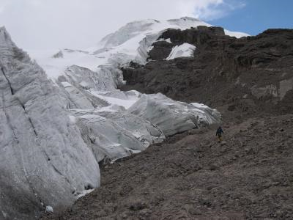
Ecological Succession
- Primary succession can occur:
- on new islands created by ________eruptions
- in areas exposed when a ________retreats any other surface that has not previously supported life
- Primary succession is very _____ because it begins where there is no soil

Slide 8
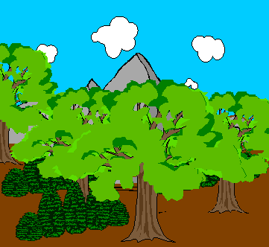
___________Succession
- Occurs on a surface where an ecosystem has __________ existed
- One community ________ another community that has been partially or totally destroyed
- Secondary succession can occur in any ecosystem that has been disturbed or disrupted by anyone or anything
____________________________

Slide 9
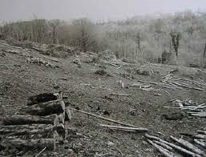
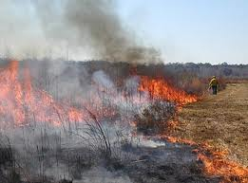
Ecological Succession
- Natural fires caused by ___________ are a necessary part of secondary succession in some communities
- _________ forest fires remove accumulations of brush and deadwood that could cause major fires
- Some animal species depend on occasional fires because they feed on the ____________ that sprouts after a fire has cleared the land

Slide 10
Ecological Succession
- ____________ succession is a type of secondary succession that occurs when farmland is abandoned
- When a farmer stops cultivating a field, grasses and ______quickly grow and cover the abandoned land
- Over time, taller plants, such as ______________ grasses, shrubs, and trees take over the area

Slide 11
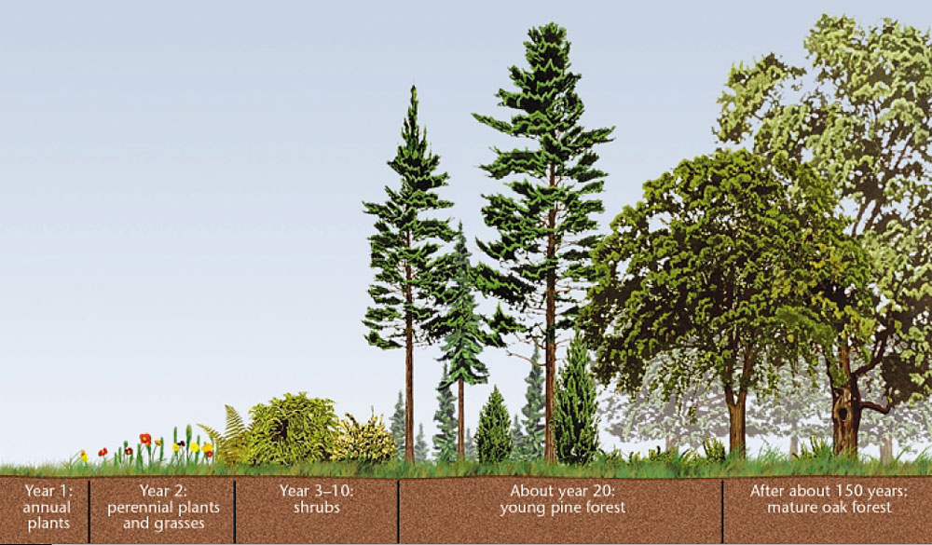
Ecological Succession

