Slide 1
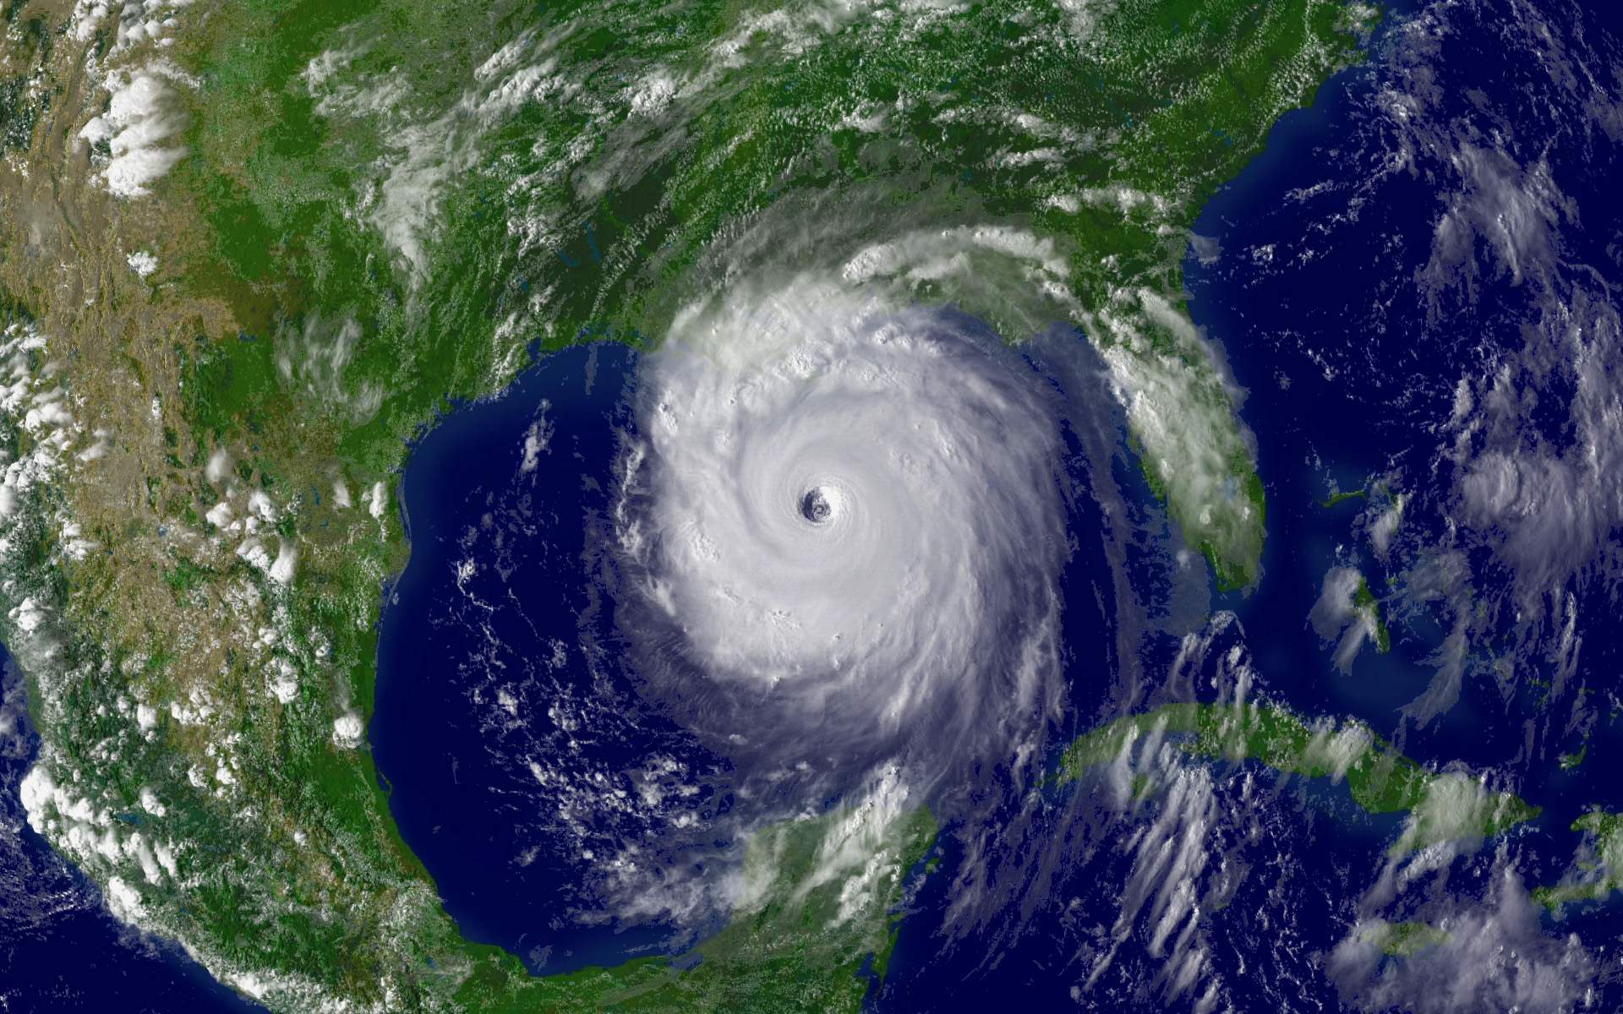
Global Climate Change
“Warming of the climate system is unequivocal.” – International Panel on Climate Change, Fourth Report

Slide 2
Global Climate Change Lecture Powerpoint
Based on the textbooks:
Living in the Environment by Miller
Environmental Science by Cunningham & Cunningham
More teaching resources and lectures available here: www.docstoc.com/profile/jamesdauray
Student notes outline available for this lecture here:
http://www.docstoc.com/docs/69621790/Global-Warming--Climate-Change-Notes-Outline
Lecture Powerpoint written by James Dauray

Slide 3
ATMOSPHERE AND CLIMATE
Weather - A description of short-term physical conditions of the atmosphere.
Climate - A description of the long-term weather pattern in a particular area.
Temperature
Humidity
Wind
Rainfall

Slide 4
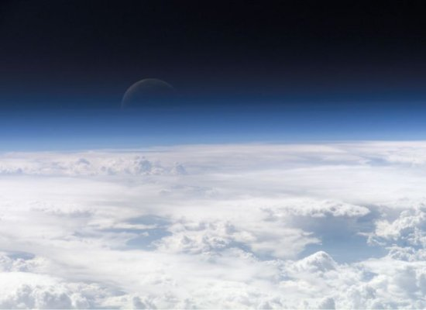
The Atmosphere
The atmosphere is a thin layer of gasses surrounding the Earth.
If the Earth were the size of an apple, the atmosphere would be the skin.

Slide 5
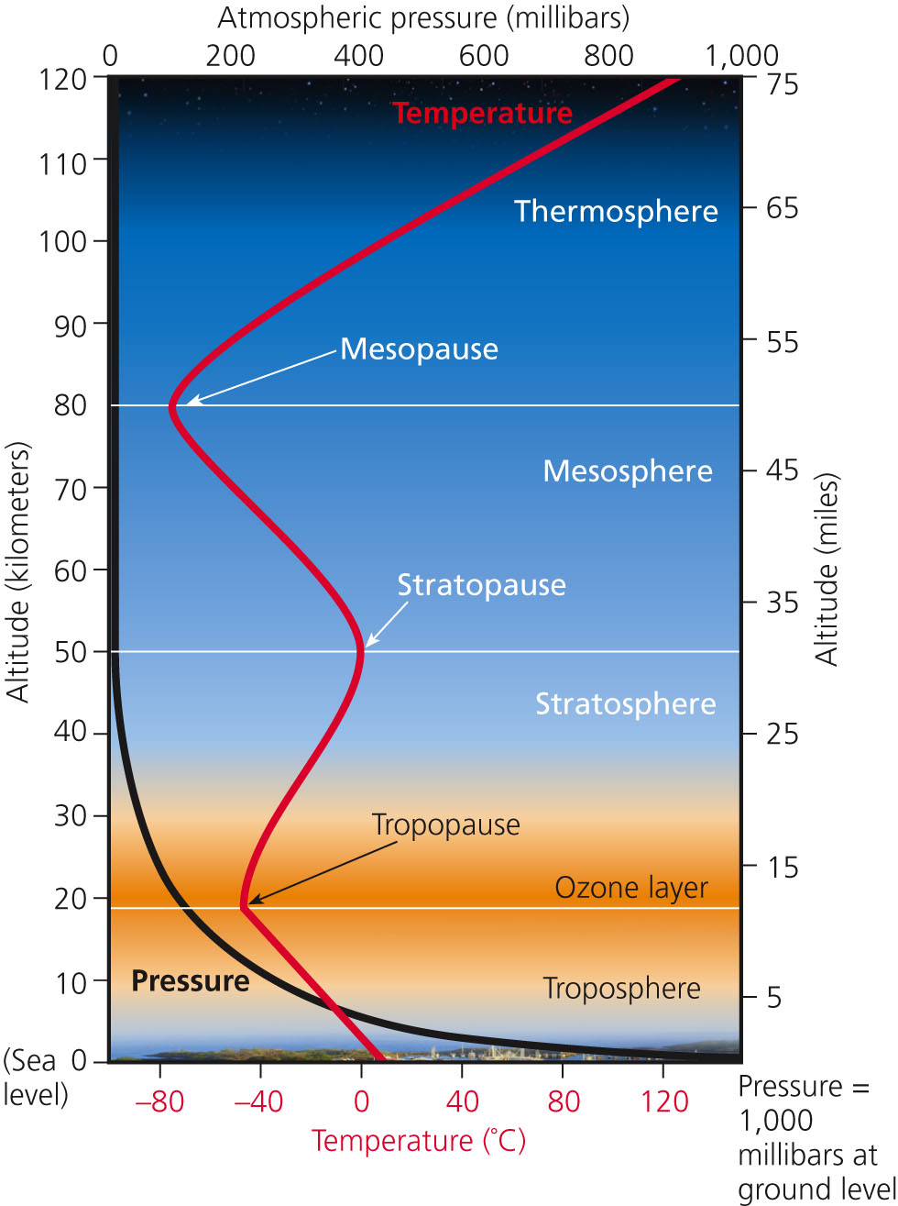
Layers of the Atmosphere

Slide 6
Troposphere
Troposphere
Largest and lowest part of atmosphere.
Weather occurs in this layer.
Carbon dioxide is trapped in this layer, forming the basis of the greenhouse effect and global warming.
Stratosphere
Very stable, calm layer of the atmosphere.
Used by aircraft.
Contains the ozone layer.

Slide 7
Solar Radiation
Visible light is energy waves that we can see as color.
These pass through the atmosphere.
Ultraviolet light is energy waves that we cannot see but can cause sun burns and cancer.
These are absorbed by ozone in the stratosphere.
Infrared radiation is the energy of the sun that we feel as heat.
This is absorbed by carbon dioxide and water in the troposphere.

Slide 8
Energy and the Greenhouse Effect
Solar Radiation
Of solar energy reaching outer atmosphere:
25% reflected
25% absorbed
50% reaches earth’s surface
Of the solar energy that reaches the surface, much is reflected:
Fresh clean snow 90%
Dark soil 3%
Net average of earth 30%

Slide 9
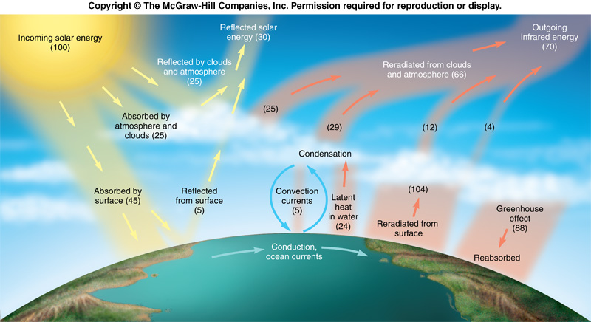
Solar Radiation

Slide 10
Solar Radiation Cont’d
Greenhouse Effect
Infrared energy that reflects off the Earth’s surface is trapped by greenhouse gases such as carbon dioxide in the atmosphere.
This is a normal process that keeps our temperature levels in a certain range.
Currently, these gases are at unusually high levels due to human activities.
How will this affect the Earth’s climate?

Slide 11
Greenhouse Gases
Carbon Dioxide - Fossil-fuel burning.
Atmospheric levels increasing steadily.
Methane - Cattle, Coal-mines
Absorbs more infrared than CO₂.
Water Vapor – Formed from evaporation.
Chlorofluorocarbons (CFC’s) – Refrigerants and aerosols. (No longer used)
Nitrous Oxide - Burning organic material

Slide 12
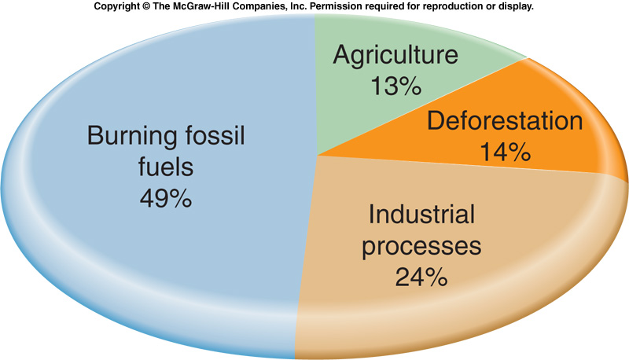
Sources of Greenhouse Gas Emissions

Slide 13
How Does Global Temperature Affect Rain?
The amount of heat in the atmosphere directly affects the movement of water.
Warm air containing evaporated water rises higher into the atmosphere.
Warm air is less dense than cool air.
As warm air rises, heat is released into the atmosphere and the water vapor condenses.
The condensed water then falls as rain or snow.

Slide 14
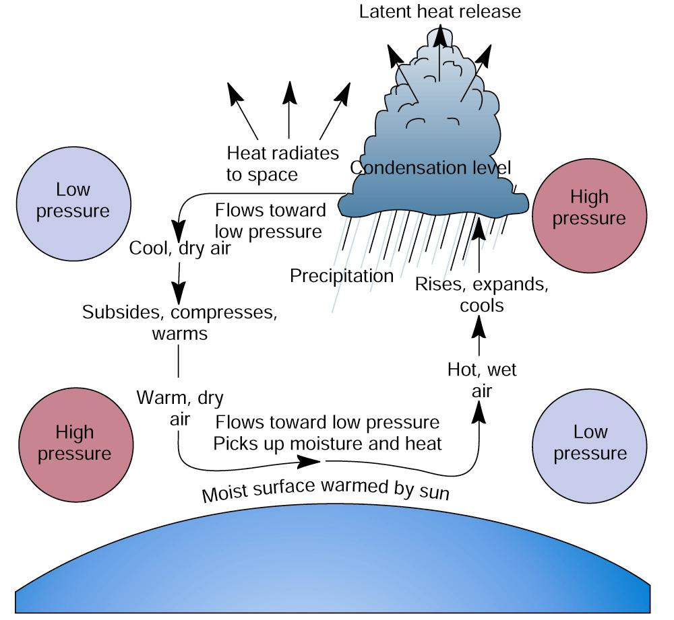
Convection Currents

Slide 15
CLIMATE CHANGE IS A NATURAL PROCESS
Changes in climate have been observed throughout history.
There have been at least 5 major ice ages.
The sun undergoes cycles where it releases different amounts of energy.
The Earth’s orbit can shift and tilt.
Example: Magnitude 8.8 earthquake in Chile shorted the Earth’s day by 1.26 millionths of a second.

Slide 16
Evidence of Global Warming
According to the EPA, the global surface temperature has increased 0.9°F since 1880.
The Earth’s surface is currently warming at a rate of about 0.29ºF/decade or 2.9°F/century.
The eight warmest years on record (since 1880) have all occurred since 2001, with the warmest years being 2005 and 2010.
Arctic temperatures have increased twice as fast as the rest of the Earth.
Source: http://epa.gov/climatechange/science/recenttc.html

Slide 17
Is Global Warming Human-Caused?
The Intergovernmental Panel on Climate Change (IPCC) released its fourth report in 2007.
Two important statements are made in the summary of this report:
“Warming of the climate system is unequivocal, as is now evident from observations of increases in global average air and ocean temperatures, widespread melting of snow and ice, and rising global average sea level. ”

Slide 18
Is Global Warming Human-Caused?
Second statement of the IPCC fourth report summary:
"Most of the observed increase in global average temperatures since the mid-20th century is very likely due to the observed increase in anthropogenic greenhouse gas concentrations."

Slide 19
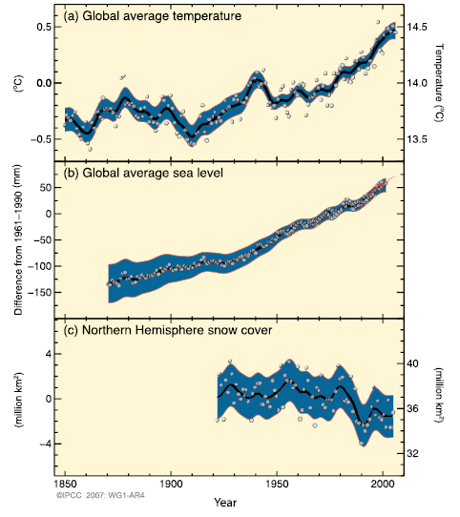
IPCC Data

Slide 20
Global Warming Timeline
19th century: Beginning of industrial revolution
1958: Daily records of carbon dioxide levels start.
Venus found to have surface temperatures above boiling point.
1970: First Earth day.
1973: Arab embargo -- energy crisis.
1977: Scientific opinion converges on global warming as the major climate risk.
1981: Warmest year on record.
1995: Reports on breaking up of Antarctic ice shelf.
1997: Kyoto protocol established.
1998: Strong El Nino produces warmest year on record.
2003: Deadly European heat wave / major ice sheets collapse

Slide 21
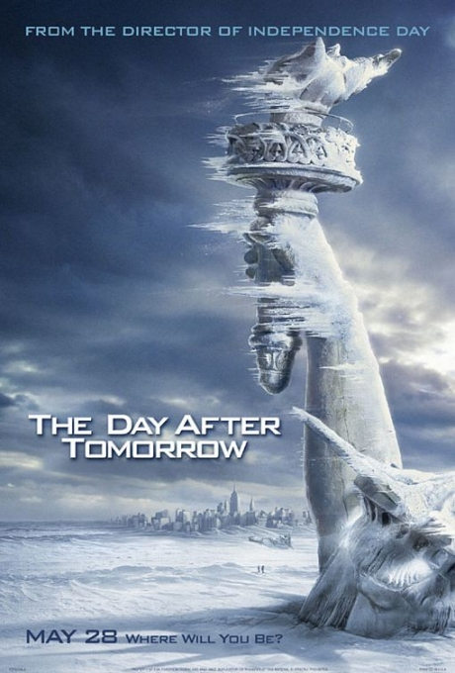
2004: Day After Tomorrow

Slide 22
Day After Tomorrow Clip 1: Breaking of the Larsen B Ice Shelf

Slide 23
Day After Tomorrow Clip 2: New York City Tidal Wave

Slide 24
Day After Tomorrow Clip 3: Evacuation

Slide 25
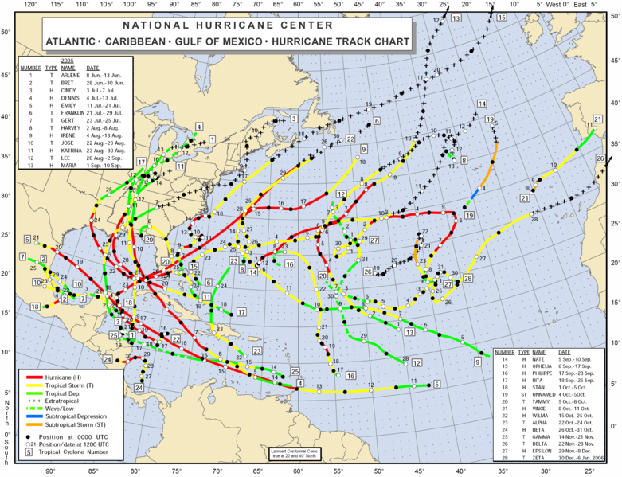
2005
Kyoto treaty goes into effect (not ratified by U.S.)
Most active hurricane season in recorded history.
Hurricane Katrina hits New Orleans.
Source: NOAA

Slide 26
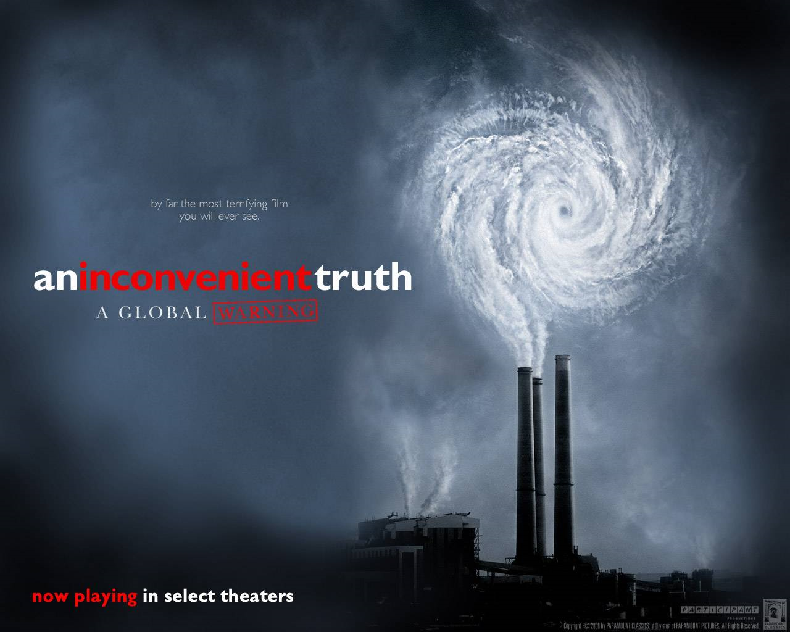
2006
An Inconvenient Truth, a documentary starring former vice president Al Gore, is released.

Slide 27
2007-Present
Severe drought hits Australia from 2007-2009, followed by severe flooding in 2010.
Severe flooding in Pakistan in 2010.
In the last stages of President Bush’s term, global warming was emphasized as a “scientific uncertainty”
In 2009, the U.S. House of Representatives passed a bill meant to gradually limit the amount of carbon dioxide produced. Stalled in the Senate.
In 2009, a series of emails from the researchers at the University of Anglia were made public; some implied data was being manipulated. This was nicknamed “Climategate.”
2010 ties 2005 for the warmest year on record.

Slide 28
Inconvenient Truth Documentary Clip 1: Background

Slide 29
Measuring Carbon Dioxide in the Atmosphere
There is a carbon dioxide detector in Mauna Loa in Hawaii.
This allows measurements far away from cities and forests.
The winds over Mauna Loa have come thousands of miles across the Pacific Ocean, swirling and mixing as they traveled.

Slide 30
Measuring Carbon Dioxide in the Atmosphere
Keeling’s first measurement, in March of 1958, was 0.0314 percent.
Slightly higher in the winter.
Slightly lower in the summer.
Why? Photosynthesis
These levels have rose steadily over the last 50 years.

Slide 31
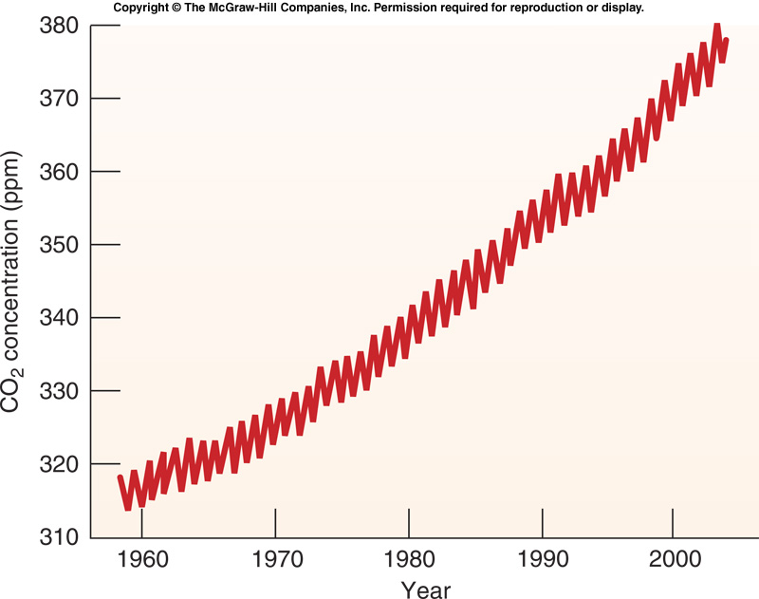
Figure 09.12

Slide 32
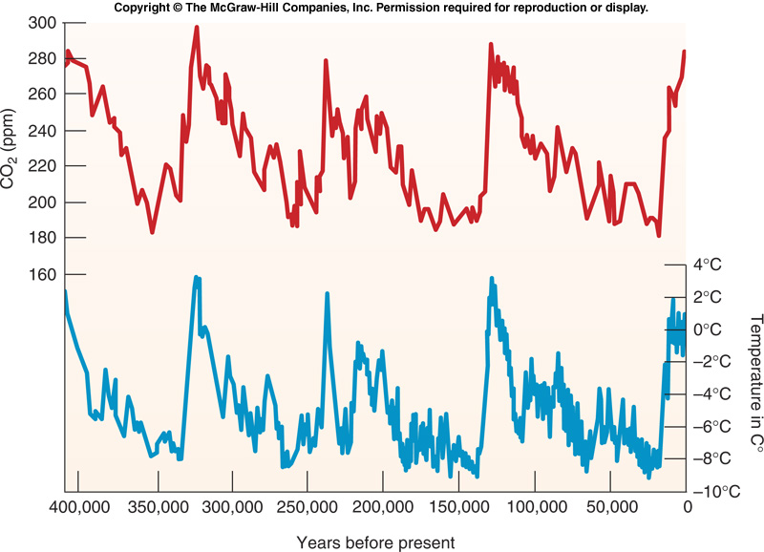
Figure 09.09

Slide 33
Carbon Dioxide-Temperature “Hockey Stick Graph
All temperature data prior to the 19th century is retrieved as a result of “proxies”
Tree Rings
Ice Core Layering
Water naturally occurs in two isotopes:
H₂¹⁶O and H₂¹⁸O
Higher amounts of the H₂¹⁸O are found in colder temperatures.

Slide 34
Older Climate Data?
The data presented only goes back about 650,000 years.
Limited by the age and extent of the Antarctic glaciers.
Deep sea cores have also been measured:

Slide 35
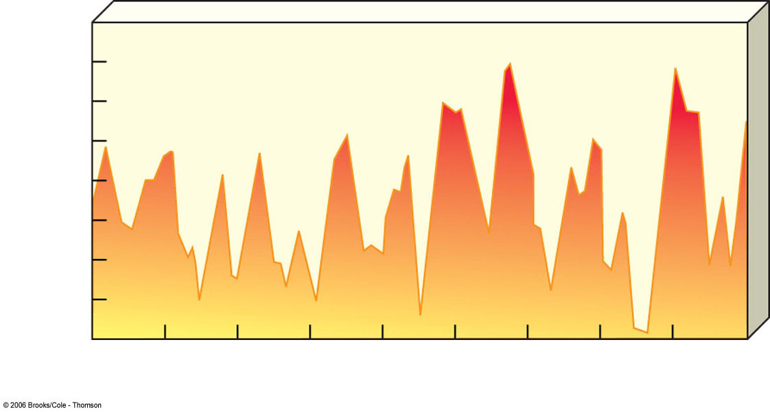
Average Global Temperature over the Past 900,000 Years
17
16
15
14
Average surface temperature (°C)
13
12
11
10
9
900
800
700
600
500
400
300
200
100
Thousands of years ago
Pres
Fig. 16-2a, p. 369

Slide 36
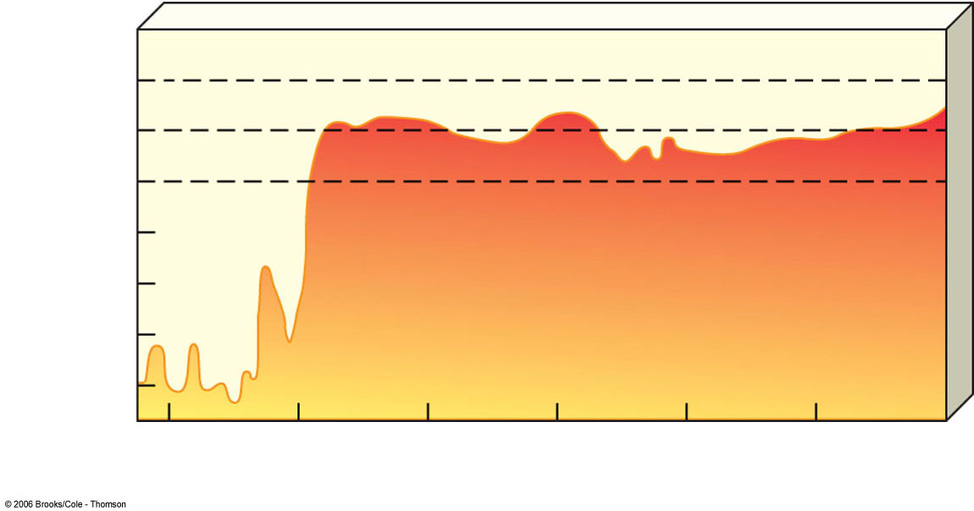
Temperature Changes Over Past 22,000 Years
2
Agricultural Revolution
Medieval warming period
1
0
–1
Temperature change (°C)
– 2
End of
last ice
age
Little ice age
– 3
– 4
– 5
20,000
10,000
2,000
1,000
200
100
Now
Years ago
Fig. 16-2b, p. 369

Slide 37
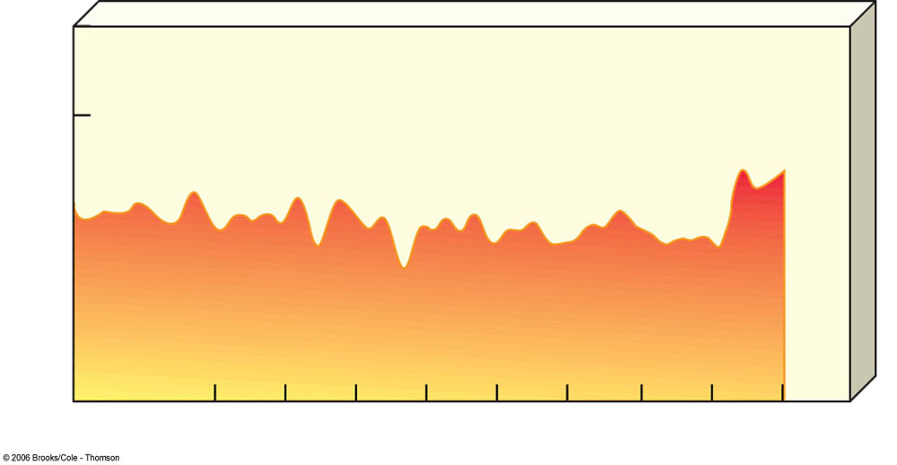
Temperature Changes Over Past 1,000 Years
1.0
0.5
0.0
Temperature change (°C)
–0.5
–1.0
1000
1100
1200
1300
1400
1500
1600
1700
1800
1900
2000
2101
Year
Fig. 16-2c, p. 369

Slide 38
Medieval Warming Period
Occurred sometime between 800-1300 A.D.
This produced milder winters and longer summers throughout Europe.
Western Europe thrived with abundant crops and overall healthy populations.
Viking explorers were able to colonize Greenland and Labrador.
Much of North America, South America, and Asia experienced severe droughts.
May have been a major cause of the downfall of the Mayan empire.
Causes are unknown.

Slide 39
Little Ice Age
Period of cooling lasted from the about 1300-1800 A.D.
Effects of this cooling period:
Colder winters in North America and Europe.
Severe food shortages and famines were commonplace.
The Viking colony in Greenland died out.
Causes of this “little ice age”?
Decreased solar activity
Increased volcanic activity
Ocean conveyor was disrupted – possibly by melting glaciers.

Slide 40
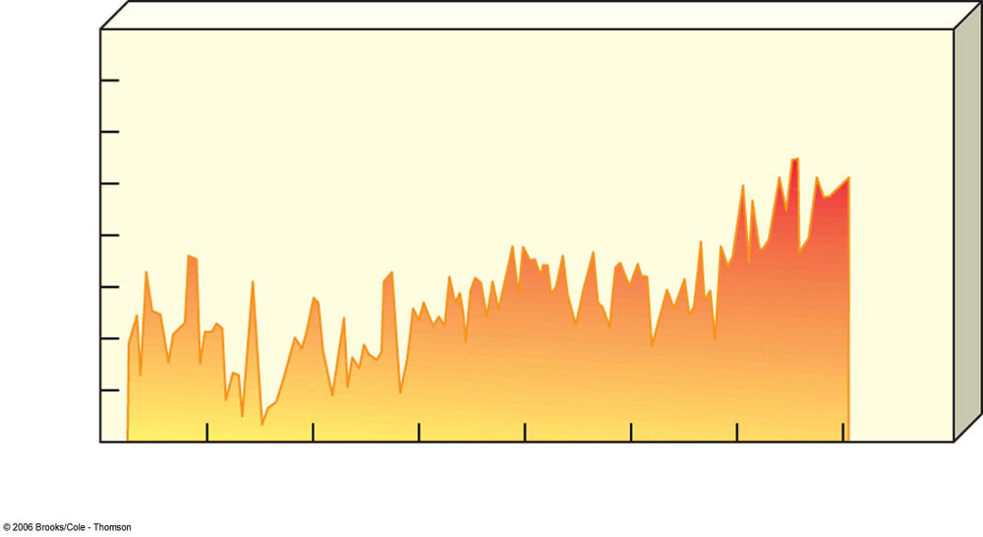
Average Global Temperature Over Past 130 Years
15.0
14.8
14.6
14.4
Average surface temperature (°C)
14.2
14.0
13.8
13.6
1860
1880
1900
1920
1940
1960
1980
2000
2020
Year
Fig. 16-2d, p. 369

Slide 41
Inconvenient Truth Documentary Clip 2: Effects of Global Warming; Hurricanes

Slide 42
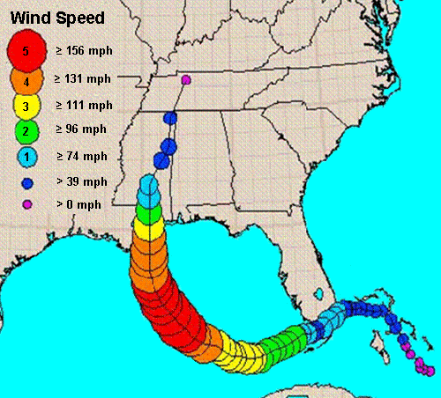
Hurricane Katrina
Formed over the Atlantic in August of 2005.
Crossed Southern Florida as a category 1 hurricane.
Strengthened very quickly over warm waters of the Gulf of Mexico
Made landfall over Louisiana as a Category 3 hurricane.

Slide 43
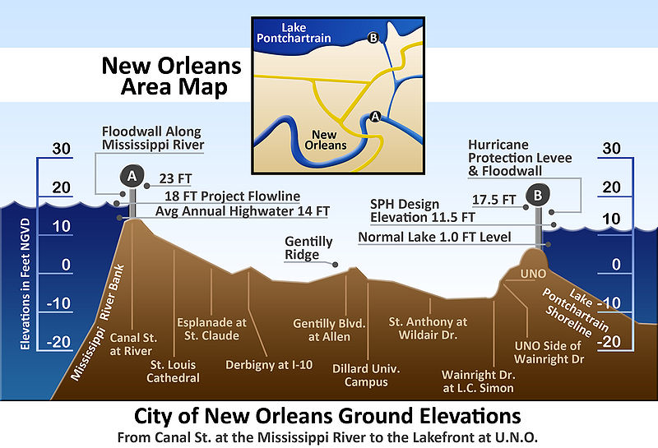
New Orleans
Parts of New Orleans are below sea level.
The levees holding back the Mississippi river and the shoreline were not maintained properly.
Immediate connections were made between global warming, the unusually warm Gulf of Mexico, and the hurricane.

Slide 44
Global Warming and Hurricanes?
No evidence to link climate change and frequency of hurricanes and typhoons.
Studies do show evidence between ocean surface temperatures and hurricane intensity and duration.
Duration and strength of hurricanes has increased about 50% over the last 30 years.
Previous models showed a 5% increase for every 1°C.

Slide 45
El Niño/Southern Oscillation
El Niño – A large pool of warm surface water in the Pacific Ocean.
Moves back and forth between Indonesia and South America.
Most years, the pool is held in the western Pacific by steady trade winds.
Every three-five years the mass of warm surface water surges back east.

Slide 46
El Niño/Southern Oscillation
During an El Niño year, the northern jet stream pulls moist air from the Pacific over the U.S.
Intense storms and heavy rains in the Western U.S.
During La Niña years, where the mass of warm water is closer to Indonesia, hot, dry weather is often present.

Slide 47
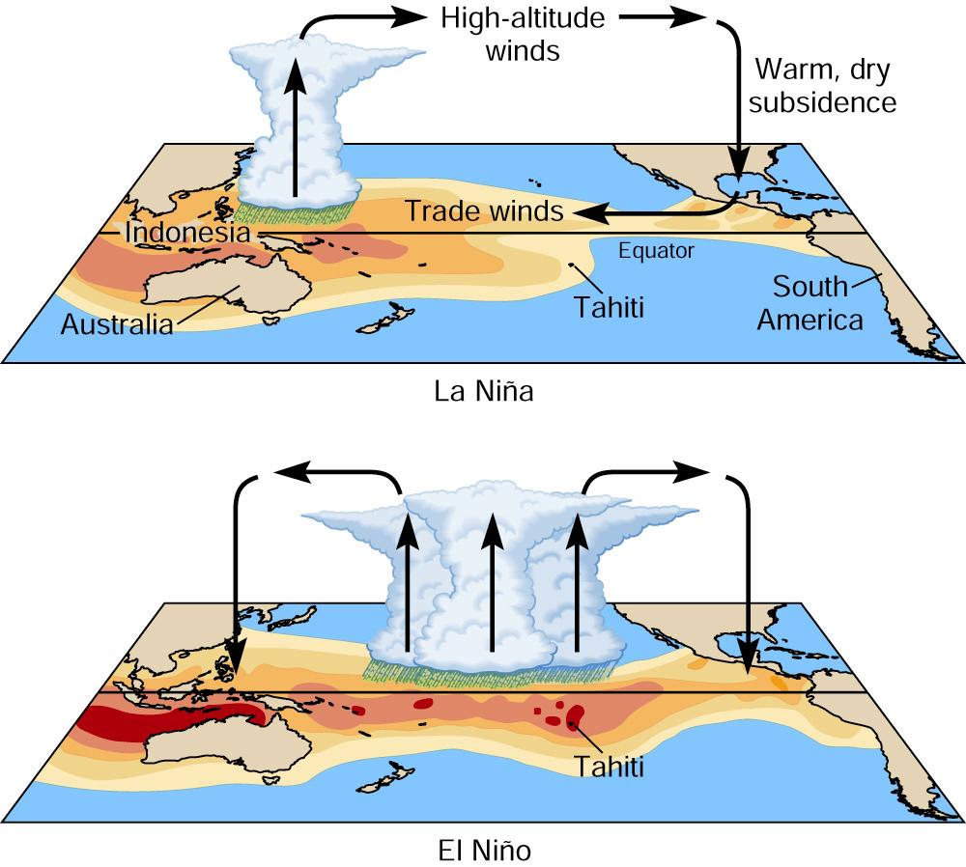
El Niño Southern Oscillation

Slide 48
El Niño Changes
A sudden change in El Niño behavior occurred between 1976-77.
There have been more frequent El Niño years than in prior history.
Relation to global warming is unknown.

Slide 49
Inconvenient Truth Documentary Clip 3: The Poles

Slide 50
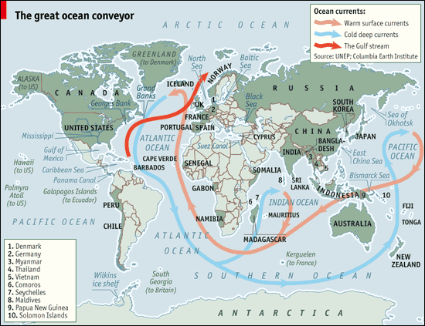
The Great Ocean Conveyor

Slide 51
Global Warming Effects on Poles
99% of sheet ice is located in Antarctica and Greenland
Ice is melting worldwide, but especially quickly at the poles.
As a result…
Ocean levels have risen about 3.0mm per year in the 10 years.
Adelle penguin population is down to 1/3 its normal level.
Multiple populations of polar bears are declining.

Slide 52
Global Warming Effects on Glaciers
Only about 1% of the world’s sheet ice is located in temperate (non-polar) regions, but these are close in proximity to human populations.
Himalayan glaciers are the sources of Asia’s biggest rivers
Biggest single source of water for the entirety of southern Asia.

Slide 53
Flawed Predictions
A statement was published by a journal that suggested the Himalayan glaciers could be melted by 2035.
These numbers were based on unrealistic calculations and this prediction was retracted.
Many dismiss global warming claims in general as a result of retractions such as this.

Slide 54
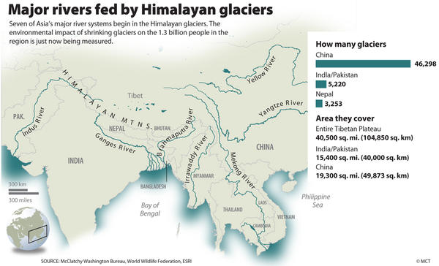

Slide 55
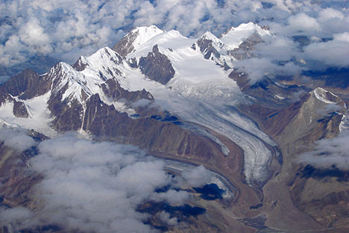
The 2007 IPCC report predicted a complete loss of the Himalayan glaciers by 2035.
This was later retracted, as it was based on a single interview of a scientist who denied making the prediction.
This rate of melting would require global warming to be occurring at 2-3x the rate it is currently.
This error damaged the credibility of the report.

Slide 56
Inconvenient Truth Documentary Clip 4: Heat and the Water Cycle

Slide 57
Effects on the Hydrologic Cycle
Surface temperatures are measurably increasing. This effects the water cycle:
Higher rate of evaporation (from land and sea both)
Warmer atmosphere is capable of holding more water vapor.
Higher likelihood of heavy precipitation (both rain and snow) weather events.
Ocean temperatures are also increasing.

Slide 58
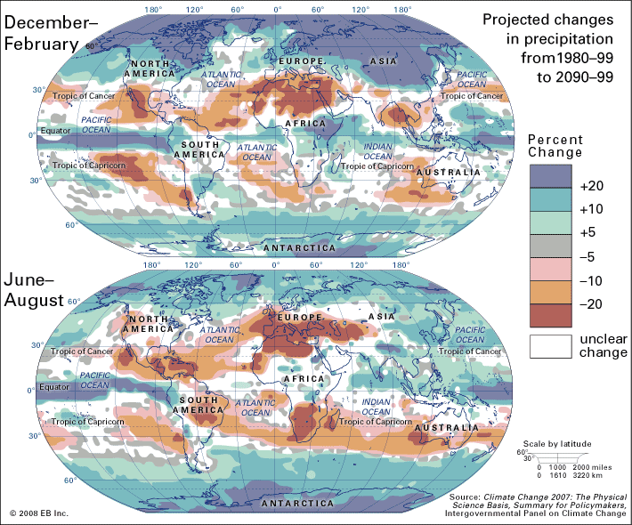
Changes in Precipitation

Slide 59
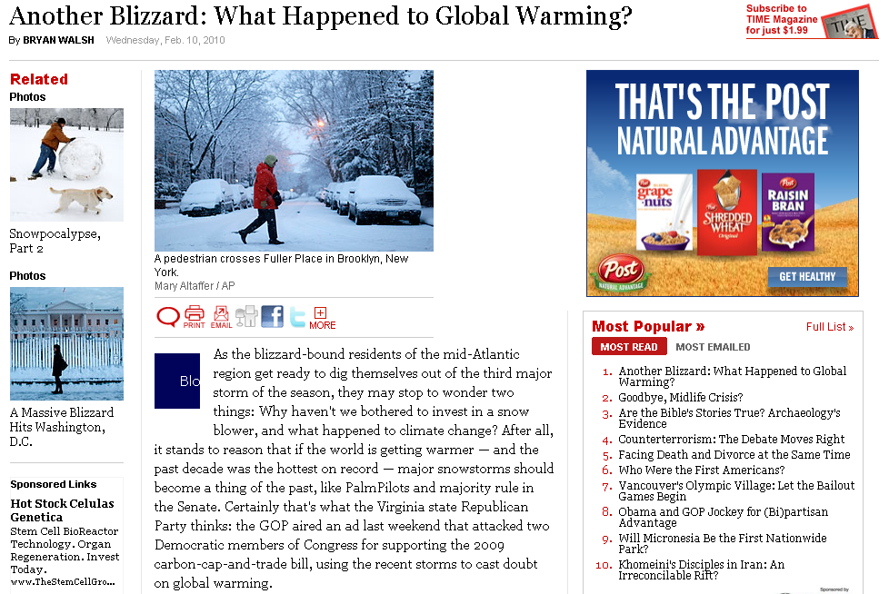
The Snowpocalypse, 2010

Slide 60
Inconvenient Truth Documentary Clip 5: Scientific Consensus?

Slide 61
Scientific Consensus?
Survey was taken in 2004 of 928 abstracts of peer-reviewed papers relating to climate change.
None disagreed with the IPCC conclusion.
Survey taken in 2009 of 3,146 Earth Scientists (defined as publishing more than half of their peer-reviewed papers on climate change)
97% agree with the IPCC conclusion.

Slide 62
Inconvenient Truth Documentary Clip 6: Human Action and Inaction

Slide 63
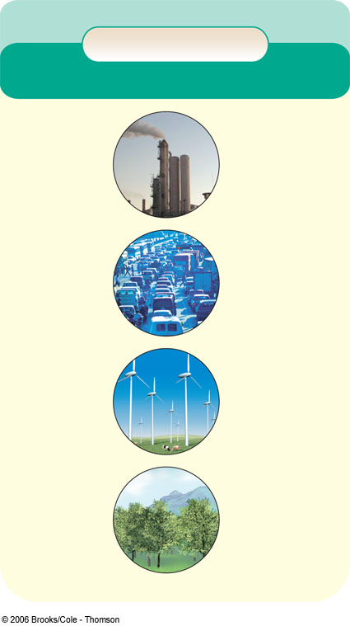
Solutions to Global Warming
Solutions
Global Warming
Prevention
Cleanup
Cut fossil fuel use (especially coal)
Remove CO₂ from smokestack
and vehicle emissions
Shift from coal to natural gas
Improve energy efficiency
Store (sequester) CO₂ by planting trees
Shift to renewable energy resources
Sequester CO₂ deep underground
Transfer energy efficiency and renewable energy technologies to developing countries
Sequester CO₂ in soil by using no-till cultivation and taking crop land out of production
Reduce deforestation
Sequester CO₂ in the deep ocean
Use more sustainable agriculture
Limit urban sprawl
Repair leaky natural gas pipelines and facilities
Reduce poverty
Use feeds that reduce CH₄ emissions by belching cows
Slow population growth
Fig. 16-13, p. 379

Slide 64
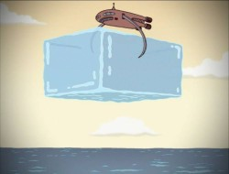
Other Ideas?
The stratoshield is an idea developed to combat global warming by blocking some of the sunlight entering the Earth’s atmosphere.
Inject sulfur dioxide or particulate pollutants into the stratosphere.
This would be too high in the atmosphere to be directly breathed or cause acid rain.
Blocks out just enough sunlight to bring global temperatures down to acceptable ranges.
Another quick solution: dropping ice cubes into the ocean.
Source: Futurama “Crimes of the Hot”

Slide 65
Legislation
Cap-and-Trade System
A limit on the amount of carbon dioxide any specific factory or power plant can produce.
Permits (or credits) are required depending on how much carbon dioxide is emitted.
An organization can purchase additional credits from other organizations that do not need them.

Slide 66
Action vs. Inaction
Significant Action
No Action
GCC is a fraud or it is naturally occurring
Increased taxation,
Increased government regulation
Economy crippled
Global depression
Continued overall prosperity.
GCC is
real and primarily human-caused
Coastal flooding; Mass refugees
Collapse of food producin`g regions
Increased diseases and infestations
Conflict over scarce resources; War
Increased taxation
Increased government regulation
Climate change occurs
Effects reduced
More prepared

Slide 67
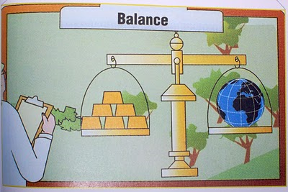
The True Dilemma
Image from An Inconvenient Truth, by Al Gore, Page 271

