Slide 1
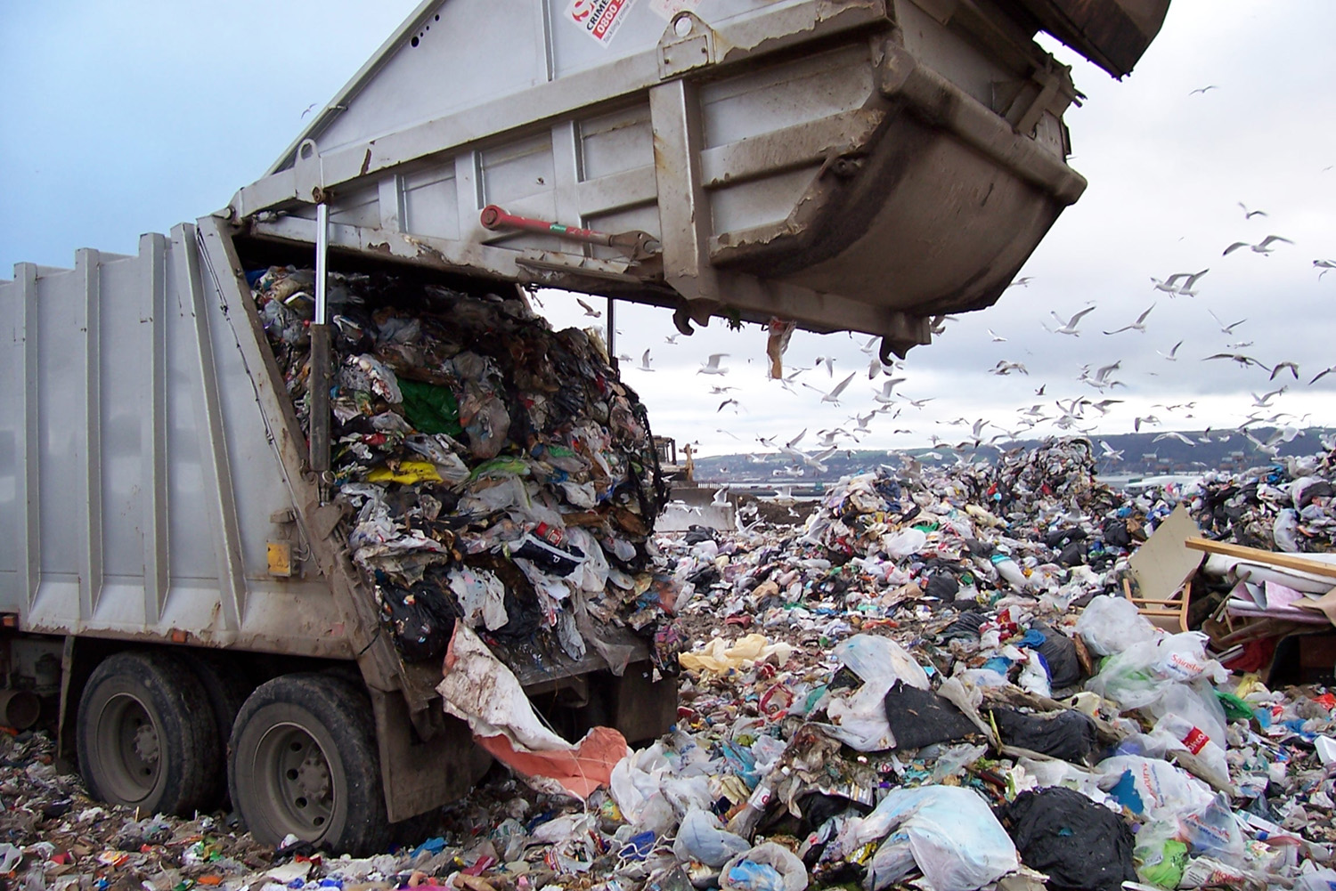
Solid and Hazardous Waste
“There is no ‘waste’ in nature and no ‘away’ to which things can be thrown.”
- Barry Commoner

Slide 2
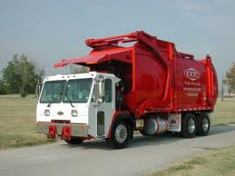
Philadelphia’s Trash Problem
Through the 1970s, the city of Philadelphia was experiencing a growing problem of how to handle its waste.
Local landfills had long since been reached capacity, forcing the city to hire private companies to export its waste to other states.
These other states stopped accepting this waste in the early 1980s.

Slide 3
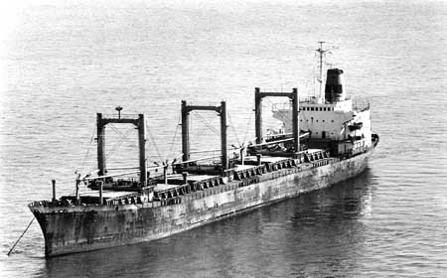
Philadelphia’s Waste Problem
The city decided to begin using incineration as a way to reduce the volume of trash it was collecting by 70%.
However, the ash that was leftover still needed to be disposed of, and it had much greater concentrations of toxins.
Another private company was hired to haul the ash away on a barge called the Khian Sea.

Slide 4
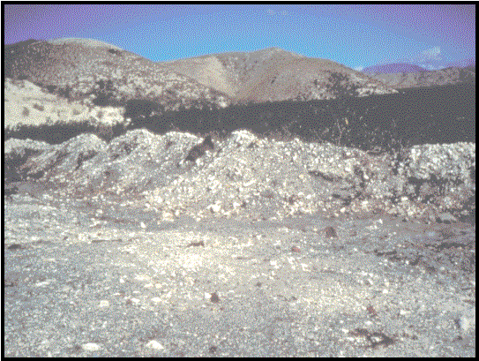
The Voyage of the Khian Sea
The barge was to be dumped on a man-made island on the Bahamas, but it was turned away.
Also turned away by the Dominican Republic, Honduras, Panama, and Bermuda.
The Haitian government was persuaded by the crew to accept 4,000 tons of the ash.
It was described as “topsoil fertilizer”.
By the time the government was alerted to the true nature of the cargo, the ship had left.

Slide 5
The Voyage of the Khian Sea
The Khian sea made its way across the Atlantic, towards southeast Asia.
The name and registration country of the ship was changed twice.
Unsuccessfully attempted to unload the cargo in Morocco, Yugoslavia, Sri Lanka, and Singapore.

Slide 6
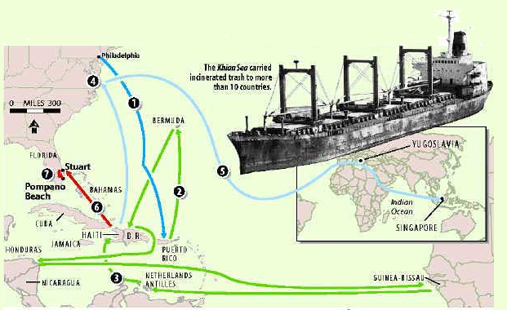
The Voyage of the Khian Sea
The ship finally returned to the United States across the Indian and Atlantic ocean. By the time it reached port, the ash was gone.

Slide 7
Waste in Natural Systems
According to the Law of Conservation of Mass,
“Matter cannot be created or destroyed, it only changes form.”
Any waste produced within an ecosystem, cycles back through the system.
When plants are consumed in a fire…
Carbon-based sugars enter the air as carbon dioxide and water vapor.
Non-combustible minerals like potassium are left behind as ash.
Future plants will absorb these materials again through photosynthesis or their roots.
What happens to human-generated waste?

Slide 8
WASTE
According to EPA, U.S. produces 11 billion tons of solid waste annually.
The sum total of all the waste produced by individuals, industries, mining, and agriculture is referred to as the waste stream.
The waste stream includes multiple forms of waste, from many different sources.

Slide 9
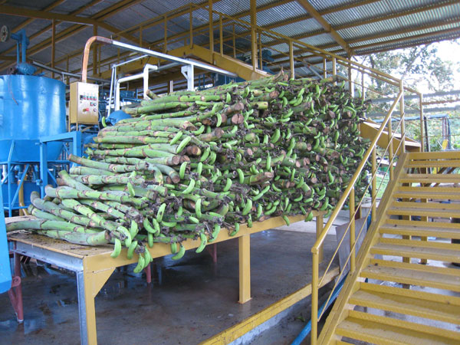
Agricultural Waste
Left over plant material, manure, pesticides, herbicides.

Slide 10
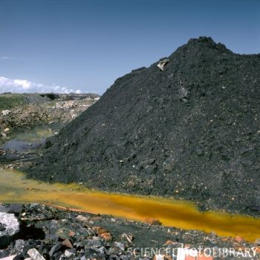
Mining Waste
Ore, gravel, and wastewater from mining operations.

Slide 11
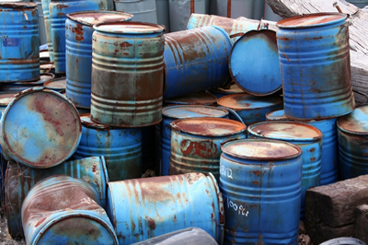
Industrial Waste
Leftover materials and waste chemicals from manufacturing and processing.

Slide 12
Municipal Solid Waste
Garbage from households, businesses, schools, etc.

Slide 13
Waste Degradation
Municipal solid waste is a mixture of multiple types of materials.
Material that can be broken down by naturally occurring decomposers is called biodegradable.
Food scraps, yard trimmings, etc.
Material that is synthetic or not able to be broken down is called non-degradable.
Plastics, glass.

Slide 14
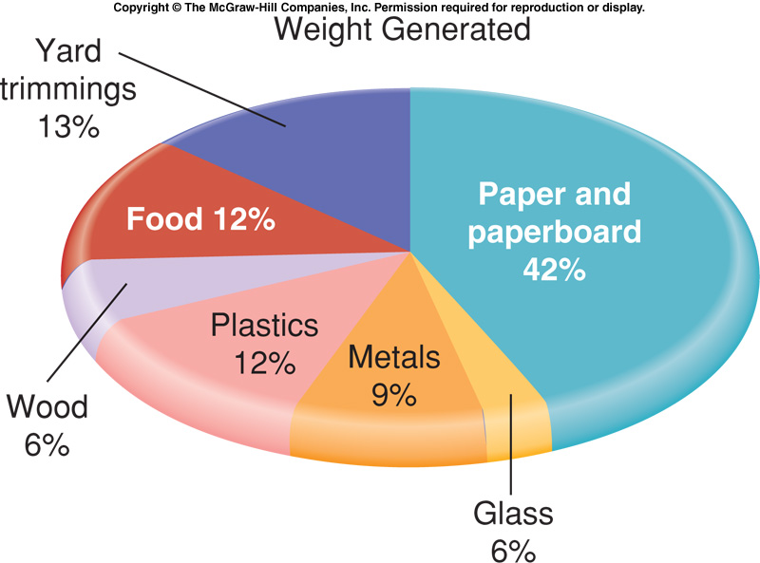
U.S. Domestic Waste

Slide 15
WASTE DISPOSAL METHODS
Since 1960, municipal solid waste (MSW) production has increased from 88 million tons to 250 million tons annually. (2010 EPA MSW Fact Sheet)
There are a limited number methods used to dispose of this waste.
Open Dumps
Villages of people will leave their waste in a shared open area.
The waste is exposed, attracts wildlife, and is aesthetically unpleasant.
Open dumps are illegal in most developed countries.

Slide 16
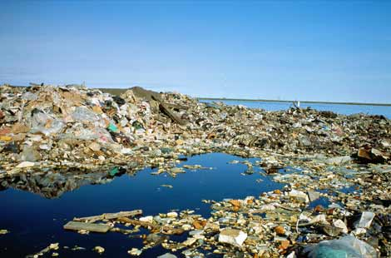
Open dump, Barrow, Alaska.
Photograph from National Geographic.

Slide 17
WASTE DISPOSAL METHODS
Sanitary Landfills
Large, excavated pit that is lined at the bottom with clay and plastic.
Prevents the escape of water that drains through the landfill, called leachate.
Refuse compacted and covered everyday with a layer of dirt.

Slide 18
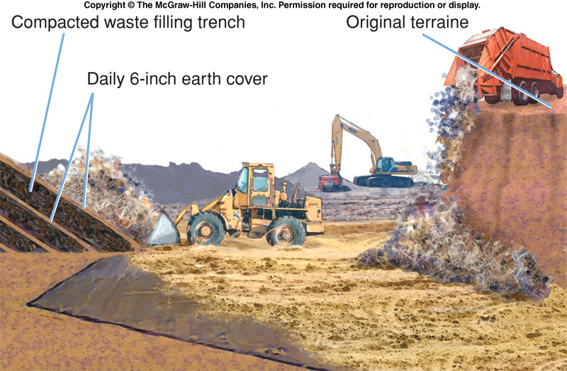
Sanitary Landfills

Slide 19
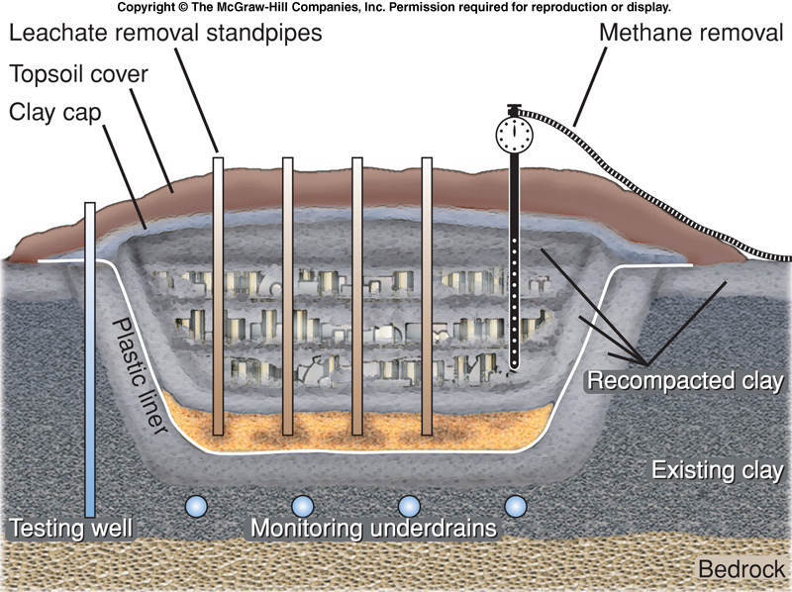
Sanitary Landfills

Slide 20
Landfills
Historically, landfills have been the most convenient, inexpensive waste-disposal option.
Costs are increasing due to the need to construct new landfills farther away from major cities.
Suitable landfill sites are becoming scarce.
Increasingly, communities are rejecting new landfills.

Slide 21
Incineration
Communities suffering from a lack of space often turn to the burning of solid waste, called incineration.
Incineration has the advantage of reducing the volume of solid waste by about 70%.
The remaining ash must still be buried in a landfill.
Incinerators are expensive to construct and usually have higher tipping fees than landfills.

Slide 22
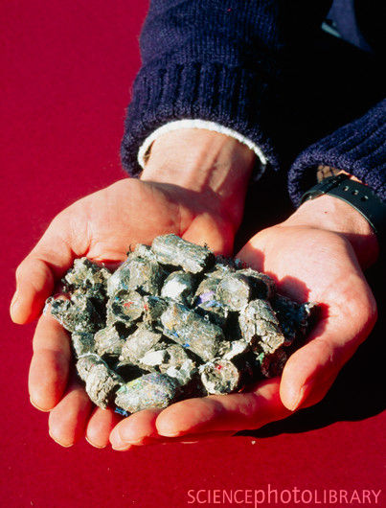
Incinerator Types
Refuse-Derived Fuel - Refuse is sorted to remove recyclable and unburnable materials.
Waste Management of Philadelphia now converts the burnable material into pellets which are placed into coal-fired power plants.

Slide 23
Mass Burn - Everything smaller than major furniture and appliances loaded into furnace.
Creates air pollution problems.
Residual ash may contain toxic material.

Slide 24
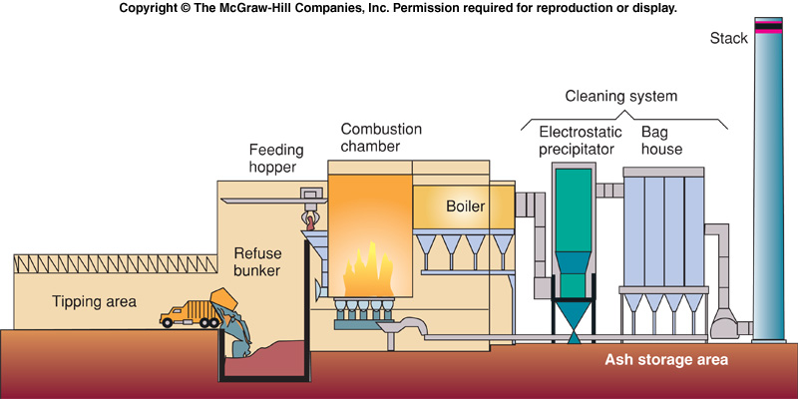
Mass-Burn Garbage Incinerator

Slide 25
SHRINKING THE WASTE STREAM
Recycling is the reprocessing of discarded materials into new, useful products.
Less expensive than producing new raw materials.
Reduces space needed for landfills.
Japan recycles about half of all household and commercial wastes.
Lowers demand for raw resources.
Reduces energy consumption and air pollution.

Slide 26
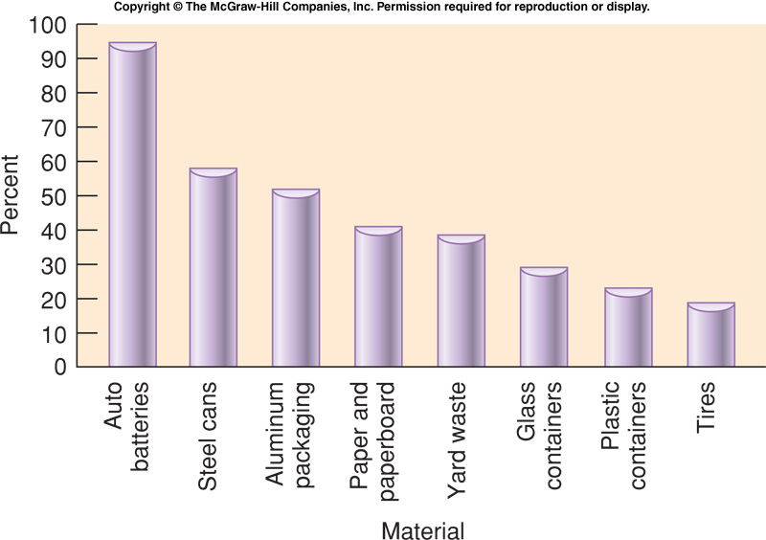
U.S. Recycling Rates

Slide 27
Recycling Cont’d
Benefits Example
Recycling 1 ton of aluminum saves 4 tons of bauxite, 700 kg of petroleum coke and pitch, and keeps 35 kg of aluminum fluoride out of the air.
Producing aluminum from scrap instead of bauxite ore cuts energy use by 95%.

Slide 28
Recycling
Potential Problems
Market prices fluctuate wildly.
The recycled materials must be separated by type.
There are several different forms of plastics, labeled #1-7.
Each must be separated before recycling is possible.

Slide 29
SHRINKING THE WASTE STREAM
Composting
Biological degradation of organic material under aerobic conditions.
Only works for biodegradable materials.

Slide 30
SHRINKING THE WASTE STREAM
Waste Reduction
The cheapest and most effective way to reduce waste is to not produce it at all.
Excess packaging of food and consumer products is one of our greatest sources of unnecessary waste.

Slide 31
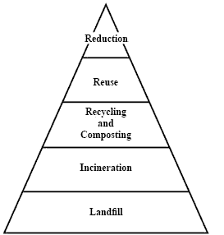
Integrated waste management
Integrated waste management arranges all of the strategies of dealing with MSW in order from top-to-bottom.
By utilizing the top methods first, the amount of material that must be incinerated or buried is minimized.
The San Francisco Department of Public Works is a good example of this strategy.

Slide 32
Recyclable materials are collected in special containers. These are collected, machine-sorted, and hand-sorted.
Dirty Jobs Season 1, Episode 4

Slide 33
Compostable material, primarily food scraps, is collected in a separate run.
Dirty Jobs Season 1, Episode 4

Slide 34
HAZARDOUS AND TOXIC WASTES
EPA estimates U.S. industries generate 265 million metric tons of officially classified hazardous wastes annually.
At least 40 million metric tons of toxic and hazardous wastes are released into the environment each year.
What is hazardous waste?

Slide 35
Hazardous Waste
Legally, hazardous waste is any discarded liquid or solid that contains substances known to be:
Fatal to humans or laboratory animals in low doses.
Toxic, carcinogenic, mutagenic, or teratogenic to humans or other life-forms.
Ignitable with a flash point less than 60º C.
Corrosive
Explosive or highly reactive.

Slide 36
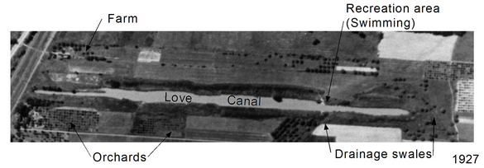
Love Canal
Founded by William Love, who was trying to design a city that ran off hydroelectric power.
Love began digging a canal to Niagara Falls, but the project was abandoned.
The area became popular as a local swimming hole.

Slide 37
Love Canal
Hooker Chemical bought the land and used the canal as a dumpsite for several hazardous chemicals.
The city of Niagara Falls, desperate for inexpensive land to accommodate a growing population, pressured Hooker Chemical to sell.

Slide 38
Love Canal
The quit deed issued when the property was sold stated,
“Prior to the delivery of this instrument of conveyance, the grantee herein has been advised by the grantor that the premises above described have been filled, in whole or in part, to the present grade level thereof with waste products resulting from the manufacturing of chemicals”
“…no claim, suit, action or demand of any nature whatsoever shall ever be made by [Niagara Falls School District], its successors or assigns, against [Hooker]”

Slide 39
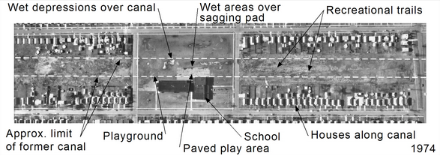
Love Canal
In spite of the warnings, the school district constructed a school immediately adjacent to the canal dump site.
The school playground was constructed immediately on top.
Dozens of homes were also constructed adjacent to the canal once the school was completed.

Slide 40
Modern Marvels, Engineering Disasters 13

Slide 41
Hazardous Waste Disposal
Resource Conservation and Recovery Act (RCRA) of 1976.
Comprehensive set of laws that require the proper treatment and storage of hazardous wastes.
Companies must track and account for all wastes from their creation to eventual disposal.

Slide 42
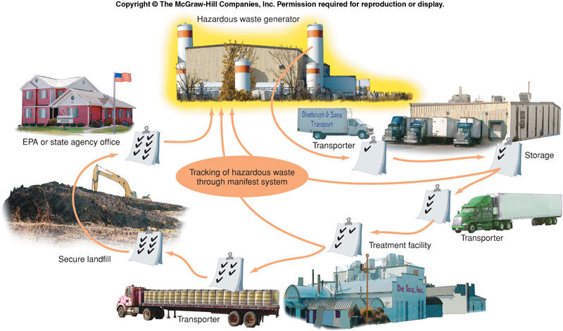
Cradle to Grave

Slide 43
Federal Legislation
Comprehensive Environmental Response, Compensation and Liability Act (CERCLA).
Also known as the “Superfund”
Aimed at rapid containment, cleanup, or remediation of abandoned toxic waste sites.
Anyone associated with a site can be held responsible for the entire clean-up cost.

Slide 44
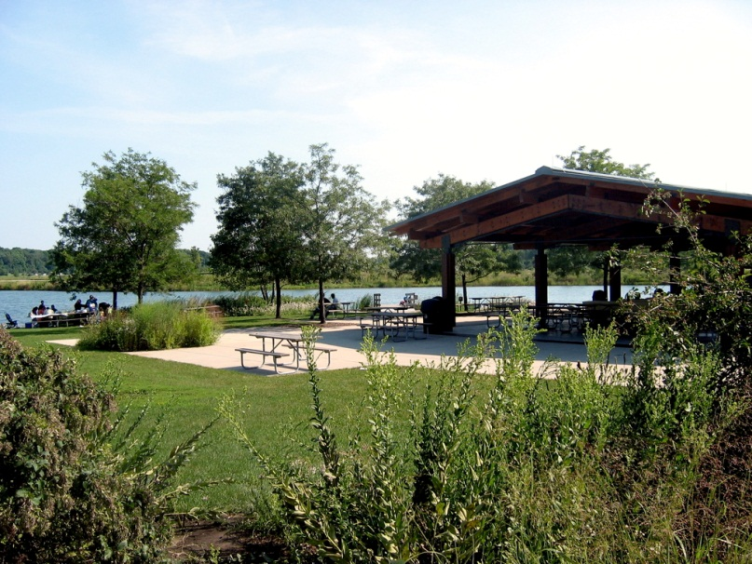
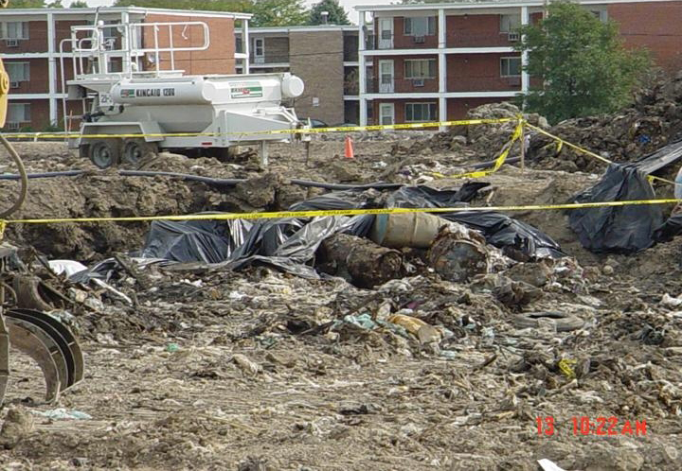
Superfund Sites in Lake County
Petersen Sand and Gravel (Libertyville)
Site of illegal dumping of paint and solvents.
Cleanup completed, redeveloped as Independence Grove
Yeoman Creek Landfill (Waukegan)
Improperly lined landfill

Slide 45
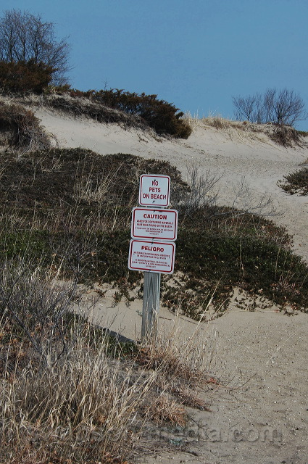
Superfund Sites in Lake County
Johns-Manville Corp. (Zion)
Asbestos disposal site in present-day Illinois Beach state park.
Waukegan Harbor (Waukegan)
Multiple contaminated sites – hydraulic fluid contamination in the harbor, waste from coke plant in the soil

Slide 46
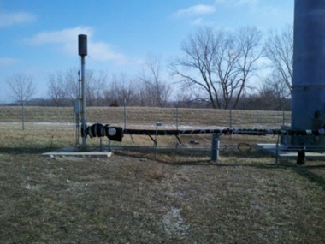
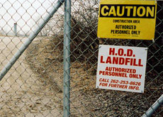
Superfund Sites in Lake County
H.O.D. Landfill
Improperly sealed, vinyl chloride entering groundwater.
Retrofitted with methane collection, used to heat nearby high school.

Slide 47
HAZARDOUS WASTE DISPOSAL
Although most industrialized nations have agreed to stop shipping hazardous and toxic waste to less-developed countries, the practice still continues.
An international agreement was passed in 1994 called the Basel Convention that banned the export of hazardous waste.
In spite of this ban, electronic waste is still often smuggled to poorer countries.

Slide 48
60 Minutes, 11/09/2008
“The Electronic Wasteland”

Slide 49
Nuclear Waste
Since the first commercial nuclear power plant opened in Pennsylvania in 1958, the amount of nuclear waste produced has continually grown.
High-level nuclear waste is primarily used fuel rods that are still radioactively active, but not enough to be used to sustain a fission reaction.
Low-level nuclear waste consists of any protective clothing or other handling materials used by plant workers.

Slide 50
Nuclear Half-Life
All radioactive elements have a half-life; the amount of time needed for half of the material to decay into smaller, non-radioactive elements.
Polonium-218, for example, has a half-life of 3 days.
After 3 days: 50% remains.
After 6 days, 25% remains.
After 9 days, 12.5% remains.
Other waste products have a much longer half-life, requiring a long-term storage solution.
Strontium-90: 29 years
Plutonium-239: 24,000 years

Slide 51
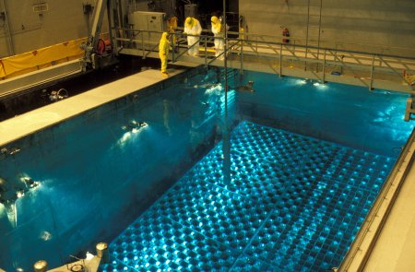
High Level Waste Storage
Used fuel rods will initially be placed in cooling pools. Water will be used to remove heat produced as the rods decay.

Slide 52
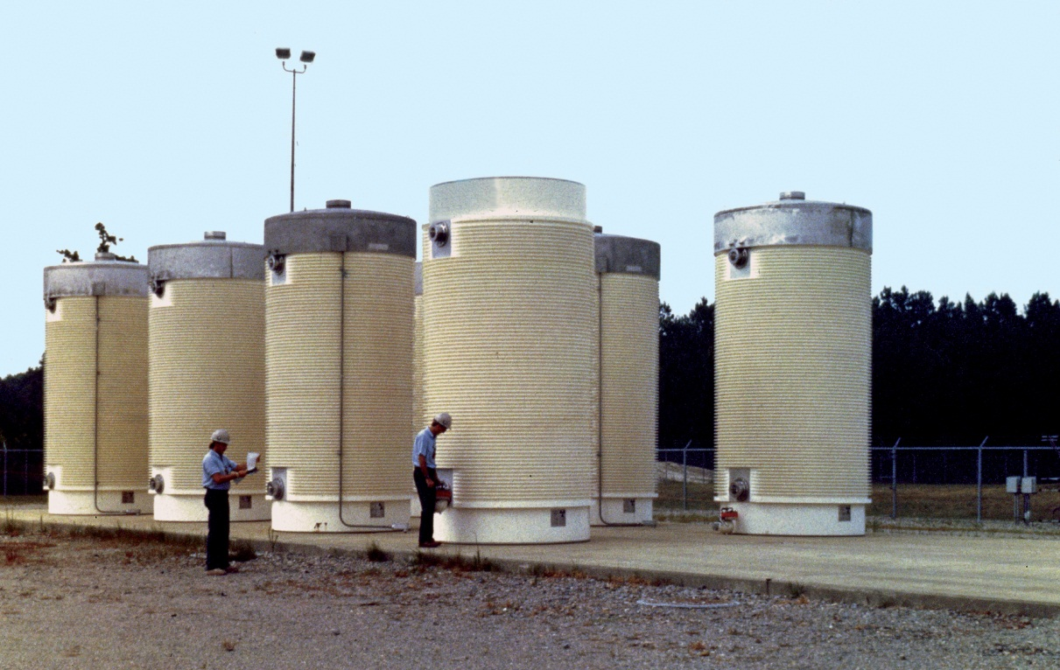
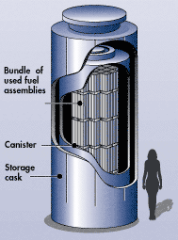
High Level Waste Storage
Once the fuel is stable enough, it can be placed in dry cask storage. These containers are made of thick steel, preventing any radiation from escape.
Presently, these containers are all kept on the site of the reactor itself.

