Slide 1
Biology
The study of life!
(bio = life) (ology = study of)
http://youtu.be/7L7x0BAqWis

Slide 2
Various Branches of Biology
Biology
Agriculture
Anatomy and Physiology (human body)
Botany (plants)
Cell Biology
Conservation Biology
Ecology
Genetics
Pathology (disease)
Zoology (animals)
Marine Biology
(ocean life)

Slide 3
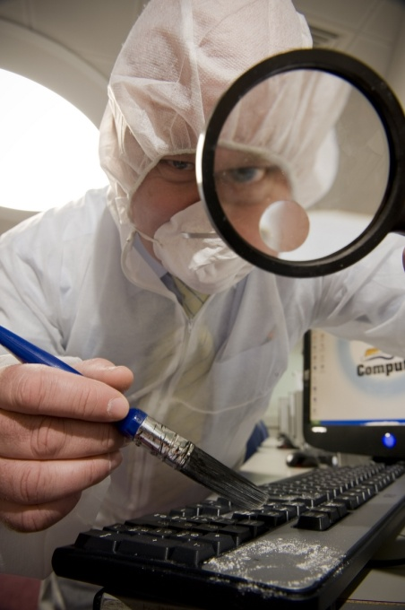
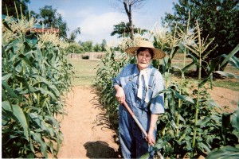

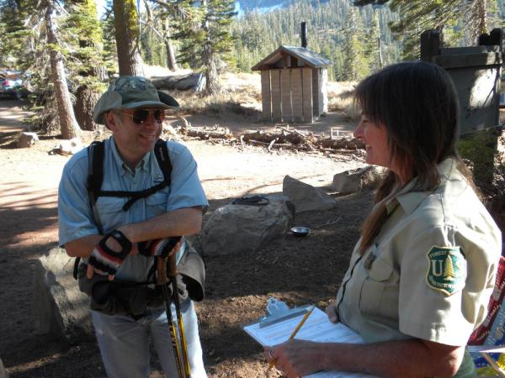
Why is biology important?
It is at the heart of many important careers such as
  Doctors, nurses, and other medical fields
  Veterinarians, marine biologists and zoologists
  Agriculturists, farmers and ranchers
  Environmentalists, foresters, wilderness rangers
  Forensics (criminal identification)
  Many others…

Slide 4
Are you considering any career choices related to biology?
Write on your board what your plans are after high school and beyond.
Is this related to biology.
Be ready to share.

Slide 5
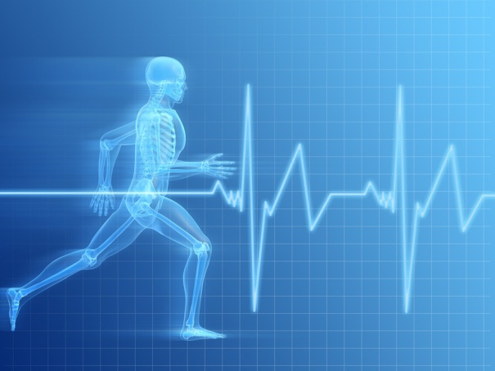
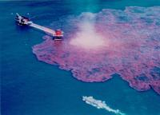
Why is biology important?
It affects our everyday lives.
  Biology helps us to study and understand
  the basic needs of our bodies.
    Sleep, diet and exercise.
  We understand the importance of good hygiene.
    Brushing teeth, taking showers, cleaning the house, etc.
  We’ve learned how to treat various diseases in humans and animals.
    Developed medicine, identified viruses and bacteria, etc.
  We understand our place in nature
  and we’re learning how our actions can
  have an effect on it.

Slide 6
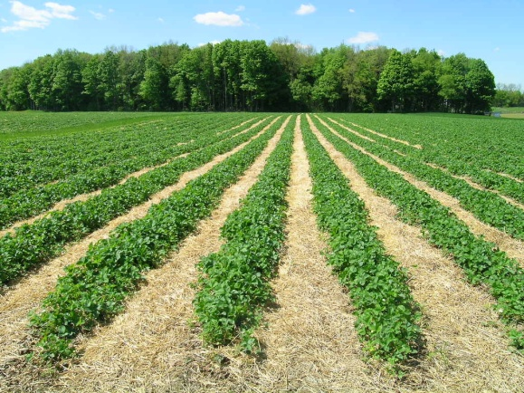
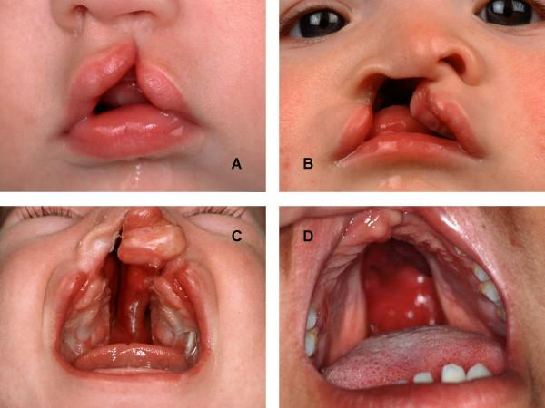
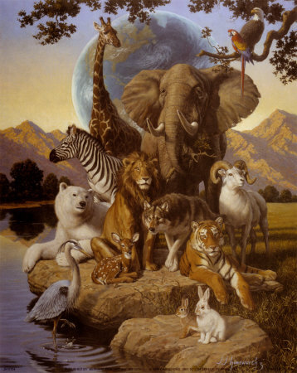

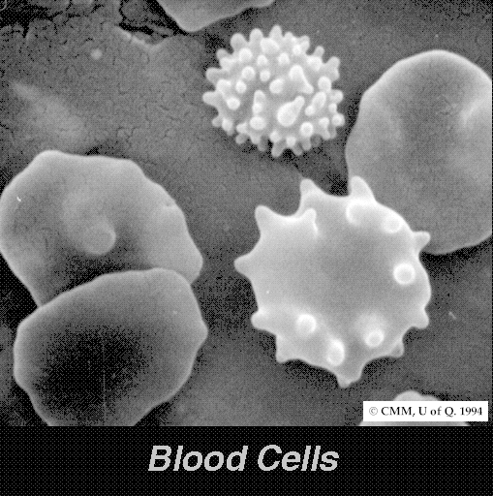
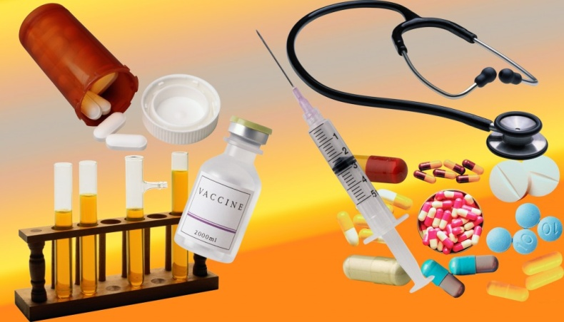
What biology topic do you hope to learn more about this year?
Write on your board.

Slide 7
Let’s take a survey…
Science is primarily concerned with understanding how the natural world works.
  True.
Science is primarily a search for truth.
  False, a truth can not change but science is always changing as we learn more about our natural world.
Science can use supernatural explanations (magical, religious or unknown forces) if necessary.
  False, science is base on verifiable evidence. It can not study or explain that which is not a part of the natural world.

Slide 8
Science typically provides only temporary answers to questions.
  True, as we learn more, scientific explanations and ideas will change.
A hypothesis is just an "educated guess" about anything.
  False, it is a prediction of what you think will happen under certain circumstances.

Slide 9
A scientific theory is merely a guess.
  False, that’s what the word theory means in everyday language, but in science a theory is a solid explanation that has been well supported.
Scientists often try to test or disprove possible explanations.
  True.
Disagreement between scientists is one of the weaknesses of science.
  False, this helps drive science forward.

Slide 10
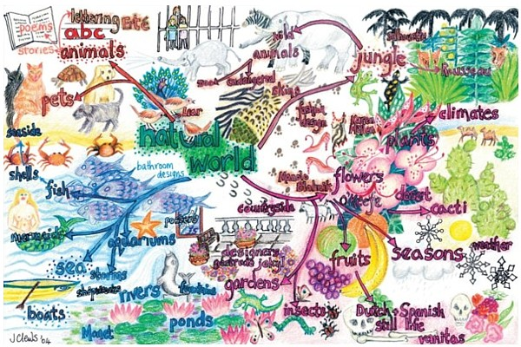
In Summary
Science is the study of the natural world.
Scientific knowledge will change with new understanding.

Slide 11
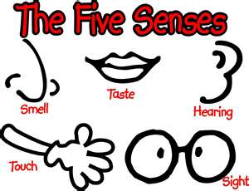
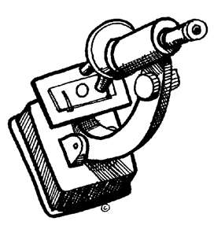
Science is based on evidence!
Evidence is obtained by making observations and measurements taken in situations ranging from natural settings to the laboratory.
  Observation: using one or more of your senses to gather information.

Slide 12
Let’s try out your observation skills!
We will be going outside and there are some general rules I’ll need everyone to follow.
  Rule #1: Be patient, be quiet and pay attention.
  Rule #2: Watch where you step and do not harm any of the plants or animals we see.
  Rule #3: You are still in class! This is an educational activity, not a break. If you treat this as a break you will receive a zero.

Slide 13
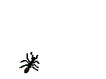
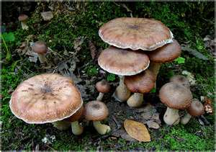
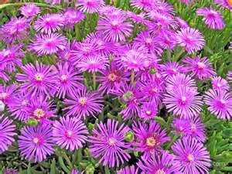
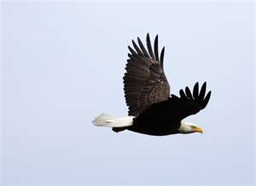
Your task.
Your job is to make detailed observations of at least 2 organisms.
  Organism: a living thing.
How can you tell if something is alive?
  On your board list one characteristic of a living thing. It must be something found ONLY in living things.

Slide 14
Characteristics of Living Things
Living things…
  Are made of cells
  Reproduce
  Have DNA
  Grow and develop
  Need energy and other materials
  Respond to their environment.
  Maintain a stable internal environment
  Change over many generations (evolve)
Revisit your board and make any changes you would make to your answers..

Slide 15
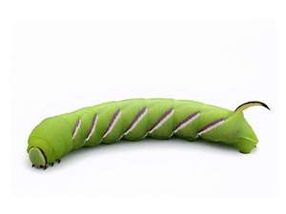
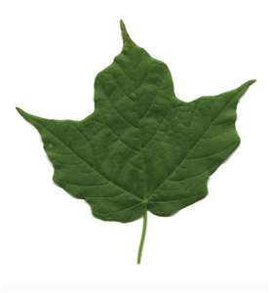
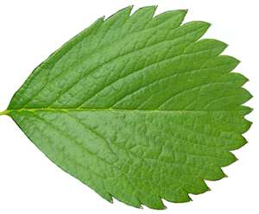
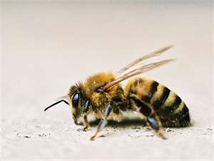
What is detailed?
What is the difference between an observation and a detailed observation?
Measurements or counts are great for explaining things in detail!

Slide 16
Open your journal to a NEW PAGE.
Set up your page
Field Observations
Date: Weather:
Name: Location:
Name of organism:
Observations:
Questions:
Sketch:

Slide 17
Outside for Observations

Slide 18
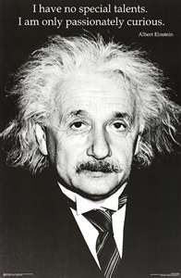
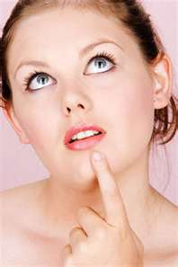

Remember that wondering is just as important in science as knowing!

Slide 19
What did you find?
Observations include:
Can these observations be organized into separate groups based on any similarities you may see?

Slide 20
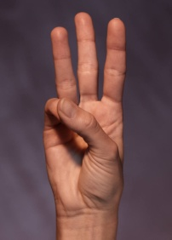
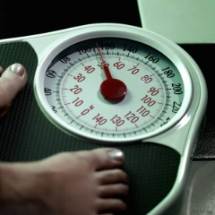
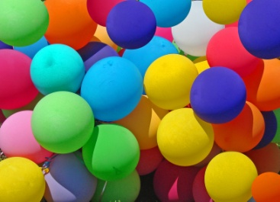
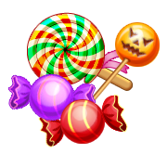

Types of Observations
When we make observations we are collecting data.
  Data: evidence we gather through observation.
    Quantitative data: deals with numbers or amounts
    Qualitative data: deals with descriptions

Slide 21
Classify these observations…
She has green eyes.
Your perfume smells sweet.
I drank one cup of coffee.
There were eight dogs at the bowl.
One of the dogs had black spots.
Insects have six legs.
The desk is smooth.
The lemonade was sour.
I saw a six inch butterfly.
The violin has four strings.
He played classical music.

Slide 22
Misunderstanding Alert!
Remember that scientific knowledge changes as we learn more about our natural world.
  Scientific knowledge is supported by a wealth of data.
MISUNDERSTANDING: Many students think of the scientific knowledge they learn as facts. This is not the case because a fact cannot be changed.

Slide 23
Review – NEW PAGE IN COMPLETE SENTENCES
What is biology?
What is science?
What is an observation?
Give an example of a qualitative observation.
Give an example of a quantitative observation.

Slide 25
Inferences
An inference is an educated guess based on observation and reasoning
      http://www.nationalgeographic.com/xpeditions/lessons/17/g68/smsciscreen.html
Scientists make many inferences about the world in which we live. These inferences are based upon evidence gathered through careful observations.
Imagine you′re producing a scientific film about an extinct animal that lived millions
of years ago. How would you know
what it looked like and how
it behaved?

Slide 26
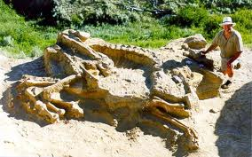
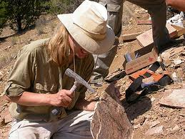
How we study the past.
Scientists study fossils to learn about an animal′s size and skeletal structure, when and where it lived, and sometimes what it ate or was eaten by.
They study behaviors of living animals for clues to their ancient relatives.
Scientists and filmmakers make
models and use computers to
help bring the past to life.

Slide 27
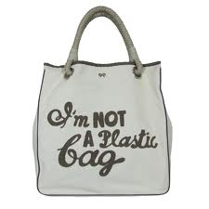
Bag Activity – Look at this bag.
What are some observations you have made about the contents of this bag? (This is your evidence.)
Who do you think this bag belongs to based on your observations? (This is your inference.)

Slide 28
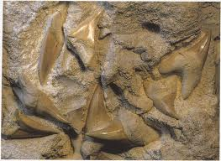
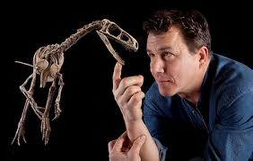
Paleontologists
What do paleontologists do?
Paleontologists search for, uncover, and study fossil remains, which is evidence of prehistoric animals.
As was done in the backpack activity, paleontologists draw inferences from the evidence they uncover.
  Example: A shark′s tooth embedded in a fossilized bone may lead a paleontologist to infer that a shark bit the animal.

Slide 29
Let’s see what they’ve come up with.
http://www.youtube.com/watch?v=hEfQKSpONX8&feature=youtu.be/
http://youtu.be/Kq5H_UhTNzw
Now I want you and a partner to go through the notes they reviewed while making this movie.
Circle the evidence.
Underline the inferences.

Slide 30
“Science begins by saying, let's forget about what we believe to be so, and try by investigation to find out what actually is so.”
- Unknown

Slide 31
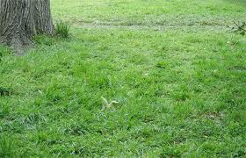
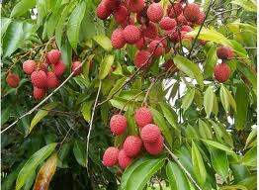
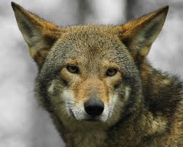
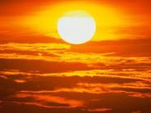
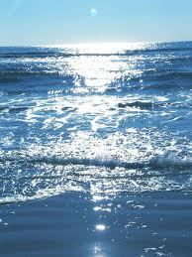
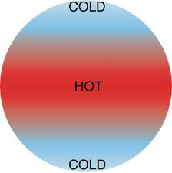
Vocabulary
Limiting factor: affects the survival of organisms in their environment.
Biotic factor: a living thing
Abiotic factor: a nonliving thing

Slide 32
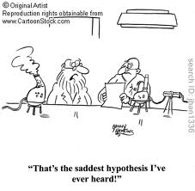
Hypothesis: What you think will happen in an experiment. Testable statement.
Variable: anything that can change in an experiment.

Slide 33
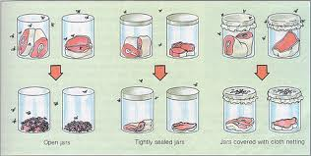
Types of variables
Manipulated (independent) variable: what you change on purpose in an experiment.
Responding (dependant) variable: Is the response to the change (result).

Slide 34
Wrapping up the day!
Work individually worksheet 1.1 due by beginning of next class

Slide 35
Scientific Inquiry

Slide 36
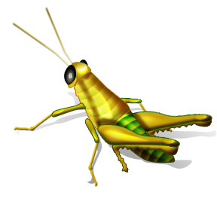
What is Scientific Inquiry?
You’re thinking and questioning are the start of the scientific inquiry process.
Scientific inquiry refers to the different ways scientists can use to study the natural world and propose explanations based on the evidence they gather.
  Some scientists run experiments in labs.
  Other scientists observe nature.

Slide 37
Inquire: a verb that means “to seek information by questioning”
Inquiry: is a noun that means “a way of seeking information by questioning.”

Slide 38
Observations – Step 1
Scientific inquiry often begins with a question about an observation.
Questions come from your experiences, observations and inferences.

Slide 39
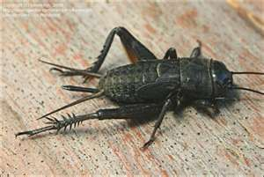
Make an observation about this cricket.
Now pose a question about this observation that you can study.

Slide 40
Developing a Hypothesis – step 2
How can you answer your question about the cricket?
  In trying to answer the question you are developing a hypothesis.
Hypothesis: a possible answer to a question.
  Not a fact!
  It must be testable!
  Formed from prior knowledge and logical inferences
Ex: Cricket chirping increases as a result of cooler air temperatures.

Slide 41
You try…
Why has my music player
stopped working?
Write two hypothesis that might answer this student’s question.

Slide 42
Step 3 The Experiment
Let’s test our hypothesis that “Cricket chirping increases as a result of warmer air temperatures.”
What would we need to do?

Slide 43
Controlling Variables
To test our hypothesis we will need to observe crickets at different air temperatures.
All other variables must be kept the same.
  Variables are factors that can change, or vary, in an experiment.

Slide 44
Manipulated variable
The one variable that is purposely changed to test a hypothesis is the manipulated variable (independent variable).
The manipulated variable in our experiment is the air temperature.

Slide 45
Responding Variable
The factor that may change in response to the manipulated variable is the responding variable (dependant variable).
The responding variable here is the number of chirps.

Slide 46
Controlled Experiment
An experiment in which only one variable is changed at a time is called a controlled experiment.
You decide to test the crickets at three different temperatures.
All other variable must remain the same or there would be no way to tell which variable influenced your results.

Slide 47
Collect Data
Before you begin an experiment it’s important to decide what observations you will make and the types of data you will collect.
Data tables help to organize your data.
Graphs help you to interpret your data by revealing patterns or trends.

Slide 48
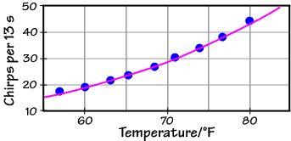
Name the variables…

Slide 49
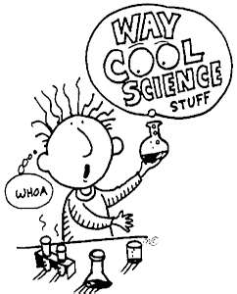
Step 4 Trials
Scientists usually repeat an experiment many times always using the same procedures and variables.
A trial is a repetition of an experiment.
Trials help scientists check the accuracy of their results.

Slide 50
Step 5 Conclusion
A conclusion is a summary about what you have learned from an experiment.
Your data may or may not support your hypothesis.
  Either way you may want to run more trials to see if you keep getting the same results.
When a hypothesis isn’t supported it usually leads to the formation of a new hypothesis.
  One experiment leads to another.

Slide 51
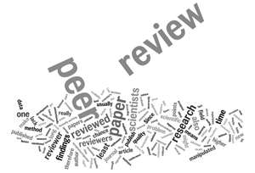
Step 6 Communicating
When scientists share the results of their research they describe their procedures so
  that others can repeat their experiments.
  Their procedures can be reviewed
  Their results can be reproduced

Slide 52
Now take a look at some scientific experiments…
You will work in teams of two to find out what each of the following scientists accomplished and how it impacted science
  Redi
  Needham
  Spallanzani
  Pasteur

Slide 53
Now take a look at some scientific experiments…
  Redi
    What did he do?
      He tested if flies produce maggots
      He had covered jars and uncovered jars with meat in them
      Left out for several days
      Concluded that maggots form only when flies come in contact with meat.

Slide 54
Now take a look at some scientific experiments…
  Redi
    What did he do?
      Hypothesis:
      Independent Variable:
      Dependent Variable:

Slide 55
Now take a look at some scientific experiments…
  Needhams
    What did he do?
    Claimed that spontaneous generation could occur under the right conditions
    HE did not sealed the bottle of gravy and heated it
    Claimed that little animals can only have come from juice from gravy

Slide 56
Now take a look at some scientific experiments…
  Needhams
    What did he do?
    Hypothesis:
    Independent Variable:
    Dependent Variable:

Slide 57
Now take a look at some scientific experiments…
  Spallanzani tests Redi’s Findings
    What did he do?
    He wanted to improve Needhams tests by sealing the containers
    He concluded that the micro-organisms came from the air.

Slide 58
Now take a look at some scientific experiments…
  Spallanzani tests Redi’s Findings
    What did he do?
    Hypothesis:
    Independent Variable:
    Dependent Variable:

Slide 59
Now take a look at some scientific experiments…
  Pasteur tests spontaneous generation
  He designed a flask to test spontaneous generation by keeping out micro organisms
  He concluded that the microorganisms were in the air.

Slide 60
Now take a look at some scientific experiments…
  Pasteur tests spontaneous generation
    Hypothesis:
    Independent Variable:
    Dependent Variable:

Slide 61
Vocabulary to define…
Find the meanings to the following terms and put them in your notes.
Spontaneous generation
Theory

